Slide 1
Communications Plan for Strategic Implementation

Slide 2
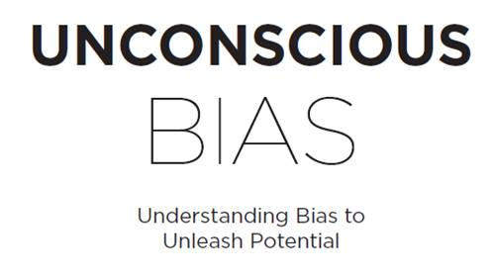
The purpose of this document is to outline the communications plan to and from mid-senior level organizational leaders during a large-scale “Unconscious Bias” implementation. The track below depicts a visual representation of the learning experience and associated communications.
Addressing Unconscious Bias to Unleash Potential
Live Online Learning Journey + Communications Plan
1 Week Post Session Email
Outline key implementation activities.
Inform learners of the five week follow-on communications which include insights and actions.
Instructions for @ your next team meeting
60 day Post Session Email
highlighting e-learning reinforcement modules and encouraging learners to utilize these video modules to engage in dialogue with their teams
Initiative Launch Communication tying the content to VHA’s values and strategic goals and encouraging learners to engage fully and meaningfully in this learning opportunity.
Pre-Work Email
Orientation Article
Implicit Association Test
Humans of NY review
Self-Assessment on Bias
Live Webinar
Identify Bias
Cultivate Connection
Choose Courage
90 day Post Session Email
driving additional tools and resources on bias, inclusion, and race
Week 1 Identify Bias
Week 2 Deepen Connections
Week 3 Challenge Yourself
Week 4 Cope with Bias
Week 5 Become an Ally or Advocate
One Week Reminder
ACTION
ACTION
ACTION
ACTION
ACTION
Leaders
@ your next Team Meeting
RESOURCE
RESOURCE
RESOURCE
RESOURCE
RESOURCE
Delivery Options:
Live Online: 4x75-minute sessions
Live In-Person: Full Day
Articles
Article
Article
Article
Articles
Refreshers
More Than You See
Your Brain and Bias
The Three Bias Traps
All of Us
Ways to Act with Courage
Courage in Action
7 Common Misconceptions About Unconscious Bias
9 Tips To Listen Well And Build Empathy With Co-workers
9 Ways To Embrace Diversity Of Thought - And Why You Should
9 Options For How To Respond When You Experience Bias at Work
6 Ways To Stand Up To Bias In Your Organization
10 Ways To Make Meetings More Inclusive - And Effective
20 – 45 minutes
All other Learners: In your next one-on-one
Revisit Key Concepts
Identify Bias
Cultivate Connection
Choose Courage
30 minutes
Article: 4 tips for talking with your team about racial injustice and inclusion
Video: 3 things you can do to foster inclusion on your team
8 Work Areas Where You're Prone To Unconscious Bias - And What You Can Do About It
Short script for Managers to host a Reconnect
Meeting as a team or in one-on-ones
PREPARE
DELIVER
REINFORCE

Slide 3
Initial Launch Email
Send the communication below to announce your Unconscious Bias initiative to the organization.
SUBJECT LINE: INVITATION – Organization-Wide Learning Initiative – Unconscious Bias and Inclusion
The last 18 months have taught us many things about resilience, seeing our way through difficult things and the true meaning of the word unprecedented. One thing that was made more clear, was the importance of diversity, equity and inclusion in our work across the Veterans Health Administration.
As leaders, from wherever you sit in the organization, I know you think critically about your decisions and what they mean for your colleagues and the results we’re trying to achieve. Do you also consider yourself an inclusive leader? As described in VA’s Diversity and Inclusion Strategic Plan, ”the mission of the Department’s Diversity and Inclusion (D&I) Program is to grow a diverse workforce and cultivate an inclusive work environment, where employees are fully engaged and empowered to deliver the outstanding services to our Nation’s Veterans, their families and beneficiaries.”
Adding this lens to our leadership is a critical component to making progress and ensuring that the VA has a culture of inclusion and the high performance that comes from each employee feeling a true sense of belonging. With that end in mind, we are embarking on an organization-wide learning initiative to ensure we each have the competence and confidence to contribute to this culture.
Every employee in the [include name of office, medical center, etc.] will participate in a highly interactive and practical 3 hour learning session that will equip you with the skills to:
Identify and adjust for bias at the individual and organizational level
Cultivate meaningful connection that allows for more equitable interactions and decision making
Choose courage to make real change on issues of diversity and equity and inclusion.
Feel confident and competent to discuss and act on difficult topics like race and opportunity
Offerings are open for registration in [include where learners can find available dates/registration]. Please do ensure you register for the appropriate course – Executive, People Leaders or Individual Contributors. TO REGISTER: [include your process for registration]
We also know that culture building and education require more than a single learning event. In the coming weeks, you will receive several pre and post learning session communications outlining opportunities to deepen your skill and ensure robust adoption of these important ideas.
Please reach out to [internal point of contact] should you have any questions and we’re excited to embark on this journey with you towards a culture of greater inclusion and higher performance!
Return to Implementation Roadmap

Slide 4
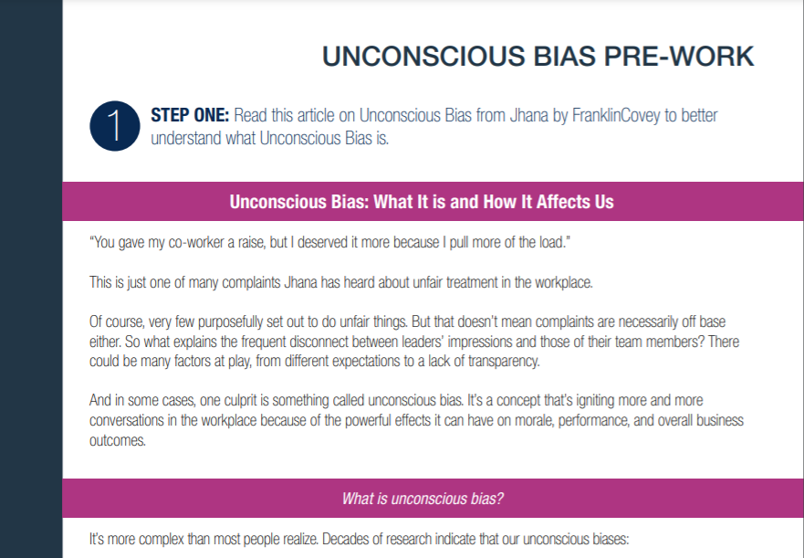
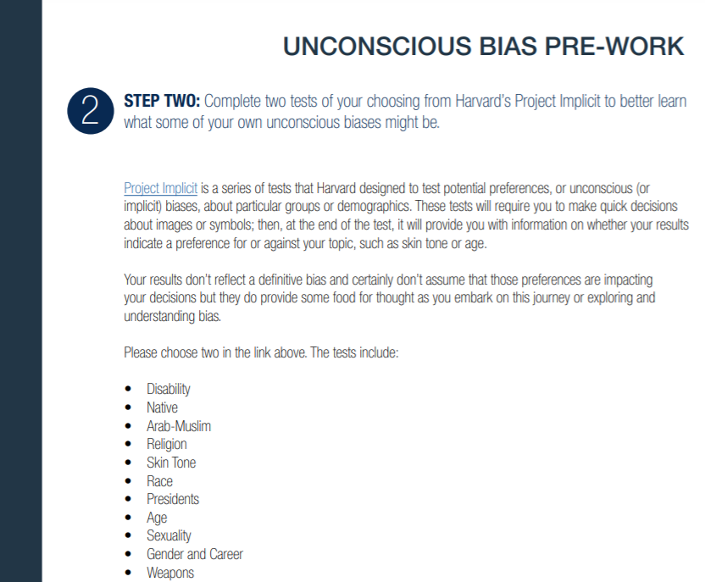
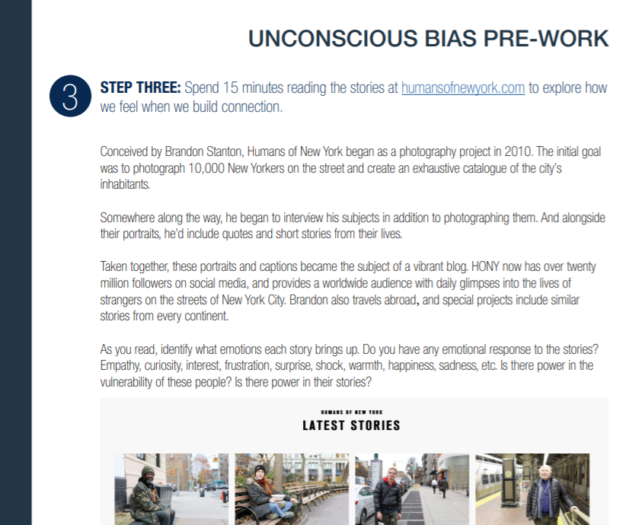
Pre-Work Email
Send the communication below to all participants at least three weeks prior to your first work session. Make sure to download and attach the document below, which will guide participants through their pre-work.
Download the “Unconscious Bias” pre-work document here.
Make sure to update the sections highlighted in yellow with your organization’s information. Feel free to add, change, or delete anything below to fit your unique needs.
“Diversity is one of the defining strengths of America and the diversity of our workforce is one of our greatest strengths in accomplishing the Department’s missions. Diversity fosters innovative solutions to some of our most challenging issues and enhances decision making by providing a broader range of perspectives and interpretations. We must continue to focus on creating a culture of inclusion that values each individual so you can reach your full potential and feel engaged.”
-VA Diversity and Inclusion Strategic Plan FY20-21
Thank you for registering for your upcoming Unconscious Bias learning session on [insert date]. This is the start of a 6-month journey of exploring unconscious bias and the impact it can have on you, your relationships, and your most important outcomes. We all have different experiences, beliefs, and opinions around this topic. The purpose of this learning journey is to create space; first, for you to learn together as leaders and then for you to share that learning with your teams.
Pre-session survey - [Contact vacare@franklincovey.com for support with pre/post surveys to evaluate the learning experience]
Attached to this email you will find a pre-work document that includes three guided activities. These activities are designed to help you expand your perspective in preparation of the upcoming Unconscious Bias work session. The time you invest in completing these activities now will enhance your work session experience and, ultimately your ability to create an inclusive, high-performance culture across the VA. The activities included are:
Read “Unconscious Bias: What It is and How it Affects Us”. As you read, think about where you’ve experienced bias in your leadership journey. Positively and/or negatively, how has bias impacted:
You, both personally and professionally?
Your team members, peers, internal stakeholders, and customers?
Philadelphia Fed’s strategic initiatives?
Complete three tests from Harvard’s Project Implicit. After completing those tests, consider the following:
What was your initial reaction to the test results?
How do your test results connect to your own personal/professional experiences with bias?
Spend 15 minutes reading the stories from “Humans of New York” . After reading, reflect on the following:
What was your emotional response to the stories that your read?
How did your initial assumptions about each person change as you learned more about their story?
At the end of each activity, you’ll find a reflection question as well as space to capture your response. We recommend that you schedule one hour of purposeful time between now and [insert date of work session or first module], to complete these activities. Please reach out to [internal point of contact] should you have any questions.
In addition to this pre-work email, you will receive a hard copy participant kit [if not using hard copies, include a link for downloading digital materials] in the mail for use during your live webinar session as well as a meeting invite with the relevant details to join the session. Please do ensure you have your hard copy participant kit in front of you for the learning session, plan to engage with camera and microphone on and join the Zoom room 15 minutes before the session to ensure there are no technical difficulties.
We look forward to embarking on this journey to inclusion and high-performance with you!
Return to Implementation Roadmap

Slide 5
1 Week Reminder
Send the communication below to all participants one week prior to your first work session. Make sure to download and attached the pre-work document and forward the original pre-work communication with this email.
Download the “Unconscious Bias” pre-work document here.
Make sure to update the sections highlighted in yellow with your organization’s information. Feel free to add, change, or delete anything below to fit your unique needs.
This is a friendly reminder that you are registered for “Unconscious Bias: Understanding Bias to Unleash Potential” on [insert date and time]. The purpose of this learning journey is to create space; first, for you to learn together as leaders and then for you to share that learning with your teams.
Before your session next week, please ensure that:
You have taken some time to complete the pre-work document. (Details outlined below and attached),
You have a meeting invite in your calendar complete with meeting room details.
You’ve [received your hard copy participant kit/downloaded your digital participant materials]. If you have yet to receive your hard copy participant materials, please contact [internal point of contact]
Please reach out to [internal point of contact] should you have any questions.
Please plan to engage with camera and microphone on and join the meeting room 15 minutes before the session to ensure there are no technical difficulties.
We look forward to embarking on this journey to inclusion and high-performance with you!
FORWARD OF PRE-WORK EMAIL INSERTED HERE
Return to Implementation Roadmap

Slide 6
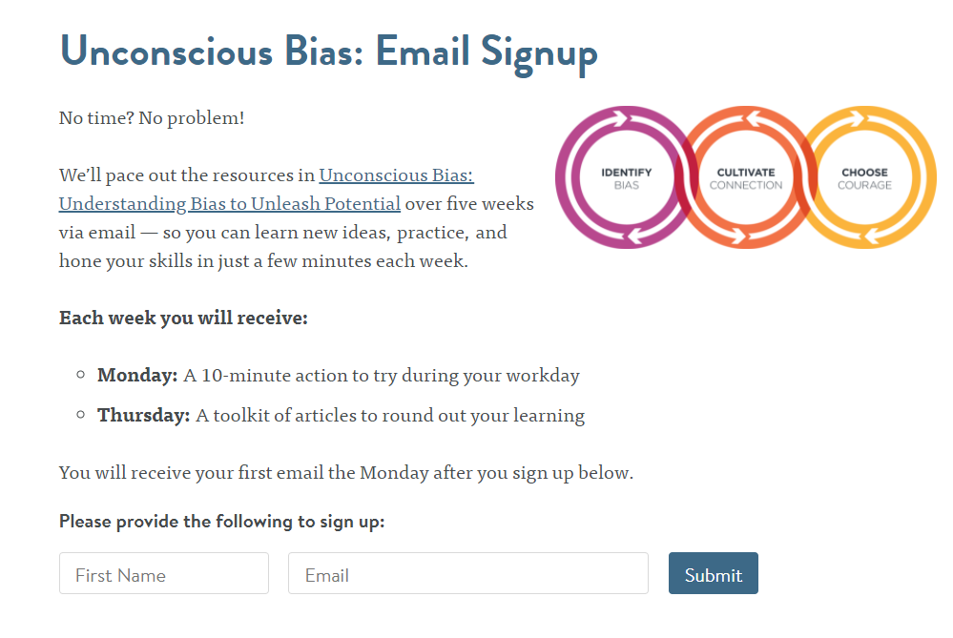
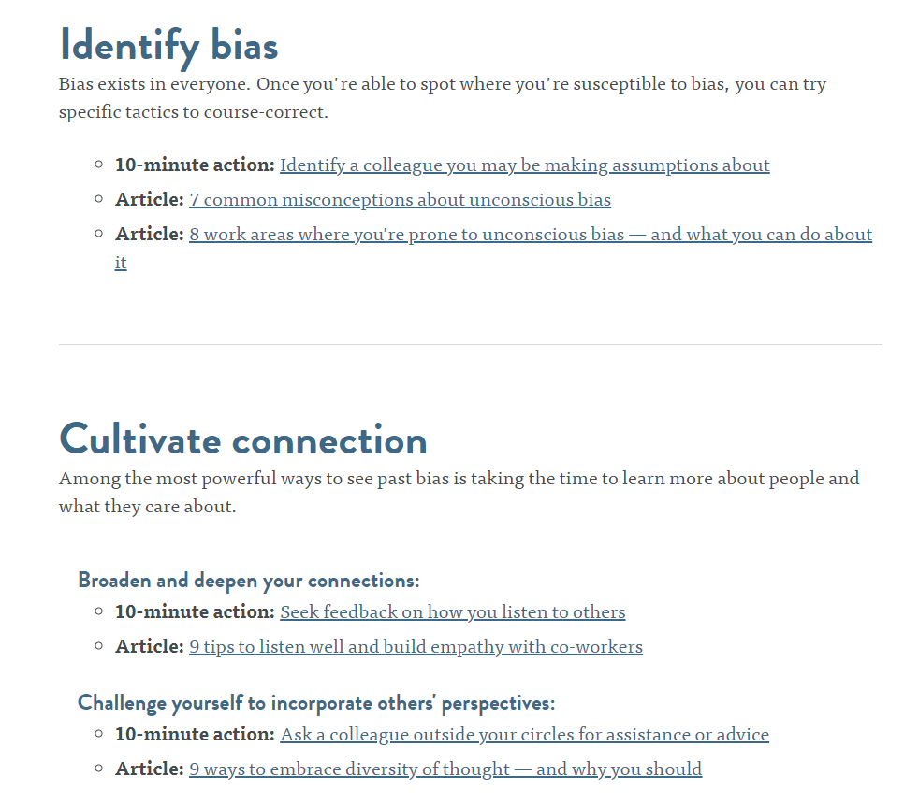
Post-Work Email
Send the communication below to all participants within a week of their learning session.
Thank you for your participation and engagement in the Unconscious Bias work session! As we discussed, the work session itself is only the first step on a bigger journey towards inclusion and higher performance.
What’s Next?
You’ll receive a welcome communication to FranklinCovey’s All Access Pass. This online portal includes two parts – the All Access Pass for accessing eLearning and Jhana for accessing microlearning. In both instances, type in your email and click on forgot password to gain entry for the first time. You’ll receive specific instructions as we go for what to access and when.
You’ve been signed up for the Unconscious Bias email track from Jhana (https://aap.jhana.com/unconscious-bias-email-signup/ ) a companion microlearning website from FranklinCovey. Jhana will send you a series of reinforcement articles over the next five weeks. These articles will encourage you to reflect, dive deeper, and take strategic action around bias and your role in the organization. For the next five weeks, you can expect to receive:
- Monday: A 10-minute action to try during your workday
- Thursday: A toolkit of articles to round out your learning
*You can also opt-in to a weekly leadership newsletter from Jhana based on your role as a leader or an individual contributor. Watch the tour in the Jhana log in portal to learn more about this.
3. As you think specifically about what we discussed in your learning session, you also have some action items:
Complete this short pulse survey - [Contact vacare@franklincovey.com for support with pre/post surveys to evaluate the learning experience]
Over the next week, pay attention to how you’re feeling in conversation with colleagues. Do you feel overwhelmed, high emotion or under duress? If so, what biases could be at play in those interactions?
Complete your network audit with a lens towards opportunity and commit to explore that further.
Pick a courage skill to discuss with your team, utilizing the Courage prompts on that page to consider adoption.
4. I encourage you to drop some time in your calendar to not only explore the resources above but also, to practice:
Practice reflecting on your day and where bias may have impacted your perspective, reaction or decision
Practice building connection in unexpected places and spending some time having connecting conversations that expand your view of the world
Practice being courageous in what you bring up and take on and advocate for
We look forward to continuing this journey to inclusion and high-performance with you!
Return to Implementation Roadmap

Slide 7
Leaders Option 1: Your Next Team Meeting
During the five week Jhana reinforcement track, Leaders can engage their teams in a debrief session. This session is an opportunity for your leaders and their teams to reconnect around their UB journey. During this 60-90 minute session, participants will:
Participate in a ‘teach-to-learn’ using the Practice Cards from their work session (download available here)
Engage in meaningful discussions
Commit to next steps and action items
The following email template can be used to schedule or remind participants of the upcoming Report Session. Remember to update all text highlighted in yellow to your organization specific information.
On [insert date of work session or first module], you will be participating in a Report Session with your peers and colleagues around our [Unconscious Bias or name of program] initiative! During this [insert length of session], you will:
Participate in a ‘teach-to-learn’ using the Practice Cards from your work session (download available here)
Engage in facilitated discussions, led by [FC consultant/internal facilitator/DEI practitioner/etc]
Commit to next steps and action items
Complete a Pulse Survey (optional – please contact vacare@franklincovey.com if you need support with surveys)
As a result of this session, you will have a deeper understanding of the role unconscious bias plays in your team as well as in [organization name’s] culture and strategic goals. You will also have a renewed focus on your commitments and be positioned to lead conversation around bias, inclusion, and performance within your teams.
You are the steward of [organization name]’s organizational culture. That culture is shaped one conversation, one action a time. Below you will find a series of discussion questions that can be used to engage your team around the top of Unconscious Bias and its impact on team performance and individual engagement:
What biases or preferences are you aware of in how our team works together? (this could be in hiring, making decisions, delegating, etc.)
What does it look like when a team member is in the damaging zone? The limiting zone? The high-performance zone? (use Practice Card 1 and workbook pages 8-9)
Is there any part of yourself that you have felt, at some point in your career, couldn’t be an aspect of who you were at work? How did that make you feel?
Which of the three bias traps are the most common in our workplace? How can we avoid them? (use Practice Cards 2, 3, and 4 from your Participant Materials)
What makes it hard to be courageous? What makes courage important in moving our team into the High-Performance Zone?
Would you like a refresher prior to the report session? Click on any of the three, 30-minute “Unconscious Bias” Excelerators below and log in to your All Access Pass Portal to review key concepts:
Unconscious Bias Part 1: Identify Bias - https://phil-frb.allaccesspass.com/mod/scorm/player.php?cm=11496&scoid=17645&display=popup
Unconscious Bias Part 2: Cultivate Connection - https://phil-frb.allaccesspass.com/mod/scorm/player.php?cm=11497&scoid=17598&display=popup
Unconscious Bias Part 3: Choose Courage - https://phil-frb.allaccesspass.com/mod/scorm/player.php?cm=11498&scoid=17600&display=popup
We’ll see you on [insert date of report session]!
Return to Implementation Roadmap
The next six pages provide a snapshot of what this Report Session would look like. As you approach this phase in the implementation roadmap, contact a member of your FranklinCovey for the companion slide deck.
*(optional activity for organizations who choose to utilize this part of the process)

Slide 8
Leaders Option 2: 10 Minutes during Your Next Six Team Meetings
During the five week Jhana reinforcement track, Leaders can engage their teams in a debrief session. This session is an opportunity for your leaders and their teams to reconnect around their UB journey. During this 60-90 minute session, participants will:
Participate in a ‘teach-to-learn’ using the Practice Cards from their work session (download available here)
Engage in meaningful discussions
Commit to next steps and action items
The following email template can be used to schedule or remind participants of the upcoming Report Session. Remember to update all text highlighted in yellow to your organization specific information.
On [insert date of work session or first module], you will be participating in a Report Session with your peers and colleagues around our [Unconscious Bias or name of program] initiative! During this [insert length of session], you will:
Participate in a ‘teach-to-learn’ using the Practice Cards from their work session (download available here)
Engage in facilitated discussions, led by [FC consultant/internal facilitator/DEI practitioner/etc.]
Commit to next steps and action items
Complete a Pulse Survey (optional – please contact vacare@franklincovey.com if you need support with surveys)
Practice leading an Unconscious Bias Huddle Discussion
As a result of this session, you will have a deeper understanding of the role unconscious bias plays in your team as well as in [organization name’s] culture and strategic goals. You will also have a renewed focus on your commitments and be positioned to lead conversation around bias, inclusion, and performance within your teams.
You are the steward of [organization name]’s organizational culture. That culture is shaped one conversation, one action a time. Thank you for your engagement in these conversations and your commitment to lead with inclusion.
Would you like a refresher prior to the report session? Click on any of the three, 30-minute “Unconscious Bias” Excelerators below and log in to your All Access Pass Portal to review key concepts:
Unconscious Bias Part 1: Identify Bias - https://link.allaccesspass.com/mod/scorm/player.php?cm=11496&scoid=17645&display=popup
Unconscious Bias Part 2: Cultivate Connection - https://link.allaccesspass.com/mod/scorm/player.php?cm=11497&scoid=17598&display=popup
Unconscious Bias Part 3: Choose Courage - https://link.allaccesspass.com/mod/scorm/player.php?cm=11498&scoid=17600&display=popup
We’ll see you on [insert date of report session]!
Return to Implementation Roadmap
The next six pages provide a snapshot of what this Report Session would look like. As you approach this phase in the implementation roadmap, contact a member of your FranklinCovey for the companion slide deck.
*(optional activity for organizations who choose to utilize this part of the process)

Slide 9
Leader-Led Session: Agenda
Review: Teach-to-Learn
Introduce Talent Lifecycle
Activity: Talent Lifecycle
Activity: Facilitated Discussion
Review: Past Commitments
Update: Future Commitments
Return to Implementation Roadmap
Report Session:
Agenda

Slide 10
Review: Teach-to-Learn (15-minutes)
Assign group members as 1, 2 or 3 (use first letter of last name to make it simple!)
Partner #1 – Using Practice Card 1, explain the ‘Impact of Behaviors’ model and share a key insight.
Partner #2 – Using Practice Cards 2 – 4, explain the ‘Three Bias Traps’ and share a key insight.
Partner #3 – Using Practice Cards 5 & 6, explain how ‘Empathy & Curiosity’ help us cultivate connections and share a key insight.
Report Session:
1 of 6

Slide 11
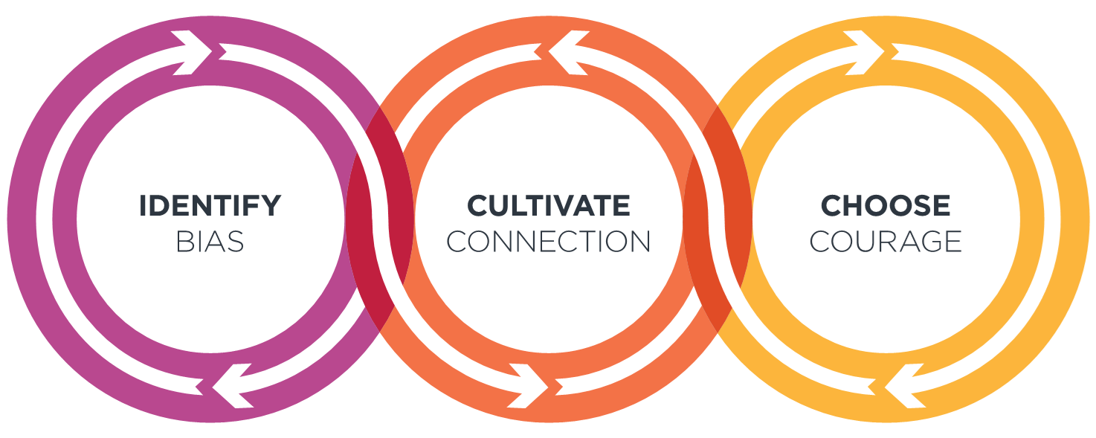
Introduce Talent Lifecycle (5-minutes)
Getting Hired
Outreach: campus
engagement, sites such as
LinkedIn and Glassdoor,
recruiting portals, etc.
Recruitment and Selection:
job descriptions and
behavioral and competency
based interview questions
Contributing & Engaging
Onboarding: new hire
orientation and new board
member orientation, code of
business conduct, company
swag, and employee and
manager onboarding sites
Development/Training:
leadership programs, core
behaviors training, etc.
Moving Up
Performance Management and
Recognition: performance goals
and assessment, high potential
and high performer programs,
rotational assignments, special
projects, leadership programs,
mentoring, networking, career
pathing, succession planning,
recognition and awards, etc.
Off Boarding: exit interviews
and evaluations
This simple three-part model highlights the decisions that occur across a person’s career – the talent lifecycle. As we think about the content we experienced, the question is, where can we identify bias, cultivate more connection and choose courage across these decision points. While we aren’t necessarily in HR, we have input into these decisions across our teams.
For example, onboarding is a policy. But the experience of onboarding is different depending on which team you join or can be different from person to person on the same team based on the level of connection that exists on that team. When we onboard people, where is there opportunity to create more connection? As each of you considers moving up, what can I do as a leader to create more informal opportunity for growth considering there aren’t necessarily always promotions to extend.
Report Session:
2 of 6

Slide 12
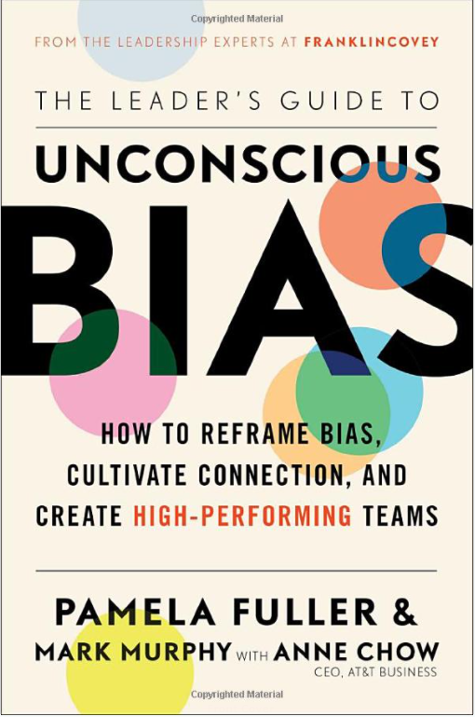
Activity: Talent Lifecycle (15-minutes)
For leaders:
Getting In – Consider your culture and practices when it comes to recruitment, hiring, and benefit distribution for your team.
Contributing & Engaging – Consider your culture and practices when it comes to the ways your team contributes and engages with their day-to-day workflow.
Moving Up – Consider your culture and practices when it comes to how your team members advance and are promoted in your organization.
For your assigned area of the Talent Lifecycle, do the following:
List the possible biases that might be at play.
Where might you apply careful or bold courage to make a change?
For individuals:
Getting In – Reflect on your experiences around recruitment, hiring, or benefits. Have your personally experienced (or seen other examples) where such decisions were likely made through the lens of bias? If so, what was the impact on your and others involved?
Contributing & Engaging – Have you personally experienced (or seen other examples) where an individual’s ability to contribute was made through the lens of bias? If so, what was the impact to you and others involved?
Moving Up – Reflect on your experiences around performance management and promotions. Have you personally experienced (or seen) a situation in which an individual’s advancement was made through the lens of bias? If so, what was the impact on you and others involved?
For a deeper dive into the Talent Lifecycle, refer to Part 4: Apply Across the Talent Lifecycle, of “The Leader’s Guide to Unconscious Bias”. Contact vacare@franklincovey.com to order.
Report Session:
3 of 6

Slide 13
Activity: Facilitated Discussion (20-minutes)
What does leadership application really look like? (Meeting structure, hierarchy and who gets to share ideas, informal networking, distribution of opportunities/delegation, etc.)
How do we ensure more connecting conversations while balancing time and sincerity?
What are the ‘unnamables’ and ‘undiscussables’ in our organization? How do we really get to the point where we can discuss and address these topics?
Report Session:
4 of 6

Slide 14
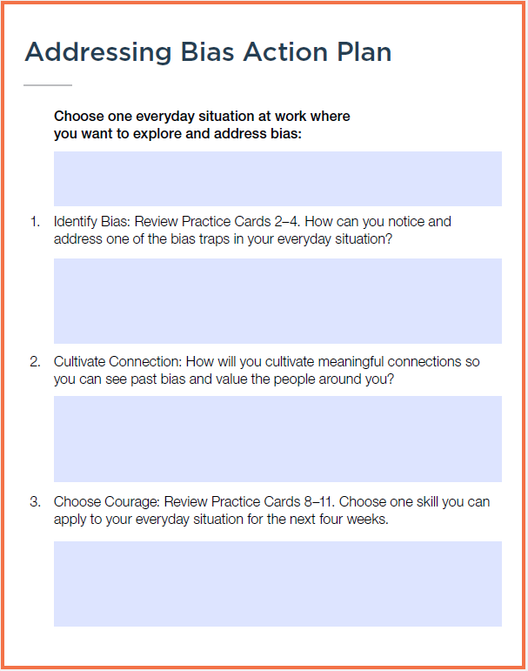
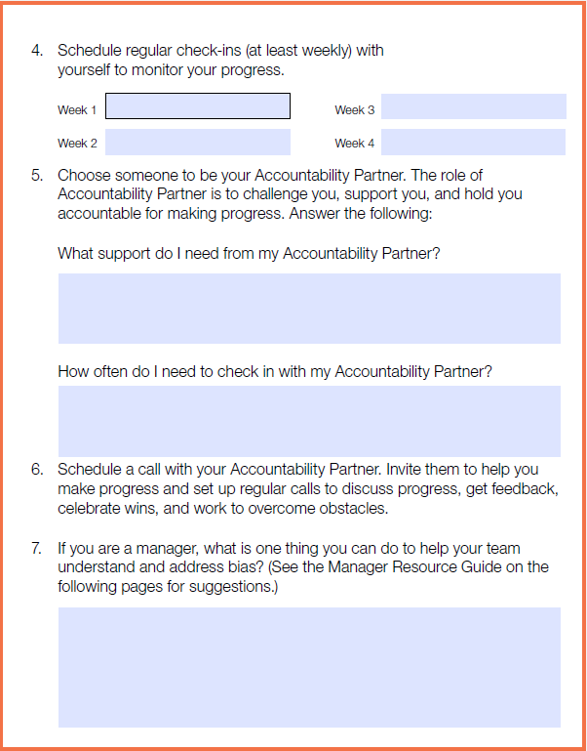
Review Commitments (10 minutes)
FIRST:
Reflect on you “Addressing Bias Action Plan” from p. 56 in your Participant Guide. With you partner, discuss the following:
What has been the most challenging part of your commitment?
What have commitments have you kept? What was your experience?
What commitments have you missed? What got in the way?
How do we really get to the point where we can name the unnamable and discuss the undiscussables?
Report Session:
5 of 6

Slide 15
Update Commitments (10 minutes)
For leaders:
What small change could your team institute to make progress on unconscious bias?
What big goal could your team set to make progress on unconscious bias?
How will you celebrate when you’ve achieved it?
For individuals:
If you had the authority, what would you change in your organization to make progress on unconscious bias?
What small practice can you institute from where you sit to make progress on bias?
How will you celebrate when you’ve made it a habit?
Report Session:
6 of 6

Slide 16
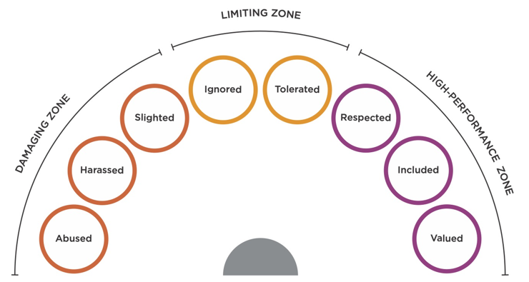
Individual Contributors: Your Next One-On-One
Following the five week Jhana reinforcement track, your participants will engage in a facilitated Report Session. This report session is an opportunity for your participants (leaders and/or individual contributors) to reconnect around their UB journey. During this 60-90 minute session, participants will:
Participate in a ‘teach-to-learn’ using the Practice Cards from their work session (download available here)
Engage in facilitated discussions, led by [FC consultant/internal facilitator/DEI practitioner/etc]
Commit to next steps and action items
Complete a Pulse Survey (optional – please contact vacare@franklincovey.com if you need support with surveys)
*Practice leading an Unconscious Bias Huddle Discussion
The following email template can be used to schedule or remind participants of the upcoming Report Session. Remember to update all text highlighted in yellow to your organization specific information.
On [insert date of work session or first module], you will be participating in a Report Session with your peers and colleagues around our [Unconscious Bias or name of program] initiative! During this [insert length of session], you will:
Participate in a ‘teach-to-learn’ using the Practice Cards from their work session (download available here)
Engage in facilitated discussions, led by [FC consultant/internal facilitator/DEI practitioner/etc]
Commit to next steps and action items
Complete a Pulse Survey
As a result of this session, you will have a deeper understanding of the role unconscious bias plays in your team, your career development, and your key relationships at [insert name of office, medical center, section, etc.]. You will also have a renewed focus on your commitments around your role in contributing to a culture of High-Performance and inclusion. Everyone in the organization owns the work around inclusion. Use the following discussion questions to prepare for your next one-on-one conversation with your leader:
To help you prepare for an effective conversation with your manager, explore this collection of resources from the Jhana microlearning website – Managing Your Boss.
Would you like a refresher prior to the report session? Click on any of the three, 30-minute “Unconscious Bias” Excelerators below and log in to your All Access Pass Portal to review key concepts:
Unconscious Bias Part 1: Identify Bias - https://link.allaccesspass.com/mod/scorm/player.php?cm=11496&scoid=17645&display=popup
Unconscious Bias Part 2: Cultivate Connection - https://link.allaccesspass.com/mod/scorm/player.php?cm=11497&scoid=17598&display=popup
Unconscious Bias Part 3: Choose Courage - https://link.allaccesspass.com/mod/scorm/player.php?cm=11498&scoid=17600&display=popup
We’ll see you on [insert date of report session]!
Consider the Impact of Behaviors Model. Where do you see yourself on this model in your current team?
What actions have you committed to that will help you shift yourself closer to high-performance?
What are the specific behaviors from your manager that support high-performance? Which behaviors diminish high-performance?
How can your manager support your action plan?
Return to Implementation Roadmap
For a deeper dive, explore this resource from the Jhana micro-learning site – Managing Your Boss.
*(optional activity for organizations who choose to utilize this part of the process)

Slide 17
60 Day Post-Work Email
Following the Report Session, send the following communication to all participants. The purpose of this email is two-fold:
Highlight additional Jhana resources for participants who would like to dive deeper (these resources are especially important for leaders who intend to engage the Huddle Guide process outlined on page ….)
Share results and insights from the Pulse assessment completed during the Report Session if your organization is using that process.
Thank you for your participation in last week’s Report Session! First, I’d like to highlight some themes and insights from the Pulse assessment that each of you completed:
1. [include themes from work sessions or optional Pulse survey data]
2. [include themes from work sessions or optional Pulse survey data]
3. [include themes from work sessions or optional Pulse survey data]
Based on this, [summative statement about effectiveness of the implementation so far and next steps]
An important part of progress is reframing our perspective. Your continued exploration of bias, inclusion, and the impact they each have on people and performance, will help you broaden your lens and unleash your team’s fullest potential. Below you’ll find some additional Jhana resources to dive deeper:
3 things you can do to foster inclusion on your team (video) - https://aap.jhana.com/video/3-things-you-can-do-to-foster-inclusion-on-your-team/
4 tips for talking with your team about racial injustice and inclusion (article) - https://aap.jhana.com/blog/4-tips-for-talking-with-your-team-about-racial-injustice-and-inclusion/
Who you should you sponsoring (not just mentoring)? (video) - https://aap.jhana.com/video/who-should-you-be-sponsoring-not-just-mentoring/
An effective way to refresh your relationship with a disengaged direct report (article) - https://aap.jhana.com/video/an-effective-way-to-refresh-your-relationship-with-a-disengaged-direct-report/
Explore the ‘Addressing Unconscious Bias’ section of Jhana for more resources - https://aap.jhana.com/overcoming-unconscious-bias/
Addressing bias and leading with inclusion are both actionable, learnable skills. They require learning, commitment, and consistent action. Much like learning a new language, the sharpness of these skills fade if we don’t bring them into our daily interactions. As a reminder, I encourage you to drop some time in your calendar to not only explore the resources above but also, to practice:
Pay attention to your experience at work. What are you doing differently? What have you seen from your leaders? We will be asking you to share this feedback in next month’s pulse survey!
Practice reflecting on your day and where bias may have impacted your perspective, reaction or decision
Practice building connection in unexpected places and spending some time having connecting conversations that expand your view of the world
Practice being courageous in what you bring up and take on and advocate for
As always, you can always refresh key concepts by viewing the three, 30-minute Excelerators. Each time you re-engage with these learning modules, you are doing so with a new frame. That new frame allows you take away fresh insight and new actions that will accelerate your personal commitment to making progress on bias:
Unconscious Bias Part 1: Identify Bias - https://link.allaccesspass.com/mod/scorm/player.php?cm=11496&scoid=17645&display=popup
Unconscious Bias Part 2: Cultivate Connection - https://link.allaccesspass.com/mod/scorm/player.php?cm=11497&scoid=17598&display=popup
Unconscious Bias Part 3: Choose Courage - https://link.allaccesspass.com/mod/scorm/player.php?cm=11498&scoid=17600&display=popup
You will receive a formal invitation to this activation session in the next two weeks. In that email, you will find instructions for completing a second pulse assessment, designed to help us understand where you’ve seen change and what we can do to support you on this journey. As always, reach out to [internal point of contact] should you have any questions.
We look forward to continuing this journey to inclusion and high-performance with you!
Return to Implementation Roadmap

Slide 18
90 Day Post-Work Email
Send the communication below to all participants 90 days after their learning session.
Over the past 90 days, you have explored the impact of bias for yourself, your teams, and the overall performance of the Philadelphia Fed. We are grateful for your commitment to create a culture of inclusion and belonging for every employee that contributes to our organization!
Understanding and addressing bias is an ongoing journey; you learn more, you see more, you take action, and the cycle repeats. This 90-day mark is a milestone on that journey, and we are asking you to pause for a moment and share your experience with us. Take 5 minutes and complete this pulse survey [contact vacare@franklincovey.com for support setting up the optional Pulse survey] to help us understand your journey so far and how we need to chart the course going forward.
At this point, there are several actions you can take to reinforce what you’ve learned and refine your commitments to action:
Revisit the Jhana reinforcement track for yourself and share it with your peer and employees - (https://aap.jhana.com/unconscious-bias-email-signup/ ) a companion microlearning website from FranklinCovey. Jhana will send you a series of reinforcement articles over the next five weeks. These articles will encourage you to reflect, dive deeper, and take strategic action around bias and your role in the organization. For the next five weeks, you can expect to receive:
Monday: A 10-minute action to try during your workday
Thursday: A toolkit of articles to round out your learning
Refresh yourself on key concepts with the Unconscious Bias Excelerators in the All Access Pass Portal – as you experience your work and life through the lens of inclusion, you will find new insights each time you revisit these learning modules:
Unconscious Bias Part 1: Identify Bias - https://link.allaccesspass.com/mod/scorm/player.php?cm=11496&scoid=17645&display=popup
Unconscious Bias Part 2: Cultivate Connection - https://link.allaccesspass.com/mod/scorm/player.php?cm=11497&scoid=17598&display=popup
Unconscious Bias Part 3: Choose Courage - https://link.allaccesspass.com/mod/scorm/player.php?cm=11498&scoid=17600&display=popup
3. Keep the conversation alive during team meetings:
Leverage the Unconscious Bias Huddle guide.
Share the slides and activities provided to you following the work session. (it is recommended to attach those slides to this email for ease of access)
Explore the activities in the Manager Resource Guide found on page 58 in participant workbook.
(Insert custom thank you message from program sponsor or senior leadership as well as a preview of next steps if they are available)
Navigate to the “Unconscious Bias” Jhana email track sign-up.
Return to Implementation Roadmap

Slide 19
Emails for leaders to create excitement
Following the Report Session, leaders will begin encouraging their team members to sign up for an Unconscious Bias learning experience. We’ve found that employees pay attention to what their leaders talk about most often. These emails demonstrate the leader’s commitment to an inclusive culture while reinforcing the importance of this training for their team.
SUBJECT LINE: REGISTER for your Unconscious Bias learning experience with FranklinCovey [or title of your program/facilitator/organization]
At [organization name], we are committed to a culture where every employee can thrive and contribute their best. In a recent work session, “Unconscious Bias: Understanding Bias to Unleash Potential”, I learned that we often diminish the potential of ourselves and others. While this is often unintentional, the impact on belonging and performance can be significant.
We each play a role in advancing our culture of inclusion and belonging. Learning to make progress on unconscious bias is a step that we can all take together towards that goal. In/on [enter date or timing of training for individual contributors/direct reports], you will have the opportunity to take “Unconscious Bias: Understanding Bias to Unleash Potential” and learn what actions we can all take to mitigate the limiting effects of bias.
[Include specific instructions for registration and logistics here]
It is critical that we all are available to not only participate, but to be present in this important learning experience. Let me know what I can do to support you in making space for this training.
You’ll find a two-page course overview attached for additional context. You can also reach out to me or [internal champing or L&D contact] for questions. Thank you for taking this journey with us!
Return to Implementation Roadmap

Slide 20
Emails for leaders to create excitement - Reminder
Following the introduction email, leaders can send this follow up to encourage employees to register. In this email, leaders will share key insights and takeaways from their own experience. They are also asked to include a commitment to action that further signals the importance of this learning experience.
SUBJECT LINE: REMINDER – upcoming Unconscious Bias learning experience with FranklinCovey [or title of your program/facilitator/organization]
Recently, I sent you an invitation to sign up for the “Unconscious Bias: Understanding Bias to Unleash Potential” learning experience. The work around bias help us more fully respect, value, and include one another. It’s also a critical part of achieving our most important goals. Innovation, collaboration, problem solving, engagement, and fulfillment are all improved when we understand and address the impact of bias.
My two biggest takeaways from my own work session were:
1. Takeaway #1
2. Takeaway #2
As a result of these insights, I’ve committed to [insert leader’s personal commitment].
The reality is that I can’t do this alone. Achieving our fullest potential requires the unique contributions of every member of this team. If you haven’t already, contact [insert name of internal champion, coordinator, etc.] to register.
[Include specific instructions for registration and logistics here]
Again, it is critical that we all are available to not only participate, but to be present in this important learning experience. Let me know what I can do to support you in making space for this training.
You’ll find a two-page course overview attached for additional context. You can also reach out to me or [internal champing or L&D contact] for questions. Thank you for taking this journey with us!
Return to Implementation Roadmap

Slide 21
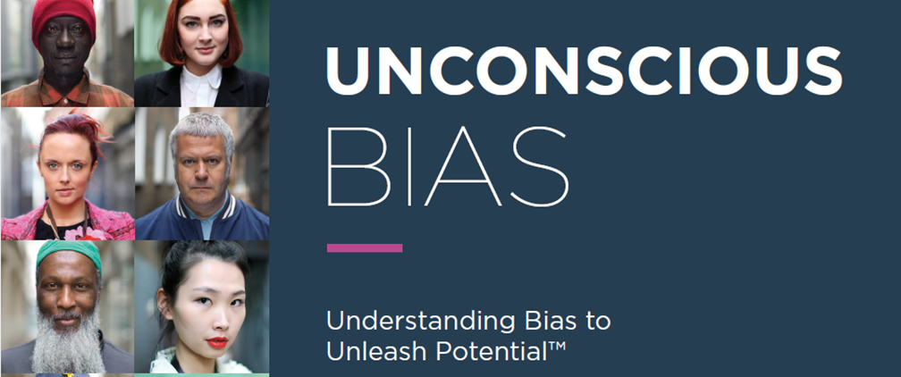
Header for any internal emails or comms needed
Return to Implementation Roadmap

