Slide 1
Notes:
This Facilitator Guide is a resource that VHA educators and leaders can use to facilitate a 30–45-minute Scenario Practice Session around a series of various Diversity, Equity, Inclusion, and Accessibility topics.
The first section is dedicated to facilitator preparation.
The second section contains the slides and speaker notes for the Scenario Practice Session.
The last section contains scenarios around a series of different DEIA topics. Select the scenario of your choice to use in your Scenario Practice Session.

Slide 2

Table of Contents
PREPARE TO TEACH | PRACTICE SESSION SLIDES
Purpose of the Session Sharpen Your Knowledge Prepare for the Session Facilitation Tips Sample Email to Send to Participants Session Agenda Resources | Scenario Practice Session Slides DEIA Scenario Practice Activity Practice Scenarios: Race Practice Scenarios: Religion Practice Scenarios: Gender Practice Scenarios: Sexual Orientation and Gender Identity Practice Scenarios: Disability Practice Scenarios: Age Practice Scenarios: National Origin Practice Scenarios: Other
Notes:
This is the complete Table of Contents for this deck. Press Ctrl+Click on a link to go directly to that topic slide.

Slide 3
Purpose of the Session
The goal of this 45-minute DEIA Scenario Practice session is to help employees improve their confidence in identifying and responding to situations where bias is at play. Participants will also explore and apply appropriate strategies for responding to those situations with courage.
The contents of this deck are organized as follows:
Slides 4-12 are for facilitator preparation for the session.
Slides 13-26 are to be used for the scenario practice session.
Practice scenarios available to use in the session begin on slide 27.
Notes:
This is the purpose and goal of the DEIA Scenario Practice Session. This deck is divided into three sections:
Facilitator Preparation – for your eyes only. Do not use these slides in the session.
Scenario Practice Session Slide Deck – to be used as visuals to facilitate the session.
Various scenarios– Choose one scenario to use for the Practice Activity.

Slide 4
Sharpen Your Knowledge
You do not need to be formally certified in FranklinCovey's Unconscious Bias course to facilitate this session. However, we do recommend that you familiarize yourself with that content prior to leading your first session by:
Completing the three, 30-minute eLearning modules found on page 11.
Reading or watching any combination of two articles and/or videos of your choice on slide 12.
Following the preparation instructions on slide 5.
To sharpen your virtual facilitation skills, review this short video on MS Teams best practices.
Notes:
If you would like to pursue certification in FranklinCovey's full Unconscious Bias work session, you will find steps to do that on the VHA All Access Pass Information Page here:
https://www.franklincovey.com/wp-content/uploads/2021/11/FranklinCovey_Road-to-Certification_8-Steps.pdf

Slide 5
Prepare for the Session
Study the DEIA Scenario Practice Session slides, speaker notes, and activity. While preparing, take notes on key points that resonate with you.
If facilitating the session in-person, choose a location. Ensure you choose a location that is spacious, quiet, and free of distractions.
Schedule a meeting request and send pre-work. Include the session time, location, and any details. Ask participants to complete the pre-work assignment prior to the session.
Select one scenario to use in the session. Review the scenarios in the back of this deck. Select one that resonates with you and the participants. Replace slide 23 with the scenario slide you want to use for this session.
Notes:
For a successful session, it’s important to plan. Complete these steps to prepare for your session.
Facilitator Note: Before your session, be sure to replace slide 23 with the Scenario slide you want to use for this session.

Slide 6
Facilitation Tips
Lead, don’t lecture. Participants should be sharing and discussing more than you talk and teach. Encourage participation from everyone to ensure it is a robust discussion.
Ask questions. Allow participants to discover their own answers and make their own connections. When someone asks a question, respond, “Does anyone have thoughts on that?” Or “Who would like to build on what [name] said?” Expand upon or clarify only as needed.
Provide a psychologically safe space. As a facilitator, your role is to create a safe, comfortable, impartial, and inspirational experience. This topic can lead to sensitive discussions. Encourage participants to fully engage and share openly and honestly.
Notes:
These are some tips you can use to ensure your Scenario Practice Session is engaging and memorable.

Slide 7
Tips for Facilitating Virtually
Make sure your technology works. Be sure to log in early, test your virtual platform, and close any other applications on your computer to maximize connection speed.
Use the chat feature effectively. Keep the session engaging by asking thought-provoking questions and encouraging participation involvement.
Give clear instructions for small-group work in breakouts. Enter any questions and activity instructions into the chat feature.
Discourage multi-tasking. At the start of the session, ask participants for their complete attention and engagement and to please refrain from multi-tasking.
Manage your time. Start and end the session on time and manage the timing of the practice activity.
Notes:
This practice session can be facilitated in a virtual environment. These are some tips you can use to ensure your virtual Scenario Practice Session is successful.

Slide 8
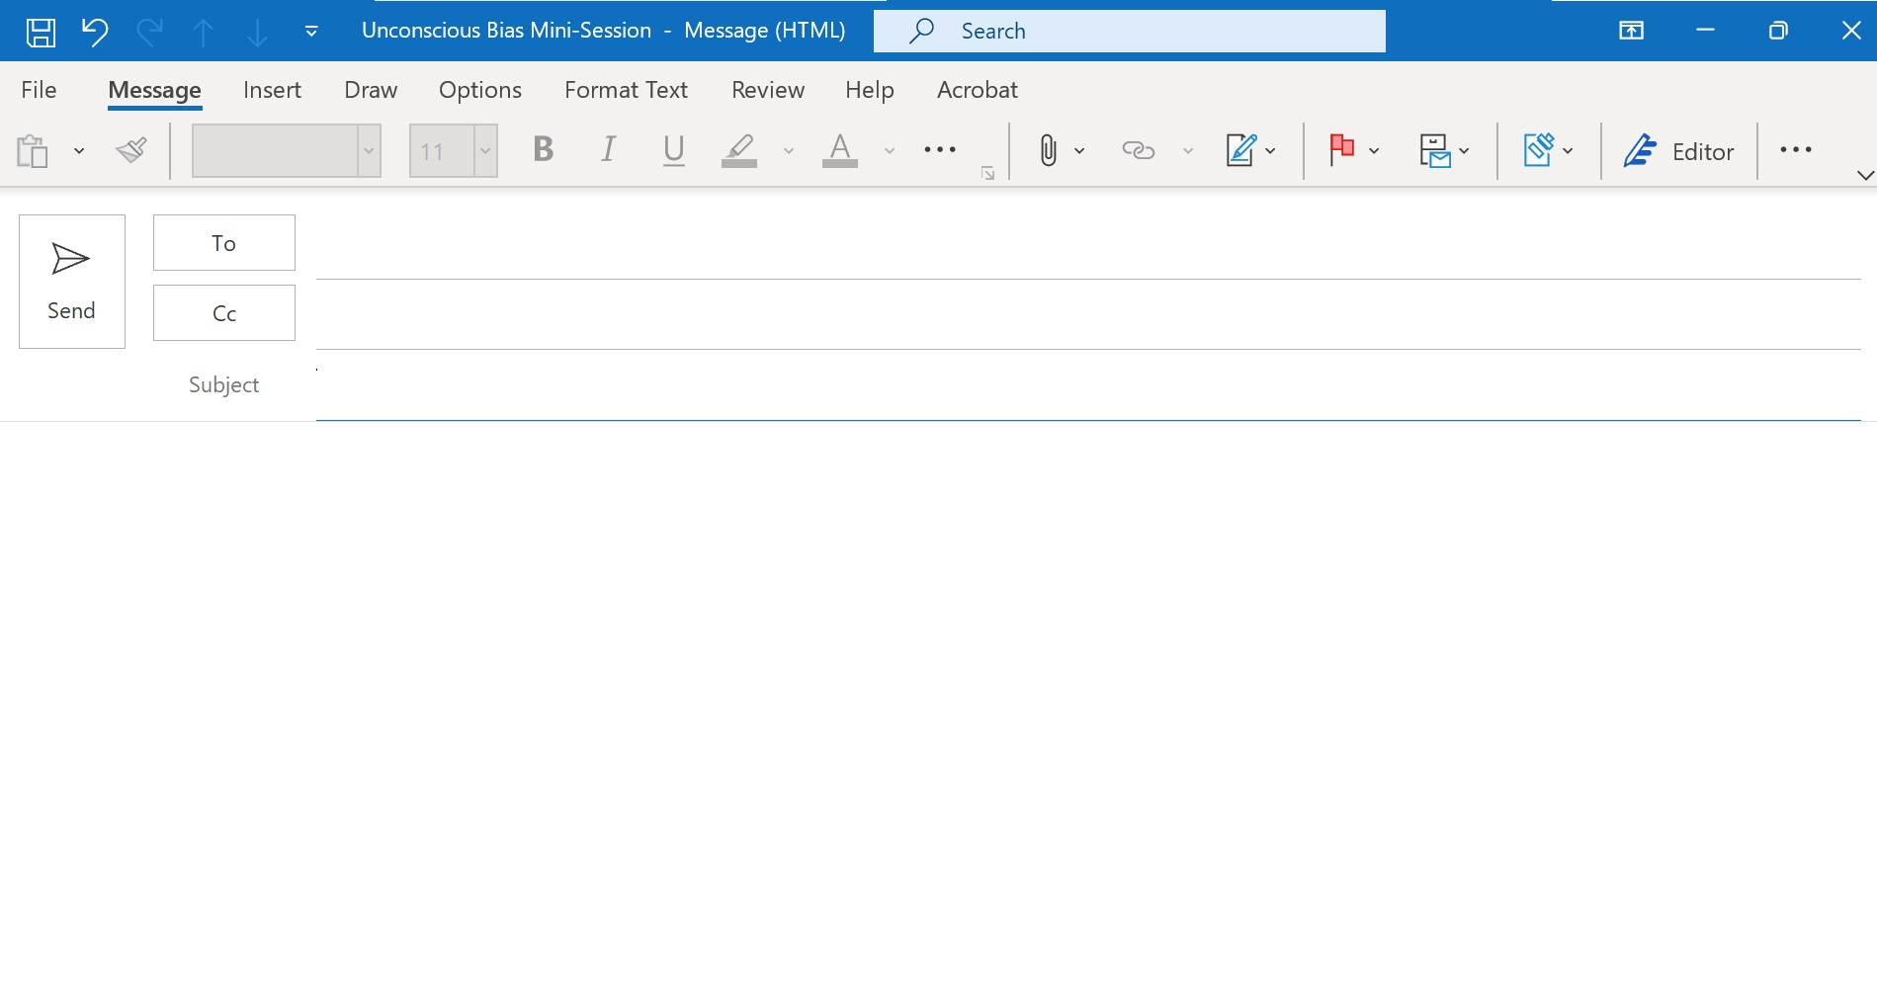
Sample Email with Pre-Work Assignment
[Enter email addresses of the participants]
Prepare for your DEIA Scenario Practice Session!
As we continue to honor our commitment to increasing Diversity, Equity, Inclusion, and Accessibility where employees are fully engaged and empowered to deliver the outstanding services to our Nation’s Veterans, their families and beneficiaries, we are pleased to invite you to a refresher practice session on Unconscious Bias. This 30-minute practice session is a scenario-based learning experience that will help us improve our confidence in identifying and responding to situations where bias is at play. By practicing with real-world scenarios, we can apply appropriate strategies for responding with courage to those situations where we are impacted by bias ourselves or when we notice it impacting those around us. Below are the details for the session.
UNCONSCIOUS BIAS MINI-SESSION
Date/Time: [enter the date and time]
Location: [enter the location]
AGENDA
  Define Bias and Courageous Action
  Practice with a Scenario Activity around Bias
  Debrief by Sharing Insights
  Close the Session
PRE-WORK ASSIGNMENT: Click on the following links to access and complete these learning activities prior to attending the session:
eLearning: Unconscious Bias Part 1: Identify Bias (2.1) - This 30-minute course will help you understand our inherent biases and recognize their impact on behavior and results.
Article: 6 Ways to Stand up to Bias in your Organization - This 10-minute article highlights 6 ways to address bias courageously when you witness bias in the workplace.
Review: Executive Order on Diversity, Equity, Inclusion, and Accessibility in the Federal Workforce
Please reach out to [internal point of contact] should you have any questions. We are excited to continue this journey with you towards a culture of diversity, equity, inclusion, and accessibility in our work across the Veterans Health Administration!
Warmest Regards,
[Signature and Contact Information]
Notes:
This slide contains an editable email template that you can send to your participants. This email verbiage contains the session purpose, agenda, location, date, time, and recommended learning activities for pre-work to be completed by participants prior to attending the session. Copy the text and place into your email message draft.

Slide 9
Scenario Practice Session Agenda (45 min)
1. Welcome and Learning Objectives…….. | 5 min
2. Define Bias and Courageous Action…… | 15 mins
4. Scenario Practice Activity….…………… | 15 mins
5. Debrief: Share Insights………………….. | 5 mins
6. Close and Next Steps…………………… | 5 min
Notes:
This is a 45-minute timed facilitation agenda for the Scenario Practice Session. If you have a larger group, the session will run approximately 60 minutes, more or less depending on the discussion time.

Slide 10
Remember to record your utilization using the 2-minute survey below after you complete a DEIA Scenario Practice session!
Alternative Usage Notification
https://www.surveymonkey.com/r/FCAlternativeUsageNotification
Notes:
Facilitator Note: Be sure to record your utilization using the 2-minute survey listed on the slide. Click the link on the slide to access the survey.

Slide 11
Resources: eLearning
Unconscious Bias Part 1: Identify Bias (2.1)
This course will help you understand our inherent biases and recognize their impact on behavior and results.
Unconscious Bias Part 2: Cultivate Connections (2.1)
In this course, you will learn how to use curiosity and empathy to hear and value diverse perspectives.
Unconscious Bias Part 3: Choose Courage (2.1)
This course will show you how to take appropriate action to courageously address biases that limit our own and others' contributions.
Notes:
Listed are the recommended eLearning courses you can access by clicking on the link. These resources are available to you and can serve as a refresher to help you prepare to lead your Scenario Practice Session.

Slide 12
Resources: Articles and Videos
Articles:
8 Places You Might be Prone to UB in the Workplace
7 Common Misconceptions About Unconscious Bias
9 Ways to Embrace Diversity of Thought
6 Ways to Stand up to Bias in your Organization
Videos:
One constructive way to confront potential bias
3 things you can do to foster inclusion on your team
Notes:
Listed are articles and videos you can access by clicking on the link. These resources are available to you and can serve as a refresher to help you prepare to lead your Scenario Practice Session. These are also great resources to share with your participants in a follow-up email to take their learning further!

Slide 13
Notes:
Do: Welcome participants as they enter the session and introduce yourself.

Slide 14
Agenda
Define Bias and Courageous Action
Practice with a Scenario Activity around DEIA and Bias
Debrief by Sharing Insights
Close and Next Steps
Notes:
.5 minute
Say: Here is the agenda for our time together today.
Do: Review the agenda items listed on the slide.

Slide 15
Learning Goals
The goal of this session is to help us improve our confidence in identifying and responding to situations where bias is at play.
We will also explore and apply appropriate strategies for responding to those situations with courage.
Notes:
.5 minute
Do: Review the learning goals as listed on the slide. Alternatively, you can ask for a volunteer to read it.
Say: The goal of this session is to help us improve our confidence in identifying and responding to situations where bias is at play. By practicing with real-world scenarios, it becomes easier for us to apply the skills and tools from our Unconscious Bias learning when we are impacted by bias ourselves or when we notice it impacting those around us.
Transition: Let’s begin with a little self-reflection.

Slide 16
What Does Bias Mean to You?
In 30 seconds, write as many words as you can to define bias.
Notes:
1 minute
Facilitator Note: Keep this activity brisk.
Say: In your Resource Guide, there are a few blank notes pages for you to take notes. I want you to take 30 seconds and write as many words or phrases as you can to define bias.
Do: Allow 30 seconds for people to make notes.
Ask: Who would like to share what they wrote?
Do: Solicit a few responses from different participants.
(Typical responses: lack of understanding, preconceived ideas, unproven beliefs, preference, discrimination, prejudice, subjective, opinionated.)
Say: Thank you for sharing! It looks like we’ve got some variations in how each of us understands this term. Let’s get a common definition for our work together today.
Transition: We will briefly cover what bias is, the two types of biases, and a few strategies for responding to bias with courage. Let’s begin by looking at a few statistics.

Slide 17
The Impact of Bias in the Workplace
Employees who perceive themselves to be the target of bias are:
3x as likely to be disengaged.
3x as likely to withhold ideas.
3x as likely to leave their job within the year.
DISRUPT BIAS, DRIVE VALUE, CENTER FOR TTALENT INNOVATION
Notes:
Facilitator Note: It’s important to engage employees at the start of the session with the answer to, “What’s in it for me? Why should I care?” Use this slide to present a few statistics on the impact bias has on employee engagement.
Say: So why is addressing bias so important? Let’s look at a few statistics on the impact bias has on employee engagement.
Do: Read the statistics listed on the slide.
Transition: Would you agree with these statistics? When employees are not treated with dignity and respect, their demeanor changes, they feel undervalued, and eventually, if left unaddressed, may become disgruntled, disengaged, and their performance suffers.

Slide 18
There is no idea more fundamental to performance than how we see and treat each other as human beings.
Notes:
Say: Our biases affect how we see and treat ourselves and how we see and treat each other. It impacts our personal and professional opportunities and performance. When we are biased, we can make errors or miss valuable information or perspectives of others. Our biases can limit our own performance and can make us to behave in ways that limit the performance of others.
Transition: Now let’s discuss the definition of bias.

Slide 19
What Is Bias?
A preference in favor of or against a thing, person, or group compared with another.
It may be held by an individual, a group, or an institution.
It can have negative or positive consequences.
Notes:
1 minute
Do: Share the definition of bias.
Say: A bias is a preference in favor of or against a thing, person, or group.
The word “preference” is important. By holding a preference, we favor something over another thing. Preferences can be harmless. For example, I can prefer mountains to oceans. Biases can be negative or positive. They are simply the result of how the brain operates or takes shortcuts.
Say: Our biases—or preferences—apply to people as well as things. There are many characteristics we all have preferences about, like age, gender, race, physical ability, religion, height, nationality, sexual orientation, and weight. Biases are not necessarily good or bad, right or wrong.
Transition: What’s important is that we identify when a bias is at play, and if it has negative consequences, we can address it. Now, let's explore some ways we can take courageous action when we witness or experience bias.

Slide 20
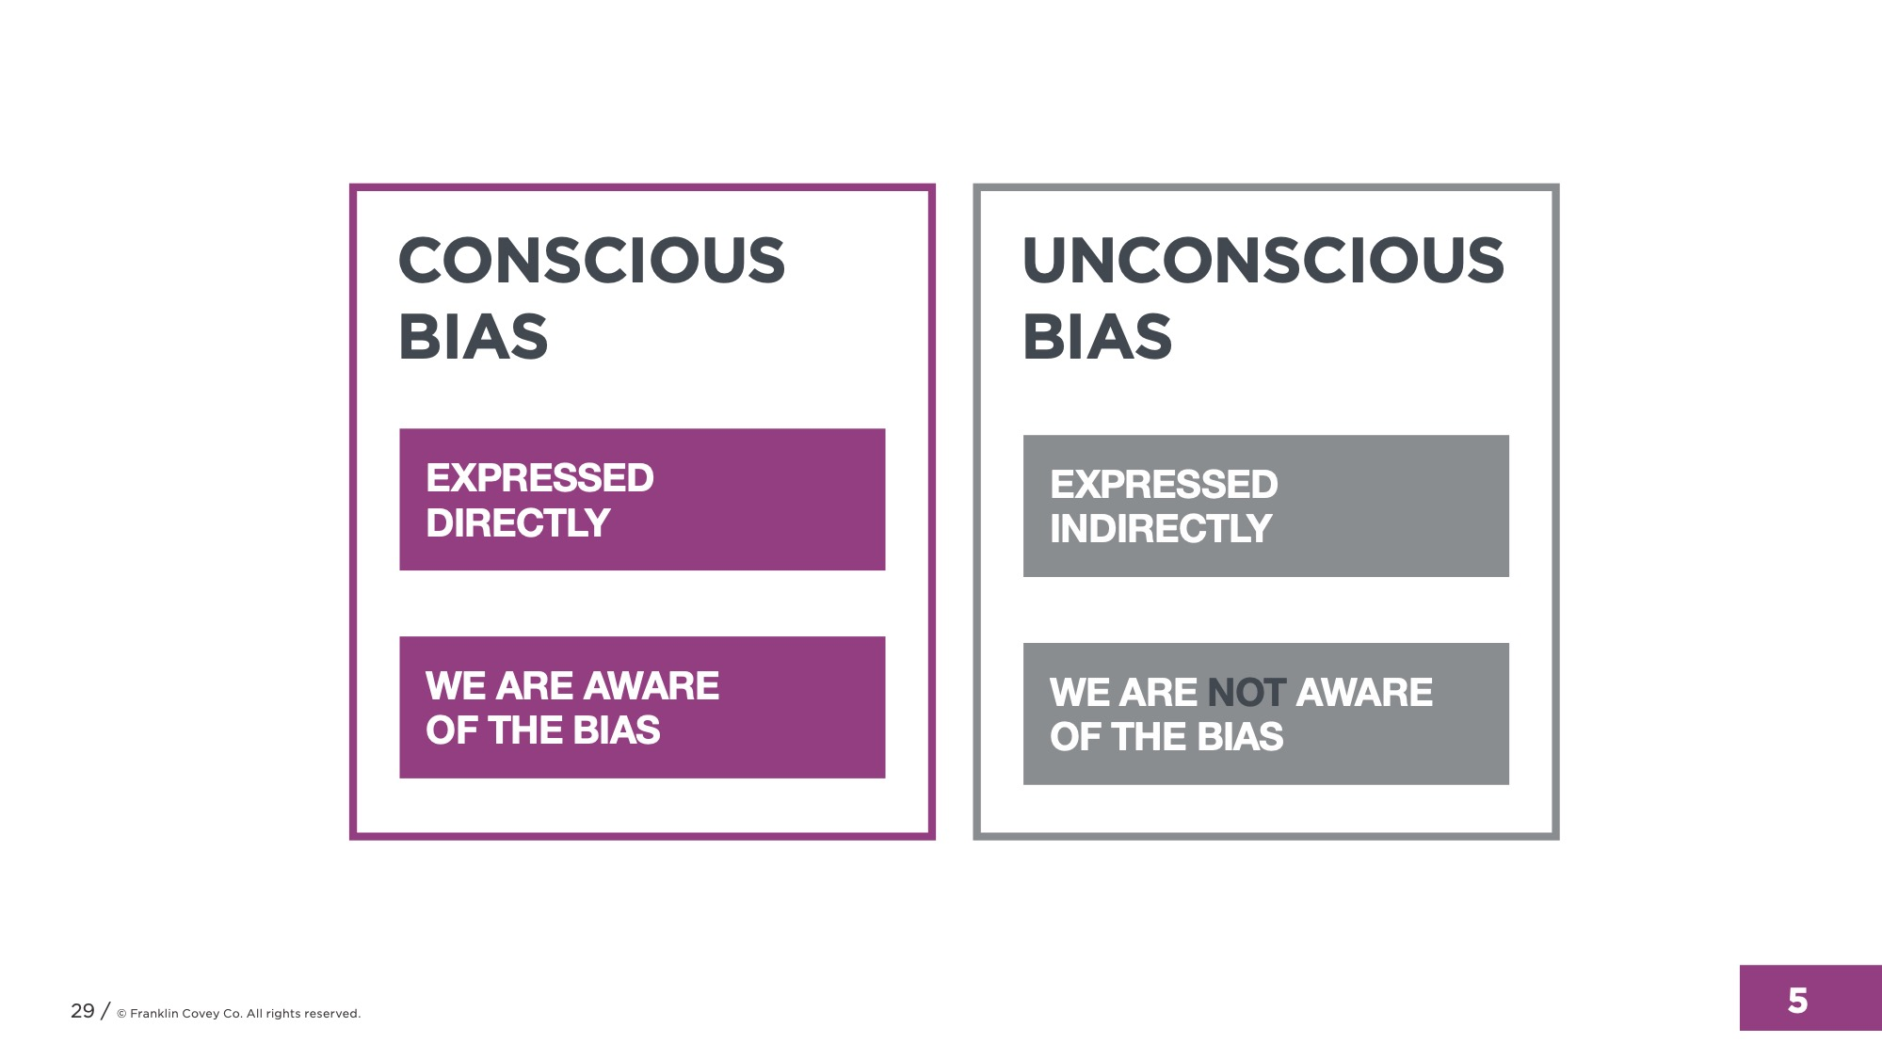
Two Types of Bias
Notes:
1 minute
Do: Share the difference between conscious and unconscious bias.
Do: Describe how unconscious biases can lead to flawed judgements and short-sighted decisions that limit opportunities for yourselves and others.
Say: Unconscious bias (or implicit bias) is something we don’t consciously think about. We may not express it verbally. It shows up in what we do rather than what we say.
Say: Unconscious biases trigger us to act. We might call them instincts. Sometimes they are useful. For example, if I am walking alone at night, and I pass a dark alleyway, I might cross over to the other side of the street where the light is without thinking about it. I’ve got a feeling that the dark alleyway is not safe. I just cross the road instinctively.
SAY: When we notice bias impacting ourselves and others, we have an opportunity to take courageous action and shape a positive experience for our colleagues and the Veterans we serve. This helps us recognize situations that may be in contrast to our commitments around diversity, equity, inclusion, and accessibility.
Transition: Now let’s practice how to respond to bias.

Slide 21
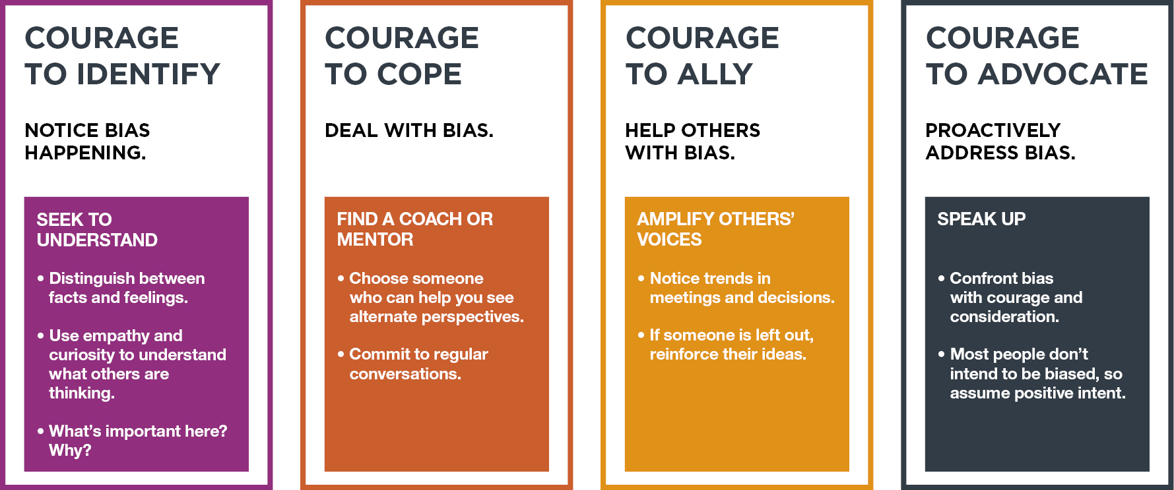
Four Ways to Act with Courage
Notes:
5 minutes
Say: Here are four ways to act with courage to address bias: identify, cope, ally, and advocate.
Courage to Identify. We can be courageous and notice bias when it is happening. One way to do this is seeking to understand.
In-person session: Ask: What does seek to understand mean?
Virtual session: Chat feature: Type in the chat your ideas on what seek to understand means.
Do: Respond to the ideas you receive from participants.
Courage to Cope. We can be courageous and deal with the bias in a healthy way.
In-person session: Ask: How could having a coach or mentor help us to deal with bias?
Virtual session: Chat feature: Type in the chat your ideas on how having a coach or mentor could help us to deal with bias.
Do: Respond to the ideas you receive from participants.
Courage to Ally. We can be courageous and help those experiencing bias.
In-person session: Ask: What does it mean to amplify other’s voices and how would that help us to deal with bias?
Virtual session: Chat feature: Type in the chat your ideas on what amplify other’s voices means and how you think that would help us to deal with bias.
Do: Respond to the ideas you receive from participants.
Courage to Advocate. We can be courageous and proactively address bias.
In-person session: Ask: How would you speak up when you see bias in action?
Virtual session: Chat feature: Type in the chat your ideas on how you would speak up if you witnessed bias in action?
Do: Respond to the ideas you receive from participants.
Transition: Let’s explore the two types of bias.

Slide 22
Practice Activity
Notes:
15 minutes
Small Group Activity
Do: Divide participants into small groups of 4 or 5. If you have a smaller group of participants, you can divide them into groups of 2.
Say: I’m going to show you a scenario. In your group, I want you to read the scenario, then answer a few questions that I will display on the slide. You will have 10 minutes to discuss as a small group, then we will debrief as a large group.
Do: Display the next slide and review the scenario that you chose with the group.
For virtual sessions:
Ask participants to take a picture of the scenario slide with their cell phone to refer to in the breakout group activity.
Type scenario questions in the chat.

Slide 23
Replace this slide with the Scenario slide you want to use for this session
Notes:
Facilitator Note: Replace this slide with the Scenario slide you want to use for this session. Then allow participants to read the scenario. Ask participants to take a picture of the scenario slide with their mobile phone to refer to in the breakout group activity.
Say: For this scenario, please discuss the following questions:
Where does bias show up in this situation for all parties involved?
Based on the skills that we just reviewed, how might you respond if you were directly affected?
If you witnessed the situation?
If you were the leader?
What could make it difficult to be courageous in this situation?
You will have 10 minutes to discuss as a small group, then we will debrief as a large group.
For virtual sessions:
Ask participants to take a picture of the scenario slide with their cell phone to refer to in the breakout group activity.
Type scenario questions in the chat.
Do: Start the activity. Give a 1-minute warning, bring the activity to a close, then debrief with the questions on the next slide.

Slide 24
Activity Debrief
  Where does bias show up in this situation?
  How might you respond if you were directly affected? If you witnessed the situation? If you were the leader?
Notes:
5 minutes
Say: Let’s start with the two questions you were asked to discuss in your breakout groups. Who would like to share your thoughts?
Do: Debrief the activity using the questions listed on the slide. Allow a few responses, time permitting. Elaborate on the scenario answers as needed.

Slide 25
Activity Debrief
  What could make it difficult to be courageous in this situation?
  How does it impact our commitment to DEIA if we choose not to act with courage?
Notes:
5 minutes
Do: Ask these additional questions listed on the slide to the large group. Allow a few responses, time permitting. Elaborate on the scenario answers as needed.

Slide 26
Notes:
Say: Great ideas and discussion around DEIA! Thank you all for coming and sharing your perspectives openly and honestly.
Do: Thank participants for attending and close the session.

Slide 27
Notes:
Review these scenarios which are organized by category of bias. Select one that resonates with you and the participants that will be in the session. Replace slide 23 with the Scenario slide you want to use for this session.
For virtual sessions:
Ask participants to take a picture of the scenario slide with their cell phone to refer to in the breakout group activity.
Type scenario questions in the chat.

Slide 28
Notes:
The following slides highlight a scenario example based on race.

Slide 29
Scenario: Race
Candace, a person of color, is a Social Worker at the hospital. Her manager consistently gives her cases exclusively with minority patients. When she asks about this, her manager responds, “I thought these would be more comfortable and relatable for you”.
Notes:
For virtual sessions:
Ask participants to take a picture of the scenario slide with their cell phone to refer to in the breakout group activity.
Type scenario questions in the chat.
Suggested answers:
Where does bias show up in this situation?
Candace’s manager may have a bias towards Candace that’s impacting the assignments she’s given.
How might you respond if you were Candace?
You could have a conversation with your manager. While it seems easy to jump to a conclusion about their behavior, it’s important to assume positive intent and seek to understand their intent. Ask a clarifying questions like, “What makes you feel like these patients would be more comfortable and relatable for me?”. NOTE: Even if the manager’s intent is truly to make Candace or the patients feel comfortable, the reality is that this type of thinking impacts Candace’s work opportunities and can leave her feeling slighted and diminished.
You could seek support from some of your colleagues to brainstorm how you might approach your manager or to help you roleplay a conversation.
You could connect with your human resources contact to share your experience and seek formal support in navigating this situation with Frank.
How might you respond if you were aware of the situation as Candace’s colleague?
Check in with Candace first to see if it’s something she’s open to discussing with you. Let her know you’ve noticed some trends that concern you and that you’d like to share your observations. Then, share what you’ve noticed and ask Candace what support she might want from you, if any.
In a meeting, share your observation with the group. “I’ve noticed that Candace seems to be assigned a certain kind of patient quite often. Has anyone else noticed that?”. Calling out the situation in a group setting as an observation can disarm defensiveness and force Candace’s manager to consider the impact. NOTE: Not everyone is comfortable with addressing this publicly. Make sure to discuss with Candace first.

Slide 30
Scenario: Race
You notice that the attending physician is treating two interns very differently, even though the interns seem to be of a similar skill level. With Alex (a Hispanic person) the attending is short and condescending. With Julia (who is a white female) the attending is much more friendly and less strict. You are uncomfortable with the situation and feel that you should do something.
Notes:
For virtual sessions:
Ask participants to take a picture of the scenario slide with their cell phone to refer to in the breakout group activity.
Type scenario questions in the chat.
Suggested answers:
Where does bias show up in this situation?
In-group Bias - Julia may be in the attending physician’s ingroup and receive the benefits of preferential treatment because of that.
Availability Bias – because your perspective on the intern’s performance is limited, you might not have the full picture.
How might you respond?
Amplify Other’s Voices – You could reinforce Alex’s perspective when he shared ideas. When you notice the attending physician being short with Alex, you could ask clarifying questions on his behalf. Courage to Advocate – you could speak to the attending physician directly and share your observations. This can feel risky given the power dynamic in your relationship and you may want to seek advice from a peer or roleplay the conversation with someone in Education or HR. NOTE: Even if the attending were to share the Alex’s performance is not to expectation, that does not justify the condescending attitude or short interactions. You might share with the attending that encouragement might boost Alex’s confidence and help drive that performance.
You could connect with your human resources contact to share your experience and seek formal support in navigating this situation with Frank.
How might you respond if you were aware Julia?
Amplify Other’s Voices – You could reinforce Alex’s perspective when he shared ideas. Since Julia does seem to receive preferential treat, she could defer some of that attention to Alex. When the attending asks her a question, she could say, “I have some ideas, but I’m curious to hear what Alex thinks first”.
Julia could also acknowledge the situation in private with Alex. Given their roles as interns, they may not feel comfortable or safe speaking up. Just letting Alex know that you recognize what’s happening and are open to supporting him can be helpful.

Slide 31
Notes:
The following slides highlight a scenario example based on religion.

Slide 32
Scenario: Religion
You are the only Muslim in your office. You and your co-workers are talking after a meeting and the topic of conversation turns to a recent terrorist event near the US Embassy in Saudi Arabia. A passing colleague interjects with, “That’s Islam for you. Are you surprised?”. Most of the group laughs, but the person who brought up the topic makes eye contact with you. Based on your religious identity, you immediately feel unsafe in your working environment.
Notes:
For virtual sessions:
Ask participants to take a picture of the scenario slide with their cell phone to refer to in the breakout group activity.
Type scenario questions in the chat.
Suggested answers:
Where does bias show up in this situation?
The commenting colleague has a bias about Islam and the people who practice it.
How might you respond if you were directly affected?
Seek to understand. “What do you mean by that?” or “Why wouldn’t we be surprised?”.
Speak up. “That comment was offensive to me personally and demeaning to my religion.”
Connect with your human resources contact to share your experience and seek formal support in navigating this situation.
Seek out a coach or mentor. If situations like this happen often, find someone who can support you in addressing it or be a sponsor to help you move into a different work environment.
How might you respond if you witnessed the situation (one of the co-workers in the discussion)
Seek to understand as in the example above.
After the conversation is over, offer support to the person directly impacted (the Muslim person).
Notify a supervisor or HR representative of the interaction to make sure it is properly addressed.
What about the person who made the comment?
How would you respond if someone spoke up or sought understanding as soon as you said it?
Apologize. Own the impact of your comment without trying to defend your intent.
What might you do if you realized later that your comment was offensive?
Apologize. Connect with your colleagues, especially your Muslim colleague, and ask if you can discuss what happened. If they are open to it, acknowledge the comment was offensive and invite them to share how they were impacted.

Slide 33
Scenario: Religion
Sarah, whom you know is a Jehovah's Witness, has asks in a team meeting to be excused from attending your team’s Christmas party for religious reasons. Your manager says, “Everyone is required to be there and participate. This is about teambuilding, not religion.” Sarah is quiet the rest of the meeting and leaves quickly when it’s over.
Notes:
For virtual sessions:
Ask participants to take a picture of the scenario slide with their cell phone to refer to in the breakout group activity.
Type scenario questions in the chat.
Suggested answers:
Where does bias show up in this situation?
It’s hard to say whether or not the manager’s comment was based on a bias against Sarah’s religion, though it certainly could be. Regardless, the impact of the manager’s behavior leaves Sarah feeling ignored or slighted AND it may be considered discrimination.
How might you respond if you were Sarah?
Speak up. “It is about religion for me. I appreciate our team and value opportunities for us to gather, and I will join future events that do not have a religious context.”
Connect with your human resources contact to share your experience and seek formal support in navigating this situation.
Seek out a coach or mentor. If situations like this happen often, find someone who can support you by sharing a similar experience and how they navigated it.
How might you respond in the meeting with Sarah?
Be an Ally/Speak Up: You could advocate for a ‘Holiday’ party, encouraging the team to keep the focus on teambuilding and create an inclusive event for everyone.
: After the conversation is over, check-in with Sarah and see how you might be able to support her. Make her aware of resources in the department, etc.
Speak Up: Have a 1:1 conversation with your manager after the meeting. Ask if you can share your observation, describe the impact, and offer a solution (Holiday party, apologize to Sarah and explore alternatives, simply approve her request, etc.)

Slide 34
Notes:
The following slides highlight a scenario example based on gender.

Slide 35
Scenario: Gender
You work on a committee and have regular meetings with five other committee members. The committee chair, Paul, three male colleagues, and one female. During a weekly committee meeting, the female team member, Claudia, makes an excellent recommendation, and Paula says, “That’s a possibility. Let’s come back to that.”
A few minutes later, one of your male colleagues in the room makes a very similar recommendation, and Paul responds, “That’s a fantastic idea. Team, what are some ways we can begin implementing this?” You don’t say anything in the moment, but it has been bothering you. You’ve noticed that Paul rarely acknowledges Claudia’s comments, and that others often restate her ideas and get the credit for them.
Notes:
For virtual sessions:
Ask participants to take a picture of the scenario slide with their cell phone to refer to in the breakout group activity.
Type scenario questions in the chat.
Suggested answers:
Where does bias show up in this situation?
Paul may have a bias towards Claudia based on her gender.
Paul may have a bias towards Claudia’s personality (or a preference for a more extraverted personality).
How might you respond if you were Claudia?
Seek to Understand. Depending on your relationship with Paulo, explore whether he is aware of this.
Find a coach or mentor. There may be other women or people in leadership who can help you address this situation.
How might you respond if you witnessed the situation as one of Claudia’s colleagues?
Amplify Others’ Voices. In future meetings, restate Claudia’s comments, giving her credit for them.
Team Up With Others. Invite others to work with you to create ground rules/behaviors for listening to and acknowledging everyone’s contribution.
Speak Up. “I’ve noticed that when Claudia shares ideas they aren’t considered, but when a male colleague mentions the same idea later it has credibility. Why might that be?”

Slide 36
Scenario: Gender
A fellow nurse shares with a provider that one patient is frequently inappropriate with her. The provider looks concerned and asks, “What do you mean?”. The nurse shares that the patient makes lewd comments about her appearance and has even exposed himself to her once.
The provider nods and says, “That sounds frustrating. But don’t worry about Mr. Smith; he’s harmless”.
Notes:
For virtual sessions:
Ask participants to take a picture of the scenario slide with their cell phone to refer to in the breakout group activity.
Type scenario questions in the chat.
Suggested answers:
Where does bias show up in this situation?
The provider may have some assumptions the kinds of behavior that nurses should accept from patients.
How might you respond if you were the nurse dealing with Mr. Smith?
Speak Up: Let the provider know that the behavior isn’t harmless to you. Ask for additional support from the provider; they may be able to set some expectations with Mr. Smith.
Find a coach or mentor. There are other nurses who have dealt with situations like these. Find a preceptor or nurse manager and talk through your concerns.
Team Up With Others. As you connect with different nurses, you may be able to sign a petition or take some other form of collective action requiring the hospital to hold patients accountable for inappropriate behavior.
How might you respond if you were present when your colleague had this conversation?
Amplify Others’ Voices. Reinforce how serious this seems to you and encourage the provider to take it seriously. You might even recommend that the provider talk to Mr. Smith directly.
Share Your Experience: It can be easy to dismiss one person’s experience. Share your experiences with similar situations at work to lend credibility and urgency to your colleagues experience.
Offer Support: Connect with you colleague after. Provide emotional support. Visit Mr. Smith with them on their next rounds.

Slide 37
Notes:
The following slides highlight a scenario example based on sexual orientation/gender identity.

Slide 38
Scenario: Sexual Orientation
Alex, a project manager, has always kept to himself in the office and is a reliable and consistent employee. Recently, Alex’s demeanor has shifted. He wears his wedding ring to work now, has a photo on his desk of his husband on their wedding day, and has opened up with colleagues, sharing his weekend plans and highlights of a recent vacation he and his husband took.
Most of the office is thrilled to see this side of Alex but his supervisor, Frank, is less receptive. He seems to be actively avoiding Alex and it’s getting in the way of work they need to collaborate on.
Notes:
For virtual sessions:
Ask participants to take a picture of the scenario slide with their cell phone to refer to in the breakout group activity.
Type scenario questions in the chat.
Suggested answers:
Where does bias show up in this situation?
Frank may have a bias towards Alex based on his sexual orientation.
How might you respond if you were Alex?
You could have a conversation with Frank. While it seems easy to jump to a conclusion about Frank’s behavior, it’s important to assume positive intent and seek to understand Frank’s intent.
You could seek support from some of your more supportive colleagues to brainstorm how you might approach Frank or to help you roleplay a conversation.
You could connect with your human resources contact to share your experience and seek formal support in navigating this situation with Frank.
How might you respond if you witnessed the situation (Frank’s seeming discomfort) as Alex’s colleague?
Check in with Alex first to see if it’s something he’s open to discussing with you. Let him know you’ve noticed some trends that concern you and that you’d like to share your observations if that’s ok. Then, share what you’ve noticed and Alex what support he might want from you, if any.
Schedule a 1:1 conversation with Frank. Share your observations objectively by describing behavior and the impact it’s having. Avoid making accusations, but make sure Frank understand what message his change in behavior might be sending to Alex or others in the office.
How might you respond if you were the leader? (Frank)
Recognize that your interactions with Alex have changed and ask yourself why that might be. Do you hold beliefs or opinions that are impacting your leadership responsibility?
Reach out to your HR team for support and to properly address any concerns you have about discussing the situation with Alex.
Schedule a conversation with Alex and work engage Alex with the same frequency and quality as other members of the team.
Join an ERG or consume content that helps you better understand Alex’s experiences in the workplace.

Slide 39
Scenario: LGBTQ+
Derrick, a member of your professional network, just accepted an offer for a position in your medical center. You’ve shared with several colleagues how excited you are for the value Derrick will add to the Veteran experience.
On his first day, you notice your colleagues have mixed reactions to Derrick’s flamboyant mannerisms. A colleague says to you, “I didn’t know you were part of that network”. You pause, and they add, “I’m just kidding!” before laughing and walking away. You’ve never had concerns about your colleagues before, but now you’re worried about the treatment Derrick might receive.
Notes:
For virtual sessions:
Ask participants to take a picture of the scenario slide with their cell phone to refer to in the breakout group activity.
Type scenario questions in the chat.
Suggested answers:
Where does bias show up in this situation?
Frank may have a bias towards Derrick based on his behavior, assuming his sexual orientation.
You may have an unconscious bias about how Derrick will be received in the workplace.
How might you respond to your colleague’s ‘joke’?
Seek to Understand: “I’m not sure what you mean by ‘that’ network. Can you help me understand?”
Directly name what’s happening. “Jokes like that seem to imply there’s something wrong with Derrick or my professional network. If you say that to me, I’m concerned for what Derrick might experience here.”
Ask: What actions would you take next?
Share the comment with your supervisor and ask them to check-in with Derrick regularly and make sure the joke-teller understands that it was not an appropriate comment.
Pay attention to how others engage with Derrick and the comments that are made. Prepare to be an ally for Derrick if needed. NOTE: share the comment with Derrick at your discretion. It could be helpful to know, and it could also cause extra stress and concern for Derrick as he tries to settle into the workplace.
How might you respond if you overheard the comment that the colleague made?
Let the person who heard the joke know that you heard it too and that it made you uncomfortable. Ask them for what might support they might need from you, if any.
Intervene and address the comment as soon as you hear it. Ask the joke-teller to clarify what they mean or describe the impact the comment had on you.

Slide 40
Notes:
The following slides highlight a scenario example based on disability.

Slide 41
Scenario: Disability
Prasert is an HR specialist in your medical center. He is deaf and requires a sign language interpreter for team meetings. The interpreter needs to be scheduled 24 hours in advance. The other team members often express frustration at how this level of planning hampers innovation and prevents the team from unscheduled brainstorming with Prasert.
Several team members have asked their manager why they can’t just hold the meetings without the interpreter and catch Prasert up on the outcomes with email. The manager feels strongly that he needs to support Prasert’s accommodation (the sign language interpreter) and keep him involved in team meetings.
Notes:
For virtual sessions:
Ask participants to take a picture of the scenario slide with their cell phone to refer to in the breakout group activity.
Type scenario questions in the chat.
Suggested answers:
Where does bias show up in this situation?
The team may have a bias towards Prasert because of his disability.
The team may be experiencing negativity bias; this may only cause a scheduling challenge occasionally but, because it’s frustrating to the team, it feels more frequent than it actually is.
The team may be experiencing an attribution bias; they focus more on the inconvenience of Prasert’s accommodation instead of focusing on addressing their reliance on impromptu meetings.
How might you respond if you were Prasert?
You could have a conversation with Frank. While it seems easy to jump to a conclusion about Frank’s behavior, it’s important to assume positive intent and seek to understand Frank’s intent.
You could seek support from some of your more supportive colleagues to brainstorm how you might approach Frank or to help you roleplay a conversation.
You could connect with your human resources contact to share your experience and seek formal support in navigating this situation with Frank.
How might you respond if you were one of Prasert’s team members?
Seek to Understand. What are the circumstances that demand unscheduled brainstorming?
Check Assumptions. What assumptions are being made about how to communicate? Are there other formats or technologies that could be used for just-in-time brainstorming?
How might you respond if you were the manager?
Speak Up. Confront the team members with courage and consideration. Restate the expectation to have Prasert attend with the interpreter.
Reach out to your HR team for support and make sure that Prasert has reasonable accommodations and that the work group understands the need to work with those accommodations. NOTE: It’s important for the manager to set the tone in a positive way. Treating it as an obligation still leaves Prasert feeling diminished. Framing it as an opportunity to fully engage the team, overhaul meeting processes, and drive better results is more effective.

Slide 42
Scenario: Mental Health
Han has recently been diagnosed with clinical depression. He’s surprised by this diagnosis as he’s never really had mental health challenges before. Recently, he has been consistently late to or missed the meetings scheduled before 10:00 am.
Many of your colleagues have been whispering and talking about Han’s persistent lateness behind his back. You ask Han about this out of concern. He shares his recent diagnosis and confides that he’s been really struggling to get out of bed in the mornings. He’s not sure what to do about it.
Notes:
For virtual sessions:
Ask participants to take a picture of the scenario slide with their cell phone to refer to in the breakout group activity.
Type scenario questions in the chat.
Suggested answers:
Where does bias show up in this situation?
The team may have an Attribution Bias towards Han; they seem him show up late and make assumption about his reasons.
Depending on the differences amongst team members, Han may be experiencing Out-Group Bias. Instead of giving him feedback or expressing concern directly, most of the team gossips about Han.
How might you respond if you were Han?
Find a Coach or Mentor: Enlist the support of your supervisor to help normalize your schedule and minimize assumptions or negative treatment by team members. Engage with HR to find support and accommodation.
Speak Up: Make it clear to team members that your work schedule has changed temporarily for personal reasons and reset expectations around when you’ll be available and how work gets done. (NOTE: Suffering depression, especially newly, can make this kind of conversation hard. It is meant as a recommendation only if Han is comfortable navigating that discussion).
You could seek support from some of your more supportive colleagues to brainstorm how you might rebalance your work load.
How might you respond if you were the team member that Han confided in?
Be an Ally. Interrupt gossip about Han’s schedule when he isn’t present. Do not share his personal information! But you can redirect the conversation or express your confidence in Han’s work and that he wouldn’t be late like this without a good reason.
Offer Support. Connect with Han to see what kind of support you can provide as a colleague. You can also encourage Han to leverage the resources at his disposal through his employment with the VA.

Slide 43
Notes:
The following slides highlight a scenario example based on age.

Slide 44
Scenario: Age
You are approaching retirement and recently began working for a young, new manager. He’s highly educated and driven to get results. He also seems to make assumptions about the older employees on the team. Recently, you approached him about being a SME for the upcoming Cerner implementation. You enjoy new technology and understand how it supports the team’s legacy processes.
He tells you, “I’ve already asked Antonio to be our SME. He’s tech-savvy and really understands how this system can help us be more efficient”. Antonio is 30 years younger than you.
Notes:
For virtual sessions:
Ask participants to take a picture of the scenario slide with their cell phone to refer to in the breakout group activity.
Type scenario questions in the chat.
Suggested answers:
Where does bias show up in this situation?
The manager may have a positive bias towards Antonio because of his age and/or experience with technology.
The manage may have a negative bias towards older people and assume they might struggle with technology.
How might you respond?
Pause/Question It. Examine how you’re reacting and what your biases are about your manager delegating the work to Franz instead of you
Seek to Understand. Find out from the manager what’s important here and what the rationale is for the decision to engage Franz.
Seek a coach or mentor. You could seek support from some of your more supportive colleagues to brainstorm how you might approach Frank or to help you roleplay a conversation.

Slide 45
Notes:
The following slides highlight a scenario example based on national origin.

Slide 46
Scenario: National Origin
You are the committee chair on a cross-functional project to implement HRO best practices across your healthcare system. All the team members speak English, but it is a second language for Fatima.
Her accent is strong, and you feel uncomfortable having conversations with Fatima beyond simple small talk and basic work assignments. You know you aren’t maximizing her potential and you’re concerned that she might notice your discomfort.
You also don’t want to accidentally say the wrong thing or offend her. Particularly with all the events in the news lately, you feel like you could easily and inadvertently say something insensitive.
Notes:
For virtual sessions:
Ask participants to take a picture of the scenario slide with their cell phone to refer to in the breakout group activity.
Type scenario questions in the chat.
Suggested answers:
Where does bias show up in this situation?
You may have a negative bias against people with accents.
You may have a confirmation bias; you believe that Fatima’s accent and ethnicity will make it difficult, so you find reasons that it does.
How might you respond as the committee chair?
Seek to Understand. Ask Fatima how the conference calls are working and what suggestions she has for improvement.
Amplify Others’ Voices. Ask team members to amplify voices that may not otherwise be heard—like Fatima’s. Plan 1-on-1 time with Fatima, even if virtually, so you can understand her career goals and find opportunities to help her achieve them.
Learn. Seek to understand the kinds of statements that might be insensitive given current events. Avoid those statements.
How might you respond if you were Fatima?
Find a coach or mentor. Seek out colleagues who have had similar challenges connecting with colleagues and learn best practices to help you engage.
Speak up. Let the committee share know that you are passionate about contributing to this project, but you don’t feel your interactions are allowing you to do your best work.
Seek to understand. Tel the committee chair that they seems uncomfortable in your interactions and invite them to share any concerns they have. Share your perspective and work together to strengthen your working relationship.

Slide 47
Scenario: National Origin
You’re a federal employee, and your department is about to kick off a project involving an area in your city with a large Dominican population. You’ve only been with this department for six months, and you’re still learning the ropes.
Your manager just selected you to manage this high-profile project. In your one-on-one meeting, she said “I think you’re a great fit for this project. You really speak the language of this community.”
Your parents are from Brazil and you actually grew up in an affluent suburb in the United States. You are uncomfortable with this assignment and worry that other, more qualified people have been passed over.
Notes:
For virtual sessions:
Ask participants to take a picture of the scenario slide with their cell phone to refer to in the breakout group activity.
Type scenario questions in the chat.
Suggested answers:
Where does bias show up in this situation?
Your manager may have a bias about your background, experience, and interest based on your National Origin.
You manager may have a bias about other team members not being able to meet the needs of this community based on their identity.
How might you respond as you receive this assignment?
Seek to Understand: “When you say that I speak the language of this community, what do you mean?” or “I actually don’t speak the language. What else do you feel makes me a great a fit?”
Speak Up: Let your manager know that you are Brazilian and speak Portuguese, not Spanish. Make it clear that you aren’t comfortable with work assignments being made based on assumptions about your ethnicity.
Offer alternatives: Tell your manager that you speak Portuguese and this is a largely Spanish-speaking population. However, you believe that there are many qualified people in the office to do community outreach work and a translator can help bridge the language gap.
How might you respond if you were Fatima?
Find a coach or mentor. Seek out colleagues who have had similar challenges connecting with colleagues and learn best practices to help you engage.
Speak up. Let the committee share know that you are passionate about contributing to this project, but you don’t feel your interactions are allowing you to do your best work.
Seek to understand. Tel the committee chair that they seems uncomfortable in your interactions and invite them to share any concerns they have. Share your perspective and work together to strengthen your working relationship.

Slide 48
Notes:
The following slides contain additional scenarios from other categories such as recruiting, hiring, nicknames, tenure, family status etc.

Slide 49
Scenario: Family Status
You and your wife had your first child eight months ago. Your wife has a high-pressure job and a higher salary. You work for a non-profit and care deeply about your job, and you hope to keep growing there.
A more senior position in your department just become available, and you told your manager you were interested in the job. She responded by saying “We’re looking closely at David for this position. He’s just more reliable right now.” David hasn’t started a family yet, and you know that you’re more qualified.
Notes:
For virtual sessions:
Ask participants to take a picture of the scenario slide with their cell phone to refer to in the breakout group activity.
Type scenario questions in the chat.
Suggested answers:
Where does bias show up in this situation?
Your manager may have a bias towards people without children, leading them to favor those people and see them as more reliable.
Your manager may have preference for reliability over quality.
Your manager might have a bias based on their own perceived capabilities; “I couldn’t do that job with a young family. They probably can’t either.
How might you respond?
Seek to understand. Ask your manager to talk about the requirements/expectations for the job.
Seek to understand. Ask your manager to clarify what ‘reliable’ means.
Find a coach or mentor. Connect with a peer or another manager who has dealt with navigating work with a family.

Slide 50
Scenario: Risk Averse
You are assigned to a critical project with several other new hires. The project lead has a reputation for being a collaborative team player who manages projects efficiently.
In your first meeting, you and your colleagues excitedly bring up new and innovative ideas. You quickly notice that the project lead wants to ‘keep the meeting on track’ and his responses seem to minimize your contributions.
He says things like, “We have some reliable processes – let’s stick with what we know works” and, “In my experience, trying approaches like that will impact our timeline. Let’s focus on the basics”.
You leave the meeting feeling discouraged and frustrated.
Notes:
For virtual sessions:
Ask participants to take a picture of the scenario slide with their cell phone to refer to in the breakout group activity.
Type scenario questions in the chat.
Suggested answers:
Where does bias show up in this situation?
Confirmation Bias: Seeing everything through the lens of risks
In-Group Bias: Experienced employees versus new hires
In-Group Bias: Risk aversion versus risk tolerance
Anchoring Bias: Assuming that because the new hires are coming up with new ideas, they won’t know how to implement them
How might you respond?
Seek to Understand. Ask questions to examine the thinking behind the new ideas: Do the new team members have experience in implementing equivalent ideas?
Check Assumptions: What assumptions is the team making about the ideas they are suggesting and how practical/ easy they are to implement?
How might your colleagues respond?
Amplify Other’s Voices: When your ideas are minimized, they could speak and bring the conversation back to what you’ve shared.
Team Up: The team could work together and, publicly or privately, share the impact of the manager’s behavior and suggest alternatives.
What could the leader do differently?
Check Assumptions. What assumptions are you making about the level of risk in the ideas the team members are suggesting? What assumptions is the team making about the ideas they are suggesting and how practical/ easy they are to implement?
Seek to Understand. Ask questions to examine the thinking behind the new ideas: Do the new team members have experience in implementing equivalent ideas?

Slide 51


