Slide 1
Greatness Starts Here.
5 Choices to Extraordinary Productivity
Flipped Classroom Guide
Veteran’s Health Administration

Slide 2
What is The Flipped Classroom approach?
A type of blended learning, which aims to increase engagement by having learners complete course content independently first and then gather live with colleagues to debrief learnings and discuss application.
Benefits of the flipped classroom approach with OnDemand courses:
Saves facilitation certification and delivery resources by leveraging OnDemand content
Provides flexibility for learners to have access to courses at any time
Maximizes the time spent together live with discussion and application
Creates a sense of community for learners that want to develop their skills

Slide 3
Preparation

Slide 4
End-to-End Impact Platform Flipped Class Process
Create Team in Impact Platform
Assign Course in Impact Platform
Email Participants with Context
Schedule Sessions and Send Invites
Lead Discussion Sessions
Optional Participant Capstone Presentation

Slide 5
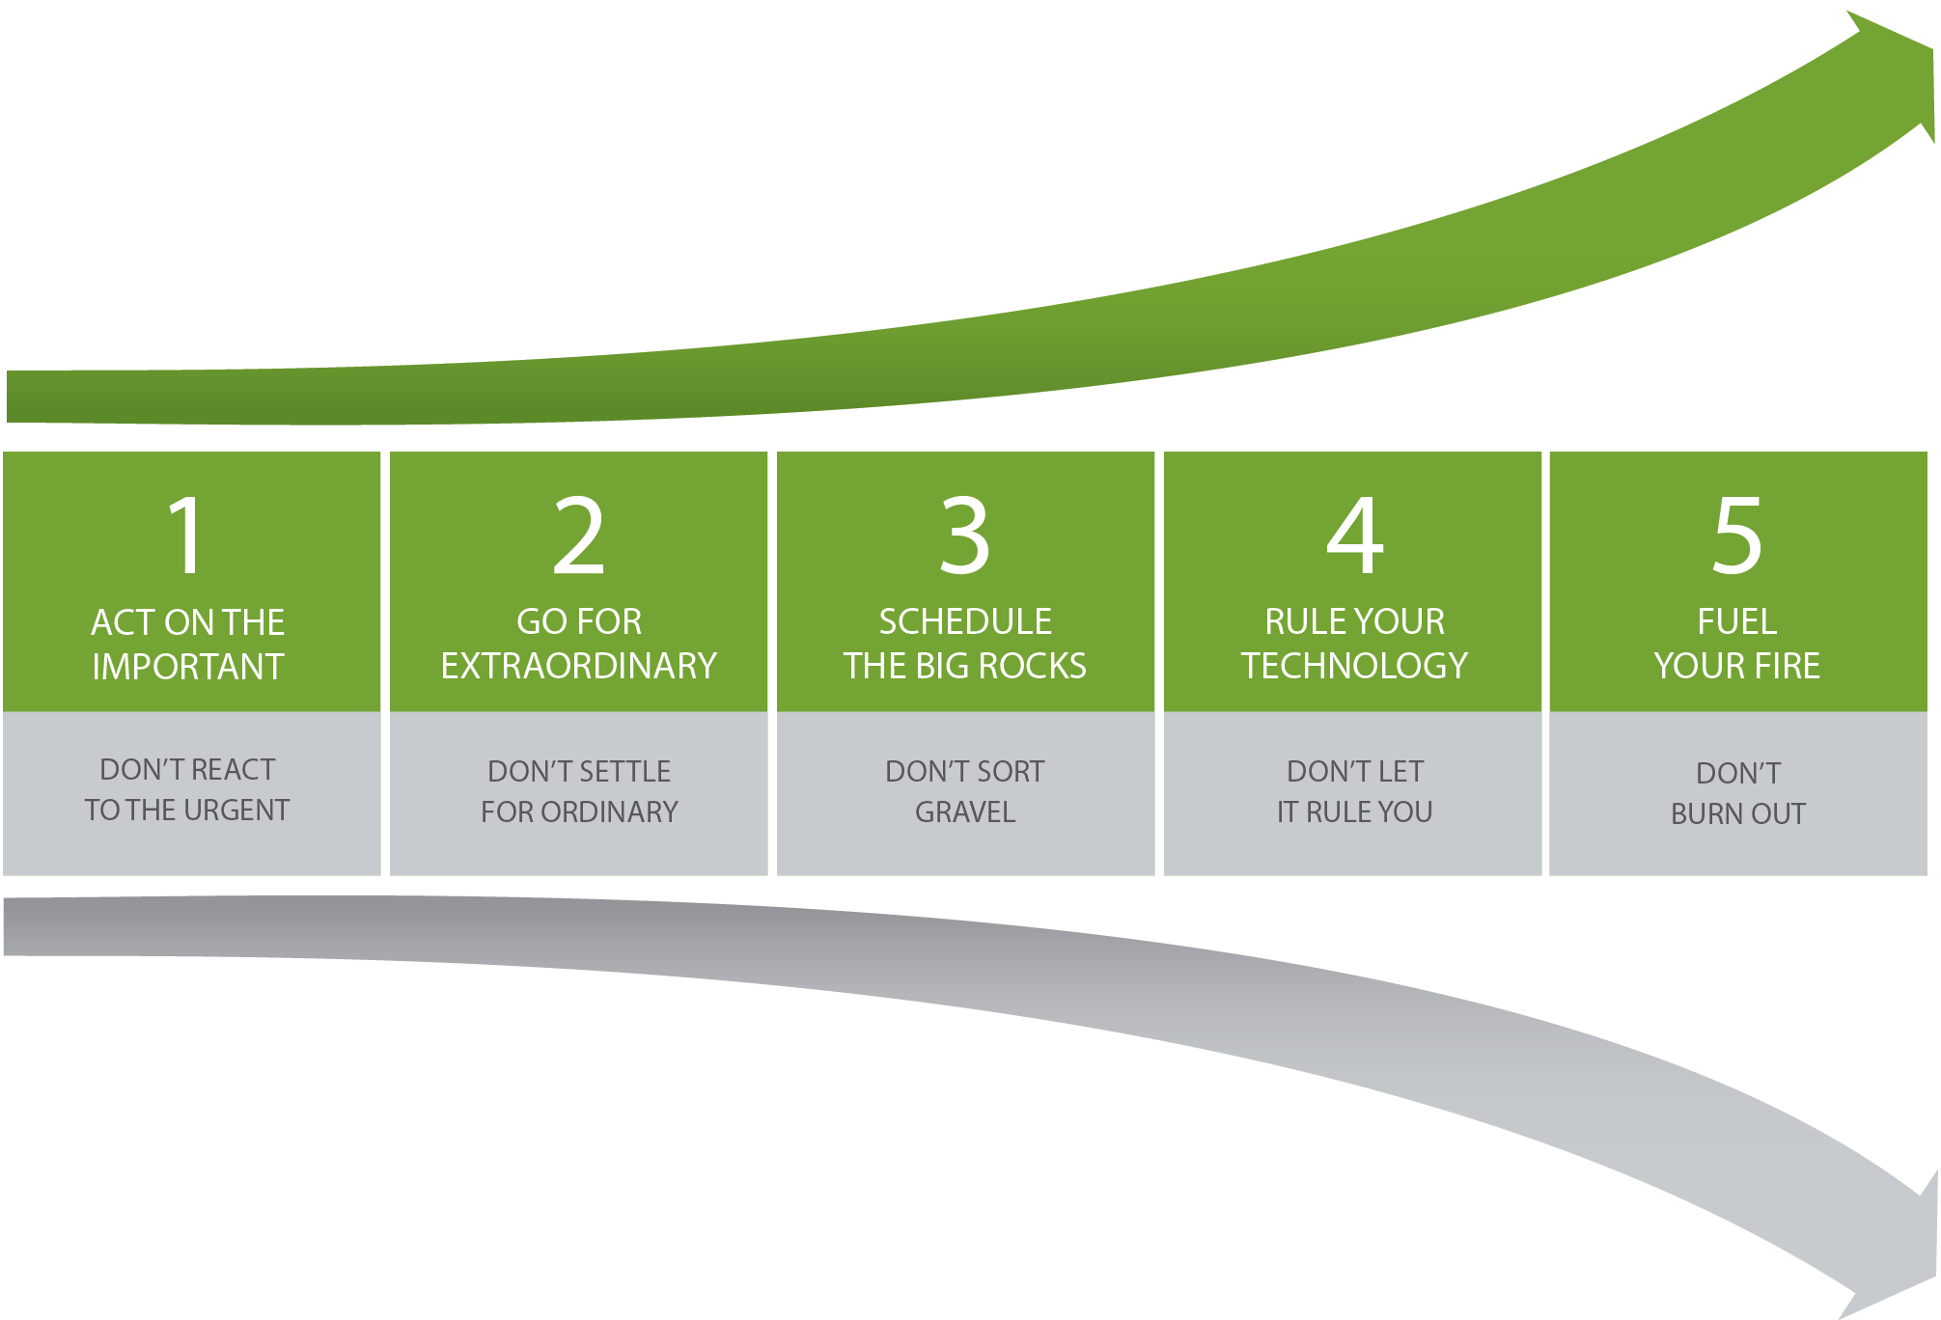
The 5 Choices to Extraordinary Productivity®
Measurably increase the productivity of individuals, teams, and organizations. It’s not about getting everything done, it’s about getting the right things done without burning out. The 5 Choices to Extraordinary Productivity combines timeless principles with current neuroscience research to help better manage decisions, attention, and energy.
1
Outcomes
2
Schedule & Commitment
Increase the speed at which work gets accomplished while simultaneously decreasing costs.
Boost team member engagement, energy, and commitment to organizational goals.
Outperform organizations and teams that do not cultivate trust at the core of their culture.
Improve their team’s reputation and make a positive contribution to their world.
DATE RANGE 12 weeks
Weekly Automated assignments: 30-minutes
Bi-weekly live debrief sessions: 1-hour
3
Course Link
The 5 Choices to Extraordinary Productivity--Impact Platform
Multiple links for old AAP Portal

Slide 6
Initial Participant Email Send directly after course is assigned in the Impact Platform
NOTE: Change link if using old portal
Hello Leaders,
We are excited to share that we’ve invested in a relationship FranklinCovey to support your development! FranklinCovey is a leader in impacting the four areas that matter most to our long-term success: leadership, individual effectiveness, culture, and achieving strategic goals.
You’ve been assigned The 5 Choices to Extraordinary Productivity- OnDemand course in their Impact Platform. Course objectives are:
Develop a new paradigm about how to feel accomplished at the end of the day,
Apply a process that measurably increases productivity of individuals, teams, and organizations.
Make more selective, high-impact choices about where to invest your valuable time, attention, and energy.
This 12-week course consists of engaging content, application challenges and educational articles. The time commitment is only 30-minutes a week for OnDemand completion and 1-hour every two weeks to attend a live debrief session. Please arrive at each session with your downloaded responses and application challenges. We appreciate you prioritizing this investment in yourself! (If relevant, include Capstone information here)
To access the Impact Platform, you should have received an email from learning@app.franklincovey.com alerting you that you’ve been assigned to the course. Please login and follow the prompts to activate your account and then bookmark the site as a favorite in your browser for easy access in the future. If you have trouble please refer here or send me a note.
Please reach out with any questions.
Thank you for your engagement and participation!

Slide 7
Session Reminder Email Send three days before the session
Hello Leaders,
This is a friendly reminder that you’re The 5 Choices to Extraordinary Productivity- Discussion session is coming up on DATE. You should have a calendar invite.
We’re investing in this program as part of our commitment to your learning and development (include any additional organizational strategies that this ties into and benefits for the learner).
Pre-work for this session is:
Complete modules X and X (total 1-hour)
Come prepared with your downloaded responses and application challenges (be specific here, ‘Q2 Conversation starter’ etc.)
Be ready to engage, listen and learn!
To access the The 5 Choices to Extraordinary Productivity- , you should have received an email from learning@app.franklincovey.com alerting you that you’ve been assigned to the course and have created an account (include any SSO if relevant). If you have trouble, please refer here or send me a note.
Please reach out with any questions.
Thank you for your engagement and participation!

Slide 8
Capstone Presentation- Optional Participants present to leadership after the course is complete
Purpose/Benefits:
Participants share their key takeaways and how they will apply the new tools they’ve learned to their work
Instills deeper engagement and commitment to learning the tools and changing behavior
Participants gain exposure with leadership and celebrate their commitment to development
Generate interest from other leaders/departments to participant in a future course
Timing:
Capstones can be done right at the end of a course where learners will discuss their immediate takeaways that they will apply. Or you can schedule them 1-2 months after the course and have leaders report on what tools they’ve applied and how it’s impacted their work/team/organization.
Presentations should only be about 7-10 minutes.
Instructions:
Chose 1-3 concepts that were most impactful to you
Share how you’ve applied learnings with your team
Describe the impact from applying the tools on your team
Discuss any benefits these tools have to the entire organization

Slide 9
Discussion Sessions

Slide 10
Foundation—Become Extraordinary Weeks 1 & 2 of OnDemand Course
Breakouts – Groups of 3
1. Discussion Questions (10 – 15 minutes)
As you watched the video, what "gravel" did you think of from your own life? How does “gravel” effect your productivity?
2. Discussion Questions (10 - 15 minutes)
What have you done in the past that was extraordinary? What's at stake if you don't choose to become extraordinary?
Notes:
Pre-Work: Remind participants have their downloaded responses from the OnDemand Course and be prepared to share their responses.
Opening: Provide context for why they are taking this course. Reiterate the investment int their learning and tie to larger organizational initiatives
Introduction: Show the 5 Choices Model. Say: Productivity isn't just about time management or completing tasks. It's about getting the right things done, and it requires: Making high-value decisions, Focusing attention, and Cultivating/harnessing/maintaining high energy.
ASK the group their first reactions to the course and the concept of Becoming Extraordinary. What stood out to them? Share your own preliminary insights.
Breakout 1: (10 – 15 minutes)
Whole Group Debrief: (5-10 minutes) Who would like to share what they discussed and any insights they had?
Breakout 2: (10 – 15 minuets)
Whole Group Debrief: (5-10 minuets) Who would like to share what they discussed and any insights they had?
Closing: Key takeaways and committed actions to next steps (hear from everyone if group is small or ask for a few if group is larger)

Slide 11
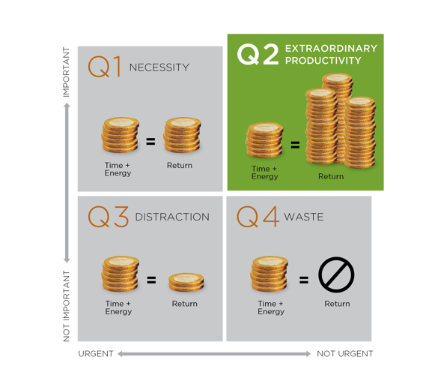
Choice 1: Act on the Important Weeks 3 & 4 of OnDemand Course
The Time Matrix
Breakouts – Groups of 3
Discussion Questions (10 – 15 minutes)
Share one of your Q1 Activities.
What is the impact on your productivity when you are in Q1 for a long time?
2. Discussion Questions (10 - 15 minutes)
What is an example of one of your Q2
activities?
What is the impact on your productivity
when you are in Q2 for a long time?
Notes:
Pre-Work: Remind participants to have their downloaded responses from the OnDemand Course and be prepared to share the types of activities they put into each quadrant
Ask: Who can describe a type of activity that would be in Q3—Distraction? Ask participants to share or chat.
Ask: Someone please describe a type of activity that would be in Q4? Ask Participants to share or chat.
Breakout 1: (10 – 15 minutes) Share Q1 activities
Whole Group Debrief: (5-10 minutes) Who would like to share what they discussed and any insights they had?
Breakout 2: (10 – 15 minuets) Share Q2 activities
Whole Group Debrief: What’s the value of spending time in Q2?

Slide 12
Choice 1: Act on the Important Weeks 3 & 4 of OnDemand Course
Q2 Conversations: How to say no and still build your reputation
Scenario:
A colleague repeatedly sticks her head in your office (or calls you on the phone) and asks “Do you have 30 seconds?” It often ends up taking 30 minutes because she’s having trouble with a project that you are only marginally involved with. Your relationship with her is important to you. How do you handle the situation
Breakouts – Groups of 3
1. Role Play (10 – 15 minutes)
Take turns practicing the conversation you want to have with this coworker. It’s ok if you make mistakes! Give each other feedback
How do you balance maintaining the relationship but not getting drawn into something that isn’t a good use of your time?
Notes:
1. Activity: Show the video from the learning journey “How to say no and still build your reputation”
2. Say: There are three steps in learning to say no to the less important in the moment of choice: pause, clarify, and decide. Once you hear the request, stop and think about it without being reactive. Don’t agree automatically just because it comes at you. Visualize the Time Matrix®. What level of importance does this task or request have for the other person? (Is it a Q1, Q2, Q3, or Q4?) What level of importance does it have for the team or organization? For your own priorities?
3. Breakout 1: (10 – 15 minutes) Role Play the scenario
4. Whole Group Debrief: (5-10 minutes) Who would like to share what they discussed and any insights they had?
5. Closing: Key takeaways and committed actions to next steps (hear from everyone if group is small or ask for a few if group is larger)

Slide 13
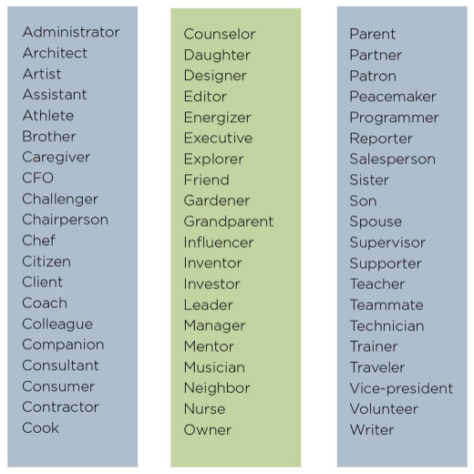
Choice 2: Go for the Extraordinary Weeks 5 & 6 of OnDemand Course
Q2 Roles and Responsibilities-Group Discussion
Notes:
Pre-Work: . Remind participants to have their downloaded responses from the OnDemand Course and be prepared to share their Q2 Roles (if they feel comfortable).
Say: ( Reveal chart) This is a short list of the many, many roles people play. Ask: How many of these roles do you play (chat your answer). Do you fill any roles not listed here? (Chat or share verbally) We should each have about 5-7 roles we want to focus on. What happens when you try to focus on more than that?

Slide 14
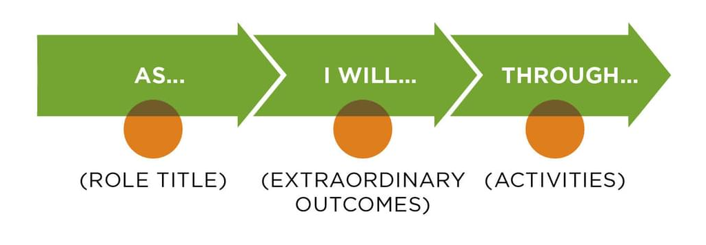
Choice 2: Go for the Extraordinary Weeks 5 & 6 of OnDemand Course
Q2 Role Statement
Breakouts – Groups of 3
1. Discussion (10-15 minutes)
In your breakout session, each person takes 5 minutes to share a role statement for one of their roles.
What do you see yourself doing and achieving in each role?
Who are the people you influence the most in this role?
What would you want these people to say about you (my actions, performance, results, achievements)?
Notes:
Say: We are going to spend a little time reviewing and refining your Q2 Role Statement. These statements should be specific and describe the outcomes and activities that guide your goals, plans, and decisions. The clearer you are, the more likely you are to be motivated to do things that help you fulfill each role. This formula can help you.
Breakout 2: (10- 15minutes)
Whole Group Debrief: (5-10 minuets) Who would like to share what they discussed and any insights they had?

Slide 15
Choice 2: Go for the Extraordinary Weeks 5 & 6 of OnDemand Course
Q2 Setting Specific Goals
Breakouts – Groups of 3
Discussion (10 – 15 minutes)
Chose one role to focus on and create a “from x to y by when” goal statement. How does this goal help you focus your energy and attention?
Who can give some feedback to help make this goal better?
Notes:
Say: To achieve the success you defined in your Q2 Role Statements, you need Q2 Goals. A Q2 Goal is a highly important goal that won't happen without you taking action. The best Q2 Goals will be structured as "From X to Y by When.“
Breakout 2: (10-15)
Whole Group Debrief: (5-10 minuets) Who would like to share what they discussed and any insights they had?
Closing: Key takeaways and committed actions to next steps (hear from everyone if group is small or ask for a few if group is larger)

Slide 16
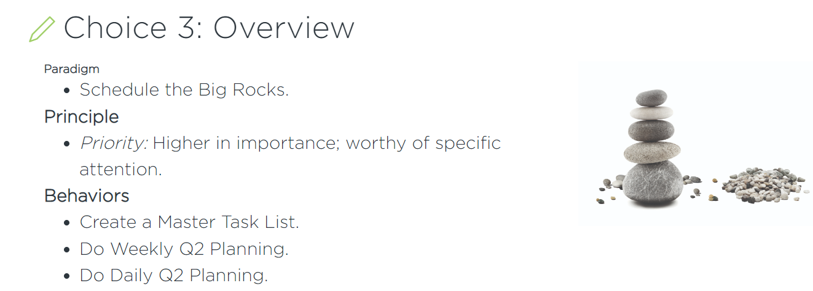
Choice 3: Schedule the Big Rocks Weeks 7 & 8 of OnDemand Course
Notes:
Pre-Work: . Remind participants to have their downloaded responses from the OnDemand Course and be prepared to share (if they feel comfortable).
Say: Traditional time management helps you organize and sort "gravel" to get more things done. But Choice 3 is not about getting things done. It's about getting the right things done⁠—your own Big Rocks.
Say: today we are going to spend time discussing Daily and Weekly Planning. Go to next slide

Slide 17
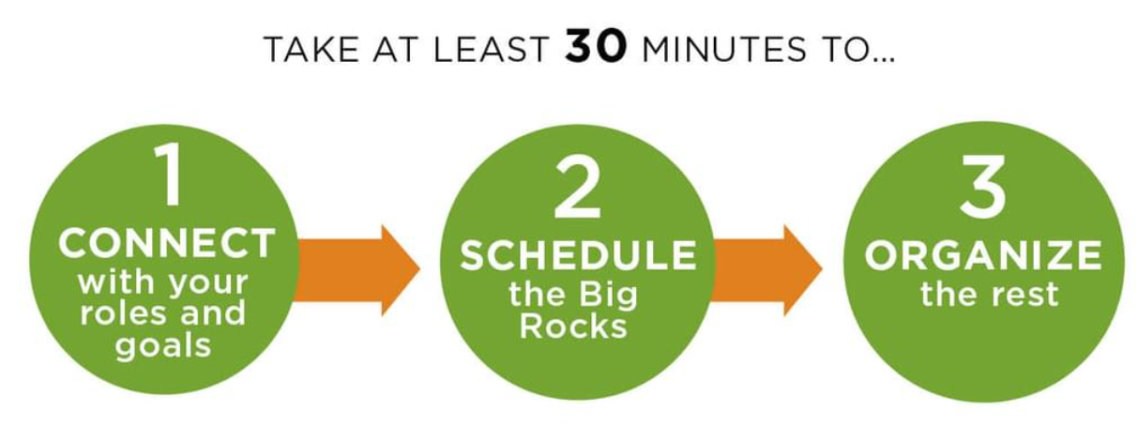
Choice 3: Schedule the Big Rocks
Weekly Planning
Breakouts – Groups of 3
1. Discussion (10-15 minutes)
In your breakout session,
Discuss what makes it easy or hard to do weekly 30-minute planning?
What’s the best day or the week and time of the day for you personally?
How do you feel when you make your plan for the week? Or if you don’t?
Notes:
Say: using chat (or raise your hand to speak)—share either a personal or professional Big Rock that is on your schedule for this week.
Breakout 1: (10 – 15 minutes) Discuss how and when you do your 30 minute planning. Share what gets in the way and seek ideas from each other to make it a habit.
Whole Group Debrief: (5-10 minutes) Who would like to share what they discussed and any insights they had?
Closing: Key takeaways and committed actions to next steps (hear from everyone if group is small or ask for a few if group is larger)

Slide 18
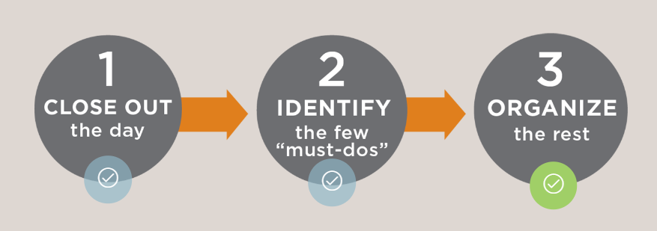
Choice 3: Schedule the Big Rocks
Daily Planning
Breakouts – Groups of 3
Discussion (10-15 minutes)
In your breakout session,
When your day doesn’t go according to plan, how do you make sure your Big Rocks stay a top priority for the week?
How do you make time for your Q2 activities every week?
Notes:
Say: Your week will never go according to plan, so use Daily Q2 Planning to ensure that you give your Big Rocks priority.:
Ask: put in “chat” how many times a week are you able to do your daily planning? Can someone share the benefit of following this 3 step process?
Say: using chat (or raise your hand to speak)—share either a personal or professional Big Rock that is on your schedule for this week.
Breakout 1: (10 – 15 minutes) Discuss breakout questions
Whole Group Debrief: (5-10 minutes) Who would like to share what they discussed and any insights they had?
Closing: Key takeaways and committed actions to next steps (hear from everyone if group is small or ask for a few if group is larger)

Slide 19
Choice 3: Schedule the Big Rocks
Daily Planning Summary
When creating your Master Task list (and then choosing your Big Rocks) remember to ask yourself:
Is this Q3? A distraction?
Is it urgent but not important?
Am I volunteering for something that does not align with my roles?
Am I taking something on that should be delegated to someone else?
Notes:
Say: It takes discipline to commit to daily and weekly planning. Remember to ask yourself these questions as you go into next week.
Closing: Key takeaways and committed actions to next steps (hear from everyone if group is small or ask for a few if group is larger)

Slide 20
Choice 4 Rule Your Technology Weeks 9 & 10 of OnDemand Course
The 4 Cores
Act or File?
CONTACT
APPOINTMENT
NOTES/ DOCUMENTS
TASK
Notes:
Pre-Work: . Remind participants to have their downloaded responses from the OnDemand Course and be prepared to share (if they feel comfortable).
THIS IS A BUILD SLIDE.
Ask: who remembers one of the Core 4? Say or put in chat (answers: Appointments, Tasks, Contacts, Notes/Documents)
Bring up each tile and ask participants “Act or File” (Appt and task are act; contact and notes are file)
Say: The Q2 Process Map is a workflow that integrates your regular Q2 Planning with your need to handle the constant day-to-day influx of information. Go to next slide.

Slide 21
Choice 4: Rule Your Technology
Design your system to manage your Core 4
“everything in one place”
Breakouts – Groups of 3
Discussion (10-15 minutes)
In your breakout session,
For each core share whether you manage it through paper or technology
What’s one “hack” or tip you can share that makes it easier for you to manage your system?
Where do you need advice?
APPOINTMENT
CONTACT
NOTES/ DOCUMENTS
TASK
Notes:
Say: You can manage the Core 4 with paper systems, digital systems, or a combination of both. (refer back to your download responses)
Breakout 1: (10 – 15 minutes) Discuss breakout questions
Whole Group Debrief: (5-10 minutes) Who would like to share what they discussed and any insights they had?

Slide 22
Choice 4: Rule Your Technology
Master Moves
Ideas
Auto-delete junk mail
Block spam
Use different ring tones for a few most important relationships
Delegate tasks (and decision making!)
Win without Fighting
When you see a recipe you want to try, turn it into a note, task, or calendar time in your next Q2 Planning
Turn an email into a task.
Put the details of an event into the appointment (Location, dress code, etc)
Turn It Into What It Is
Link to locate
Attach a document to an appointment.
Insert a link to a cloud-based document into an appointment.
Use cloud file sharing to share with your team a file of links to commonly used documents (templates, agendas, etc.).
Notes:
Say: There are 3 Master Moves that can help leverage technology to support your Q2 Process workflow and increase your effectiveness. Let’s talk through each of them.
Ask: who remembers what Win without Fighting Means? (Don’t reveal answers). Ask for a couple examples then reveal suggestions.
Ask: What does Turn it Into What it Is” means (don’t reveal answers). Ask for a couple examples. Remind participants that turning it into what it is could mean turning it into a message in your trash folder!
Ask: What does Link to Locate mean? (don’t reveal answers until after participants have provided a couple).
Summarize:

Slide 23
Choice 4: Rule Your Technology
Take charge of your apps to boost your productivity
Breakouts – Groups of 3
Discussion (10-15 minutes)
In your breakout session,
Share any apps that you use that help you with productivity.
Talk about how you organize your Apps to make them easy to find and use
Notes:
Say: You can manage the Core 4 with paper systems, digital systems, or a combination of both. (refer back to your download responses
Breakout 1: (10 – 15 minutes) Discuss breakout questions
Whole Group Debrief: (5-10 minutes) Who would like to share what they discussed and any insights they had?
Post link: https://app.franklincovey.com/explore/productivity/take-charge-of-your-apps-to-boost-your-productivity/?structured_resource_progress_id=2380b253-c2dd-4a09-9417-9696967c54a2
Share: This article is part of your learning journey, if you haven’t read it, take the link out of chat and turn it into what it is: appointment, task, or document.
Closing: Key takeaways and committed actions to next steps (hear from everyone if group is small or ask for a few if group is larger)

Slide 24
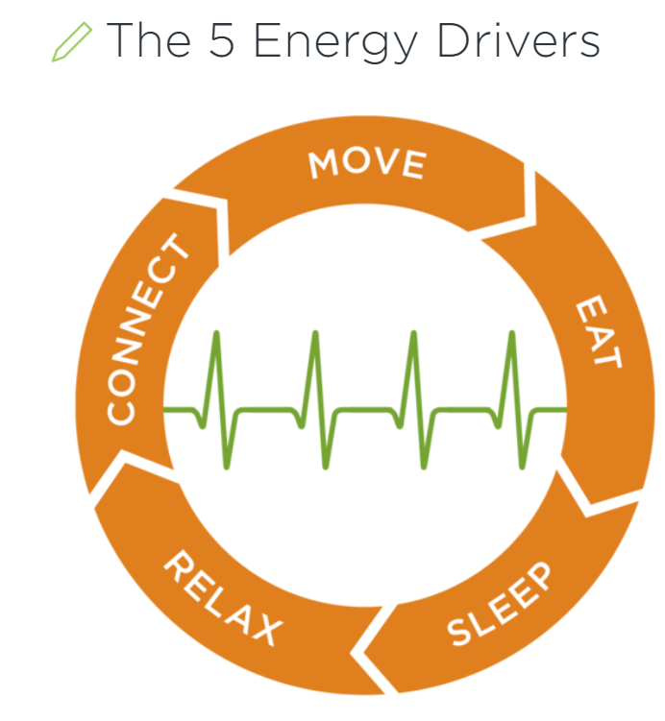
Choice 5: Fuel Your Fire Weeks 11 & 12 of OnDemand Course
Breakouts – Groups of 3
Discussion (10-15 minutes)
In your breakout session,
Think about the five major drivers of your personal energy level.
Which driver do you feel you most need to address? Why?
What do you need to start doing (or stop doing) to improve this driver?
Notes:
Pre-Work: . Remind participants to have their downloaded responses from the OnDemand Course and be prepared to share their Q2 Roles (if they feel comfortable).
Say: So many of us are so busy being busy that we fail to restore and replenish ourselves. To adopt the Choice 5 paradigm of Fuel Your Fire, you must build a habit of renewing your energy regularly.
Breakout 1: (10 – 15 minutes)
Whole Group Debrief: (5-10 minutes) Who would like to share what they discussed and any insights they had?

Slide 25
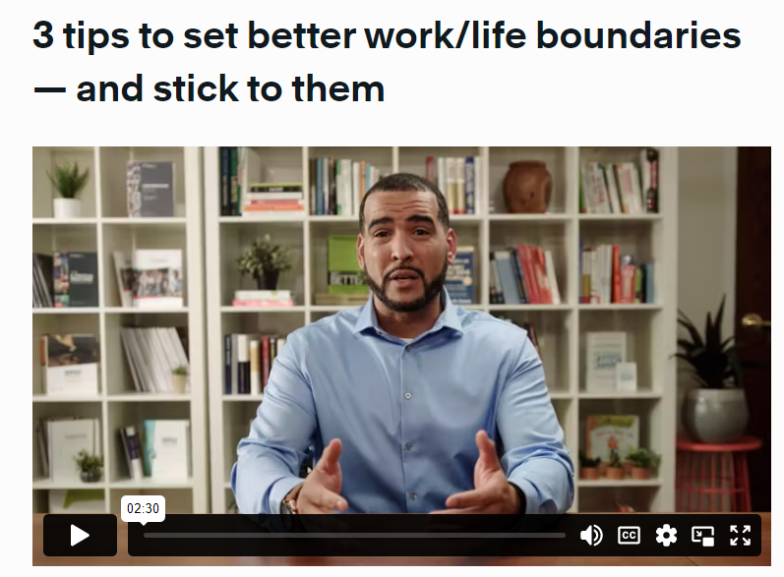
Choice 5: Fuel Your Fire Weeks 11 & 12 of OnDemand Course
Notes:
Say: It’s easy to let work follow you after you stop for the day. To keep work stress from spilling over into your home life, try building a routine for the end of the workday to help you reenergize for the other parts of your life.
Say: Let’s watch this short video on how to set better work/life boundaries. Make note of the 3 points that the presenter covers. Play Video by clicking on the video thumbnail. You can also access it here if you are on the Impact Platform: 2 Minute Mentor Video: work life boundaries Or with this link if you are using Jhana: Jhana Video: setting work life boundaries
Go to next slide to set up debrief

Slide 26
Choice 5: Fuel Your Fire Weeks 11 & 12 of OnDemand Course
Breakouts – Groups of 3
Discussion (10-15 minutes)
In your breakout session,
How well do you set—and stick to—work/life boundaries.
What is one thing the presenter shared that you can incorporate into your end of day routine?
What else can you do at the end of the day to ensure you unplug and reenergize?
Notes:
Say: It’s easy to let work follow you after you stop for the day. To keep work stress from spilling over into your home life, try building a routine for the end of the workday to help you reenergize for the other parts of your life.
Breakout 1: (10 – 15 minutes)/ Discuss Breakout session questions
Whole Group Debrief: (5-10 minutes) Who would like to share what they discussed and any insights they had?

Slide 27
What’s Next? - Use the Tools and Track Alternative Usage
These tools will help you develop and stick to good habits so that you renew your energy regularly and avoid burnout. These are all located under the Materials Tab when you are in the course in the Admin/Facilitator Platform
Q2 Roles and Goals (Form-Fillable)
Q2 Weekly Planning (Form-Fillable)
Q2 Conversation Starter (Form-Fillable)
5 Week Quickstart (Form-Fillable)
Fuel Your Fire Plan (Form-Fillable)
IMPORTANT! Tracking Alternative Usage
Once you are done with the Flipped Classroom, you will need to make sure you are tracking usage for the VHA contract.
See next slide for full details on Tracking Alternative Usage
Notes:
NOTE: you will want to provide links to your learners. These links are available through the library under Materials as long as you have admin or facilitator credentials. The learners can also find them under “additional resources” “cards/tools” for 5 Choices.

Slide 28
Alternative Usage – This is the most critical factor in tracking usage for contract renewal.
What qualifies as Alternative Usage?
Below are a few examples of the types of usage we need your help tracking!
Instructor Led (In-person or Online) - Full or portions of courses. If you track in TMS, no need to double report.
Facilitator Certification Completion of any FranklinCovey Course
If you share ANY content from FranklinCovey (Articles, videos, tools, etc.) during any of the below forums, please let us know:
Lunch and Learns
Flipped Classrooms
Town Halls
Newsletters
Sent via email, MS Teams and other platforms
Posted in digital platform
How to track Alternative Usage:
Any time you identify Alternative Usage within your facility, please let us know so we can award usage to your facility.
Complete the simple survey here.
Approximately when was the content delivered?
How many VHA Employees participated in the training?
What and how did you share the information?
Please reach out to VACare@FranklinCovey.com if you have any questions

