Slide 1
Greatness Starts Here.
6 Critical Practices
Flipped Classroom Guide
Veteran’s Health Administration

Slide 2
What is The Flipped Classroom approach?
A type of blended learning, which aims to increase engagement by having learners complete course content independently first and then gather live with colleagues to debrief learnings and discuss application.
Benefits of the flipped classroom approach with OnDemand courses:
Saves facilitation resources by leveraging OnDemand content
Provides flexibility for learners to have access to courses at any time
Maximizes the time spent together live with discussion and application
Creates a sense of community for learners that want to develop their skills

Slide 3
Preparation
Notes:
This is the backup slide if the CP wants a more conditional statement

Slide 4
End-to-End Impact Platform Flipped Class Process
Create Team in Impact Platform
Assign Course in Impact Platform
Email Participants with Context
Schedule Sessions and Send Invites
Lead Discussion Sessions
Participant Capstone Presentation

Slide 5
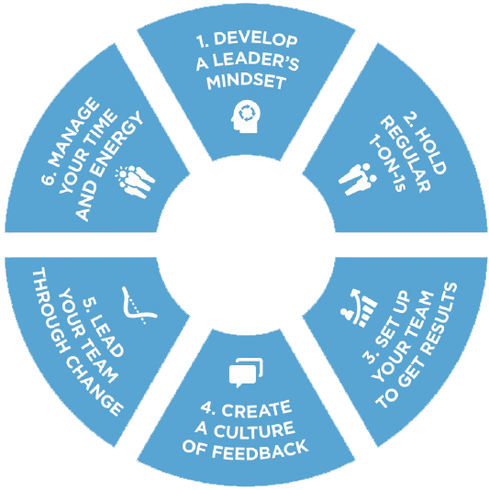
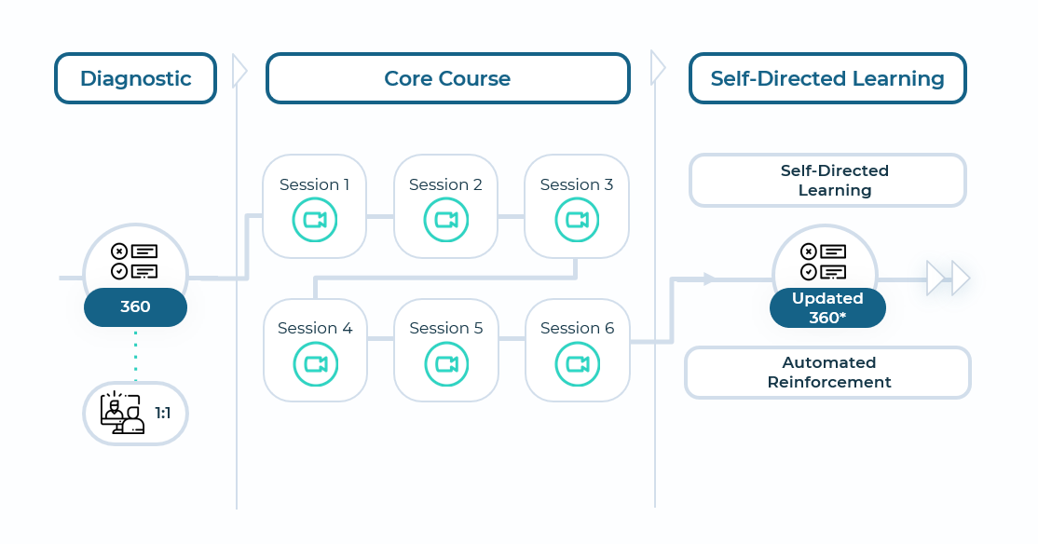
The 6 Critical Practices for Leading a Team
Equips leaders with the essential skills and tools to get work done with and through other people.
Outcomes
2
Schedule & Commitment
Maximize success as a leader of others and increase team member engagement.
Create clarity about goals and results, delegate responsibilities, and provide appropriate support.
Give feedback and seek feedback to develop confidence, competence, and improved performance.
Help team members navigate and accelerate through change.
DATE RANGE 12 WEEKS
Weekly Automated assignments: 30-minutes
Bi-weekly live debrief sessions: 1-hour
3
Course Link
6 Critical Practices for Leading a Team

Slide 6
Participant Email Send directly after course is assigned in the Impact Platform
Hello Leaders,
We are excited to share that we’ve invested in a relationship FranklinCovey to support your development! FranklinCovey is a leader in impacting the four areas that matter most to our long-term success: leadership, individual effectiveness, culture, and achieving strategic goals.
You’ve been assigned the 6 Critical Practices for Leading a Team OnDemand course in their Impact Platform. Course objectives are:
Create clarity about goals and results, delegate responsibilities, and provide appropriate support.
Give feedback and seek feedback to develop confidence, competence, and improved performance.
Help team members navigate and accelerate through change.
This 12-week course consists of engaging content, application challenges and educational articles. The time commitment is only 30-minutes a week for OnDemand completion and 1-hour every two weeks to attend a live debrief session. Please prioritize this investment in yourself! (If relevant, include language on the Capstone Presentation here).
To access the Impact Platform, you should have received an email from learning@app.franklincovey.com alerting you that you’ve been assigned to the course. Please login and follow the prompts to activate your account and then bookmark the site as a favorite in your browser for easy access in the future. If you have trouble please refer here or send me a note.
Please reach out with any questions.
Thank you for your engagement and participation!

Slide 7
Session Reminder Email Send three days before the session
Hello Leaders,
This is a friendly reminder that your 6 Critical Practices for Leading a Team discussion session is coming up on DATE. You should have a calendar invite.
We’re investing in this program as part of our commitment to your learning and development (include any additional organizational strategies that this ties into and benefits for the learner).
Pre-work for this session is:
Complete modules X and X (total 1-hour)
Come prepared with your downloaded responses and application challenges (be specific here, ‘delegation planner’ etc.)
Be ready to engage, listen and learn!
To access the 6 Critical Practices for Leading a Team you should have received an email from learning@app.franklincovey.com alerting you that you’ve been assigned to the course and have created an account (include any SSO info if relevant). If you have trouble please refer here or send me a note.
Please reach out with any questions.
Thank you for your engagement and participation!

Slide 8
Capstone Presentation Participants present to leadership after the course is complete
Purpose/Benefits:
Participants share their key takeaways and how they will apply the new tools they’ve learned to their work
Instills deeper engagement and commitment to learning the tools and changing behavior
Participants gain exposure with leadership and celebrate their commitment to development
Generate interest from other leaders/departments to participant in a future course
Timing:
Capstones can be done right at the end of a course where learners will discuss their immediate takeaways that they will apply. Or you can schedule them 1-2 months after the course is complete and have leaders report on what tools they’ve applied and how it’s impacted their work, team, organization.
Presentations should only be about 7-10 minutes.
Instructions:
Choose 2 or 3 Critical Practices that were most impactful to you
Share how you’ve applied learnings with your team
Describe the impact from applying the tools on your team
Discuss any benefits these tools have to the entire organization

Slide 9
Discussion Sessions
Notes:
You may want to create ground rules for the sessions.

Slide 10
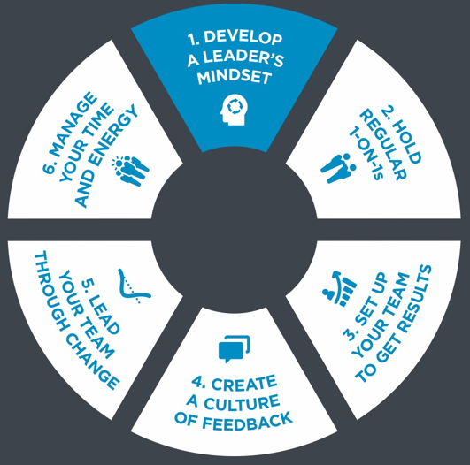
Introduction & Practice 1: Develop a Leaders Mindset Weeks 1 & 2 of OnDemand Course
Common Mindset:
I am a responsible for my results.
Effective Mindset:
I am responsible for delivering results through other people.
Notes:
Pre-Work: . Have participants come prepared with their downloaded responses from the OnDemand Course, Mindsets Self-Assessment and Application Challenge
Opening: Provide context for why they are taking this course. Reiterate the investment int their learning and tie to larger organizational initiatives
Introduction: Show only the Common Mindset. Ask the group what the Effective Mindset is. Draw out the differences in the to mindsets. What stood out to them? Share your own preliminary insights

Slide 11
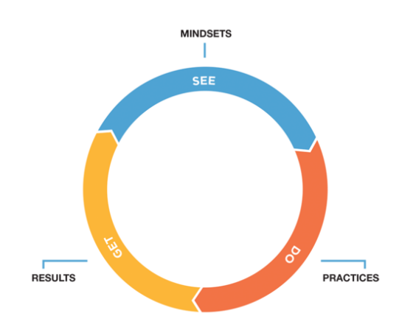
The Power of Mindsets – Practice 1
Breakout 1 – Groups of 3
Discussion Questions (10-15 minutes)
Reflect on ways that you may be looking through the Common Mindset of being responsible for the results of your team, and what the impact might be.
Discuss the areas that you want to focus on most throughout this course.
What actions can you do to make the mindset shift and display that shift to your team?
Notes:
See-Do-Get: Ask if anyone can describe the See-Do-Get Cycle. Gather their responses and the impact of this model. “The results we GET in our lives depend on what we DO. What we DO depends on how we SEE the world around us. If you want to change your results, start by changing how you see the world, or your mindset, because your mindset has a profound impact on the results you achieve.”
Breakout 1: Remind the group to have their Mindset Self-Assessment ready (10 – 15 minutes)
Whole Group Debrief: (5-10 minutes) Who would like to share what they discussed and any insights they had?

Slide 12
Effective Mindsets – Practice 1 Application Challenge
Effective Mindsets
I am responsible for delivering results through other people.
I hold regular 1-on-1s to help people get— and stay—engaged.
I help people get clear about the “why” behind the “what” and support them in the “how.”
I give and seek feedback to elevate the entire team.
I help team members understand their roles in—and support them through—change.
I must manage my time and energy to be an effective leader.
Breakout 2 – Groups of 3
Discussion Questions (5 - 10 Minutes)
Share leadership attributes that you value and respect in other leaders and why.
Identify the behaviors of those attributes (for example, ‘thoughtful listener’).
Share your plan to follow though on one good behavior and/or avoiding one bad behavior this week.
(Work on Personal Mission Statements if there is time.)
Notes:
Effective Mindsets: (don’t’ show answers) Ask the group who can share some examples of Effective Mindsets. Gather responses and then share answers.
Breakout 2: (10 – 15 minuets)
Whole Group Debrief: (5-10 minuets) Who would like to share what they discussed and any insights they had?
Closing: Key takeaways and committed actions to next steps (hear from everyone if group is small or ask for a few if group is larger)
Additional Discussion Questions (optional)
What are the 1-3 leadership attributes you value?
How will you build strong relationships up and across?
What is your plan to shape your reputation as a leader?
What is most difficult for you making the mindset shift?
OPTIONAL - Individual Exercise –Create your personal leadership mission statement and action plan (10 – 15 Minutes)
Brainstorm:
Your strengths; What motivates you; What you want to accomplish in your career; Attributes that you respect in other leaders; What does your team and organization need most
Organize into a statement:
Focus on key aspects that excite you most and decide what you want to be known for as a leader.
Incorporate aspects that will help you get where you want to go in your career and align with what your team and organization needs.
Action Plan:
List actions you’ll need to take in order to fulfill your personal statement with accountability check-points.

Slide 13
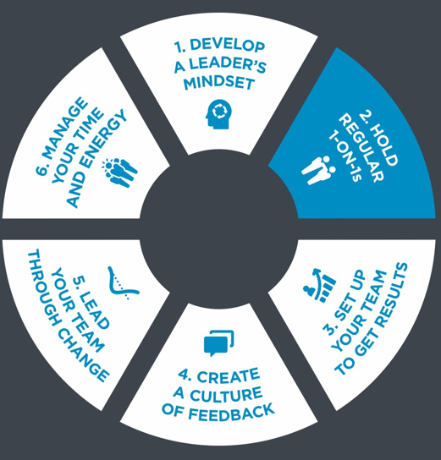
Practice 2: Hold Regular 1-on-1s Weeks 3 & 4 of OnDemand Course
Common Mindset:
I hold 1-on-1’s to check on people’s progress
Effective Mindset:
I hold regular 1-on-1’s to help people get, and stay, engaged.
Notes:
Pre-Work: . Have participants come prepared with their downloaded responses from the OnDemand Course, Mindsets Self-Assessment and 1-on-1 Prep for Manager
Introduction: Show only the Common Mindset. Ask the group what the Effective Mindset is. Draw out the differences in the to mindsets. What stood out to them? Share your own preliminary insights

Slide 14
1-on-1 Prep Sheet – Practice 2
Simple 1-on-1 Tips
Hold 1-on-1s at regular internals
Schedule at least 30 minutes for each meeting
Use the prep worksheet to identify priority topics
Draw out issues and interests with Empathetic Listening and Coaching question s
Help team members find solutions rather than solve problems for them.
Breakout 1 - Groups of 3
Discussion Questions - (10 -15 minutes)
Share your current thoughts on your 1:1s after completing the course, what could you improve?
Share an example 1-on-1 Prep Sheet for an individual on your team – maintain confidentiality by not sharing the team member's name
Provide insight and feedback
Notes:
1-on-1 Tips: (don’t show answers) Ask if anyone can share some 1-on-1 tips, gather thoughts from the group, then share answers.
Breakout 1: (10 – 15 minutes)
Whole Group Debrief: (5-10 minutes) Who would like to share what they discussed and any insights they had?
Transition to Empathetic Listening – What are some Do’s and Don’ts for Empathetic Listening? Why is it important?

Slide 15
Empathetic Listening – Practice 2 What are some Do’s and Don’ts for Empathetic Listening?
DO
Reflect Content: Put the meaning of the person’s words in your own words
“So you’re saying______”
Reflect Feeling: Concentrate on and echo the way the person feels.
“You’re frustrated about _______”
DON’T
Judge : Agree or disagree
“I couldn’t agree more”
“I don’t agree”
Jump to Conclusions: Ask questions based on assumptions
“So you want to quit, is that it?”
Advise: Recommend solutions or give counsel
“When I was in that Situation_______”
“You should______”
Notes:
Let’s review the Do’s and Don’ts of Empathetic listening.
Who remembers some Do’s? Hear from group and then share answers.
Who remembers some Don’ts? Hear form group and then share answer

Slide 16
Coaching Questions – Practice 2
Three Types of Coaching Questions
Clarifying: Seek to understand
“When you say ____ what does that mean?” “Can you tell me more?”
2. Open-ended: Create space to explore options
“How would you address that?”
3. Insightful: Tap into the creative brain
“Supposing you could_____, what would you do?
1-on-1 Question Prompts
What can I do to help with your work?
What are you most concerted about?
What’s your biggest challenge? Why?
What’s the biggest opportunity we’re missing out on?
What are we not doing that we should be doing?
One a sale of 1-10, how happy are you working here?
What development areas do you want to work on this week?
What have you learned this last week?
Notes:
Let’s review Coaching Questions
Who remembers a type of coaching questions? Hear from group and ask for examples of each before sharing the answers.
Who remembers some 1-on-1 question prompts? Hear form group and then share answer

Slide 17
1-on-1 Application Challenge – Practice 2 What’s being left unsaid?
Individual Exercise - (10 minutes)
Review the list of your direct reports and plans for your next 1-on-1
For each person you listed, ask yourself: What haven’t we talked about lately? Frequently avoided topics include:
Role satisfaction: Even if they were content in their job last quarter or last month, are they today?
Work/life balance: Is burnout a possibility for anyone?
Weak relationships: Is everyone collaborating effectively with their team members, colleagues, and you?
Career/development goals: Do you know what each person’s goals are and have a plan for helping them get there?
Recognition: Do your top performers know how valuable they are — and do you know how they prefer to be recognized?
Underperformance: Do your strugglers know where they stand and how to improve?
Notes:
1-on-1 Application Challenge: Each participant reviews their application challenge and makes improvements to their plan. Remind participants to maintain anonymity in their discussions.
If there is time, have participants share and discuss insights in groups of 3 first and then debrief with larger group.
Whole group debrief: Who would like to share their insights and plans? How is this different from what you typically do in your 1-on-1?
Closing: Key takeaways and committed actions to next steps (hear from everyone if group is small or ask for a few if group is larger)
Additional Discussion Questions (optional)
What cadence did you choose for your 1-1’s?
Walk me through your prep sheet for an upcoming 1-1
What do you do when someone’s not sharing in their 1-1?

Slide 18
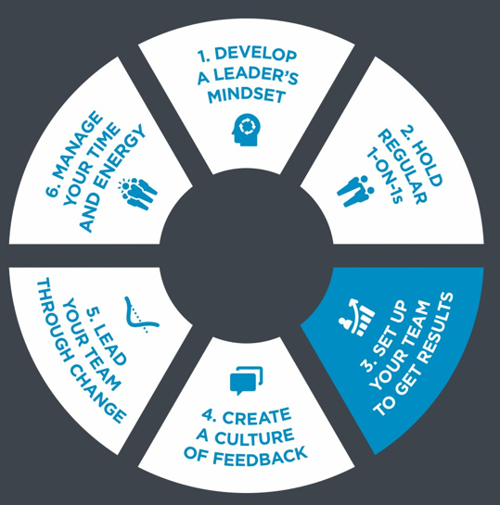
Practice 3: Set Up Your Team to Get Results Weeks 5 & 6 of OnDemand Course
Common Mindset:
I tell team members what to do and how to do it.
Effective Mindset:
I help people get clear about the “why” behind the “what” and support them in the “how”.
Notes:
Pre-Work: Have participants come prepared with their downloaded responses from the OnDemand Course, Mindsets Self-Assessment and Delegation Planner
Introduction: Show only the Common Mindset. Ask the group what the Effective Mindset is. Draw out the differences in the to mindsets. What stood out to them? Share your own preliminary insights

Slide 19
The WHY & WHAT – Practice 3
Individual Exercise
(5 minutes)
Review and refine your responses from the course
Breakout Groups of 3
Discussion Questions - (15 minutes)
Each person shares their WHY and WHAT (5 minutes a person)
Group members provide feedback and insight, learn together!
WHY
What are the top three priorities of your department?
What are your manager's most important goals?
How does your team contribute to your department's priorities and your manager's goals?
WHAT
Define your desired results
Clarify your outcomes
Refine your Goals
.
Notes:
Why: (don’t’ show answers) What questions helped you to identify your why? Why are these questions important? Share answers and gather reactions.
What: (don’t’ show answers) What questions helped you identify your what? Why are these questions important? Share answers and gather reactions.
Individual Exercise: (5 minutes)
Breakout Groups: (15 minutes)
Whole Group Debrief: (5-10 minutes) Who would like to share what they discussed and any insights they had?

Slide 20
The HOW: What’s important? – Practice 3
Guidelines: The standards and conditions that must be met.
Resources: The people, budget, tools, etc., required to complete the work.
Accountability: How to track progress and be accountable.
Consequences: How each party benefits from successful achievement of the work, as well as what will happen if the work is not completed.
Notes:
How: (Don’t show answers) First ask the group if they remember any steps form the how and why they are important. Then share the answers.
Transition to Delegation: Once you know the How, you can start to assign tasks and get things done!

Slide 21
How to Delegate – Practice 3
State the WHY: Clarify why the work is important.
State the WHAT: Be specific about the “From X to Y by When” format: what success looks like and how success will be measured.
Discuss the HOW:
Guidelines: The standards and conditions that must be met.
Resources: The people, budget, tools, etc., required to complete the work.
Accountability: How to track progress and be accountable.
Consequences: How each party benefits from successful achievement of the work, as well as what will happen if the work is not completed.
Breakout Groups of 3
Discussion Questions (15 minutes)
Each person shares their Delegation Planner (5 minutes a person)
Group members provide feedback and insight, learn together!
.
Notes:
Delegate: Who can tell me the steps to delegation? Here for the group and then share answers
Breakout Groups: (15 minutes)
Debrief in whole group/ Closing: Key takeaways and committed actions to next steps (hear from everyone if group is small or ask for a few if group is larger)
Additional Discussion Questions (optional)
Share with me how you selected and shaped your team goals.
How do you plan to delegate so that it develops your team?
How will you hold your team accountable?

Slide 22
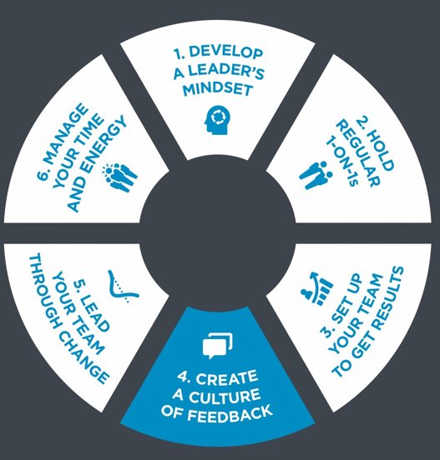
Practice 4: Create a Culture of Feedback Weeks 7 & 8 of OnDemand Course
Common Mindset:
I give feedback so I can fix people’s problems.
Effective Mindset:
I give and seek feedback to elevate the entire team.
Notes:
Pre-Work: Have participants come prepared with their downloaded responses from the OnDemand Course and Giving Feedback Planner
Introduction: Show only the Common Mindset. Ask the group what the Effective Mindset is. Draw out the differences in the to mindsets. What stood out to them? Share your own preliminary insights

Slide 23
Honest, Accurate Feedback – Practice 4 What are some Do’s and Don’ts?
DO
Clarify Your Intent: intent is to help the other person learn and grow.
Share Specific Observations: facts of what you’ve seen
Describe the Impact: state outcomes the behavior has produced
Ask for/Offer Suggestions as Needed: Explore ways to repeat positive behaviors (reinforcing) or adopt new behaviors (redirecting)
DON’T
Use Generic Language: Vague or extreme statements may sound insincere
Make Assumptions: Feedback that’s based on wrong assumptions is not valid. Ensure you have the facts about a situation to give accurate feedback.
Notes:
Let’s review the Do’s and Don’ts of providing honest, accurate feedback
Who remembers some Do’s? Hear from group and then share answers.
Who remembers some Don’ts? Hear form group and then share answer

Slide 24
Two Types of Feedback – Practice 4
Reinforcing
Share it when you catch team members doing the right thing. This feedback:
Highlights behaviors that positively impact results.
Inspires team members to repeat these behaviors moving forward.
Builds team members' confidence and competence.
Creates a culture in which people feel respected and appreciated.
Redirecting
Share it when you see opportunities for development. This feedback:
Raises team members' awareness of undesirable behaviors.
Highlights the impact of those behaviors on team performance and results.
Clarifies expected future behaviors.
Communicates belief in team members' abilities to improve performance.
Notes:
Let’s Review the two types of feedback
Who remembers the two types of feedback? Hear from group and draw them out on what each one means, then share answers.

Slide 25
Giving Feedback Planner – Practice 4
Individual Exercise
(5 minutes)
Refine your planner
Breakout Groups of 3
(15 minutes)
Each person shares their planner (5 minutes a person)
Group members provide feedback and insight, learn together!
Be sure to maintain anonymity!
Notes:
Giving Feedback Planner: Have learners get out their feedback planner
Individual Exercise: (5 minutes)
Breakout Groups: (15 minutes)
Whole Group Debrief: (5-10 minutes) Who would like to share what they discussed and any insights they had?
Feedback Do and Don’t
What are you doing well? Where can you improve?

Slide 26
Seeking Feedback – Practice 4
What’s the value?
Provides you with information to help improve and build upon your strengths and correct your weaknesses
It can build communication, trust and teamwork.
What makes it difficult?
It’s not a priority
It takes humility
You need to be ok with hearing things you might not want to hear
If you ask for feedback, you need to act on it
What influences the quality of feedback you get from others?
Level of trust
Ability to listen
Experience working together
Respect
Setting of the feedback conversation
Asking for specific feedback on a situation that a person was directly involved in.
Notes:
1. Seeking Feedback: Giving feedback is an important skill, but almost more important is seeking feedback. Let’s break this down
What’s the value? – (don’t show answers) hear from group and then share answers
What makes it difficult? – (don’t show answers) hear from group and then share answers
What influences the quality of feedback you get from others? - (don’t show answers) hear from group and then share answers

Slide 27
Seeking Feedback Guidelines – Practice 4
Declare your intent: let the other person know why you want feedback
Ask for specific feedback: I’ve been working on…. How could I get better?
Listen empathetically: listen to understand, not to explain or defend yourself.
Acknowledge the feedback: “Thanks for the feedback. Let me think about how I can apply it.”
Evaluate the feedback: Use good judgement to determine what to do with the feedback.
Commit to action: Make commitments carefully and keep them
Notes:
Seeking Feedback Guidelines: Before we practice, let’s review the seeking feedback guidelines, Does anyone remember what they are?

Slide 28
Seeking Feedback Role Play – Practice 4
Breakout Groups of 3
(10 minutes for role play and 5 minutes for observer to share notes)
There are 3 roles in this exercise
Requesting feedback from manager
Manager being requested for feedback
Observe and note taker
Role 1: Follow the Seeking Feedback Guidelines and requests feedback from manager.
Role 2: Follow the Giving Feedback Guidelines
Role 3: Observes and takes notes
Notes:
Role Play Set up: Review instructions on slide, break up groups in 3, have them decide who is doing which role. Start timer.
During Role Play: Show Seeking feedback slide once role play is set up
Debrief in whole group/ Closing: Key takeaways and committed actions to next steps (hear from everyone if group is small or ask for a few if group is larger)
Additional Discussion Questions (optional)
What positive and redirecting feedback did you share with your team?
What feedback did you receive? Did you thank them?
Share with me your plan for redirecting feedback

Slide 29
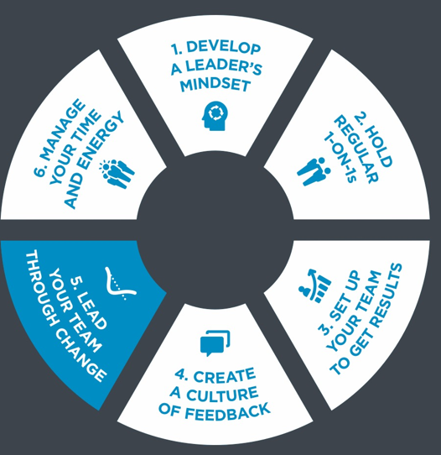
Practice 5: Lead Your Team Through Change Weeks 9 & 10 of OnDemand Course
Common Mindset:
I control and contain change for my team.
Effective Mindset:
I champion change with my team.
Notes:
Pre-Work: Have participants come prepared with their downloaded responses from the OnDemand Course and Change Worksheet
Introduction: Show only the Common Mindset. Ask the group what the Effective Mindset is. Draw out the differences in the to mindsets. What stood out to them? Share your own preliminary insights

Slide 30
5 Common Reactions to Change – Practice 5 Advantages and Disadvantages
Move: Quickly charge into action
Minimize: Change as little as possible
Wait: Do nothing until others change
Resist: Dislike a change and convince others to fight it
Quit: Go elsewhere, or stay but don’t engage
Breakout Groups of 3 (10-15 minutes)
Each person shares their top common reactions to change with a story involving a change in during their career.
Group discusses the advantages and disadvantages of their common reactions to change.
Notes:
Let’s talk about the advantages and disadvantages of the 5 Common Reactions to Change – Show each Reaction and ask the group to share. Answers are below for you to drive the conversation.
Move: Quickly charge into action
Advantages:
Not stuck in the old way.
Willing to try new things.
Easy to motivate.
Always looking to experiment.
Disadvantages:
May act too quickly or without full information.
Can leave others behind.
Minimize: Change as little as possible
Advantages:
Focuses on what is necessary.
Avoids unnecessary disruption.
Tries new things to test them out, but doesn't overcommit.
Disadvantages:
May do little to change and get little from it.
May have lower commitment.
Wait: Do nothing until others change
Advantages:
Asks great questions about the change.
Doesn't rush into the change without careful consideration.
Disadvantages:
Slower to adopt change.
May slow progress of others.
May miss opportunities.
Resist: Dislike a change and convince others to fight it
Advantages:
Tests the thinking behind a change, seeks alternatives.
Asks questions that reveal potential obstacles to address.
Counterbalances enthusiasm.
Disadvantages:
Can slow progress.
May create conflict.
May cause invalid concern.
Quit: Go elsewhere, or stay but don’t engage
Advantages:
Early warning signal.
Quitting one thing is moving to another.
Disadvantages:
Creates fallout.
May fail to grow through hard experiences.

Slide 31
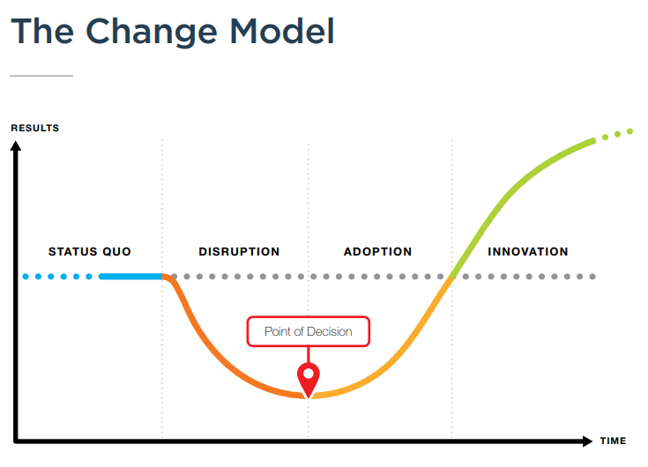
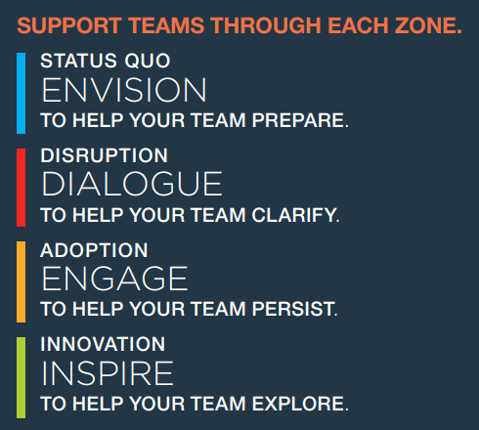
The Four Zones of Change – Practice 5
Notes:
Change Model: Who can remember the 4 zones of change? Hear from group and then share the model image
Team Support: Who can remember the best way to support our teams through each zone? Hear from the group and share image

Slide 32
Change Worksheet – Practice 5
Individual Exercise
(5 minutes)
Refine your worksheet
Breakout Groups of 3
(15 minutes)
Each person shares their worksheet (5 minutes a person)
Group members provide feedback and insight, learn together!
Be sure to maintain anonymity!
Notes:
Change Worksheet: Have participants take out their change worksheet
Individual Exercise: (5 minutes)
Breakout Groups of 3: (15 minutes)
Debrief in whole group/ Closing: Key takeaways and committed actions to next steps (hear from everyone if group is small or ask for a few if group is larger)
Additional Discussion Questions (Optional)
How will you mentally adjust to change?
How will you handle someone that opposes change?
What is your plan to guide your team through change?

Slide 33
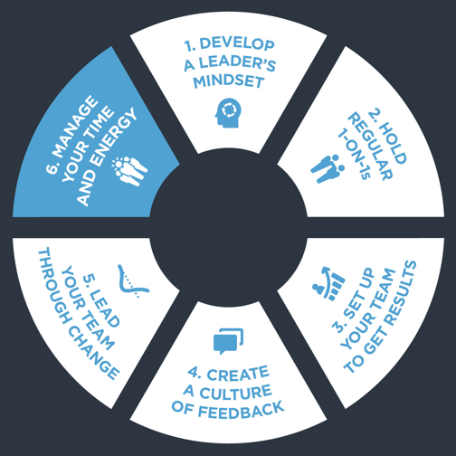
Practice 6: Manage Your Time and Energy Weeks 11 & 12 of OnDemand Course
Common Mindset:
I am too busy to take time for myself.
Effective Mindset:
I must manage my time and energy to be an effective leader.
Notes:
Pre-Work: Have participants come prepared with their downloaded responses from the OnDemand Course and Weekly Plan & Energy Driver Assessment
Introduction: Show only the Common Mindset. Ask the group what the Effective Mindset is. Draw out the differences in the to mindsets. What stood out to them? Share your own preliminary insights

Slide 34
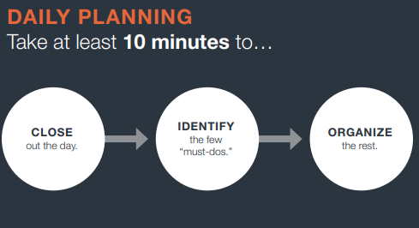
Important vs. Urgent – Practice 6 What’s the difference?
Notes:
Important vs Urgent: (Don’t show images) What’s the difference between important and Urgent? Here from the group, draw them out to hear examples
Weekly & Daily Planning: How do you plan your weeks and days? What are some things you learned from the course on planning? Hear for the group and then share images

Slide 35
Big Rocks and Weekly Plan – Practice 6
Individual Exercise
(5 minutes)
Refine your Big Rocks and Weekly Plan worksheets
Breakout Groups of 3
(15 minutes)
Each person shares their worksheets (5 minutes a person)
Group members provide feedback and insight, learn together!
Notes:
Weekly Plan: Have participants take out their Weekly Planning Sheet
Individual Exercise: (5 minutes)
Breakout Groups of 3: (15 minutes)
Debrief in large group: What insights did you have as a group? Any questions that you have?

Slide 36
5 Energy Drivers – Practice 6 Why are they important?
SLEEP
I sleep the same amount each night.
I get good-quality sleep each night.
RELAX
I have effective coping strategies to deal with stress.
My lifestyle supports my ability to manage stress.
CONNECT
I connect regularly with important people in my life.
I have relationships at work that I value.
MOVE
I get up and move throughout the workday.
I have a consistent exercise program.
EAT
I eat nutritious food at every meal.
The way I eat provide
Notes:
5 Energy Drivers: (don’t’ show answers) Who can remember what the 5 energy drivers are? Call on each person to share and draw our why they are important. Then share answers and hear more from the group
Energy influences not only what we can accomplish, but how much we enjoy what we do. Yet, so many of us are worn down and worn out by the urgencies of life. These sources of energy can help us establish patterns of constant renewal.

Slide 37
Energy Drivers Assessment – Practice 6
Individual Exercise
(5 minutes)
Refine your Energy Drivers Assessment
Breakout Groups of 3
(15 minutes)
Each person shares their assessment (5 minutes a person)
Group members provide insight, learn together!
Only share what you are comfortable sharing
Notes:
Energy Drivers Assessment: Have participants take out their Energy Drivers Assessment
Individual Exercise: (5 minutes)
Breakout Groups of 3: (15 minutes)
Debrief in whole group/ Closing: Key takeaways and committed actions to next steps (hear from everyone if group is small or ask for a few if group is larger)
Capstone Expectations (Optional)
Additional Discussion Questions (Optional)
What are your top priorities?
Have you added your planning sessions to your calendar?
How do you manage your stress?

Slide 38
What’s Next? Track Alternative Usage
IMPORTANT! Tracking Alternative Usage
Once you are done with the Flipped Classroom, you will need to make sure you are tracking usage for the VHA contract.
What qualifies as Alternative Usage?
Below are a few examples of the types of usage we need your help tracking!
Instructor Led (In-person or Online) - Full or portions of courses. If you track in TMS, no need to double report.
Facilitator Certification Completion of any FranklinCovey Course
If you share ANY content from FranklinCovey (Articles, videos, tools, etc.) during any of the below forums, please let us know:
Lunch and Learns
Flipped Classrooms
Town Halls
Newsletters
Sent via email, MS Teams and other platforms
Posted in digital platform
How to track Alternative Usage:
Any time you identify Alternative Usage within your facility, please let us know so we can award usage to your facility.
Complete the simple survey here.
Approximately when was the content delivered?
How many VHA Employees participated in the training?
What and how did you share the information?
Please reach out to VACare@FranklinCovey.com if you have any questions
Notes:
NOTE: you will want to provide links to your learners. These links are available through the library under Materials as long as you have admin or facilitator credentials. The learners can also find them under “additional resources” “cards/tools” for 5 Choices.

