Slide 1
Greatness Starts Here.
7-Habits for Highly Effective People
Flipped Classroom Guide
Veteran’s Health Administration

Slide 2
What is The Flipped Classroom approach?
A type of blended learning, which aims to increase engagement by having learners complete course content independently first and then gather live with colleagues to debrief learnings and discuss application.
Benefits of the flipped classroom approach with OnDemand courses:
Saves facilitation certification and delivery resources by leveraging OnDemand content
Provides flexibility for learners to have access to courses at any time
Maximizes the time spent together live with discussion and application
Creates a sense of community for learners that want to develop their skills

Slide 3
Preparation
Notes:
This is the backup slide if the CP wants a more conditional statement

Slide 4
End-to-End Impact Platform Flipped Class Process
Create Team in Impact Platform
Assign Course in Impact Platform
Email Participants with Context
Schedule Sessions and Send Invites
Lead Discussion Sessions
Optional Participant Capstone Presentation

Slide 5
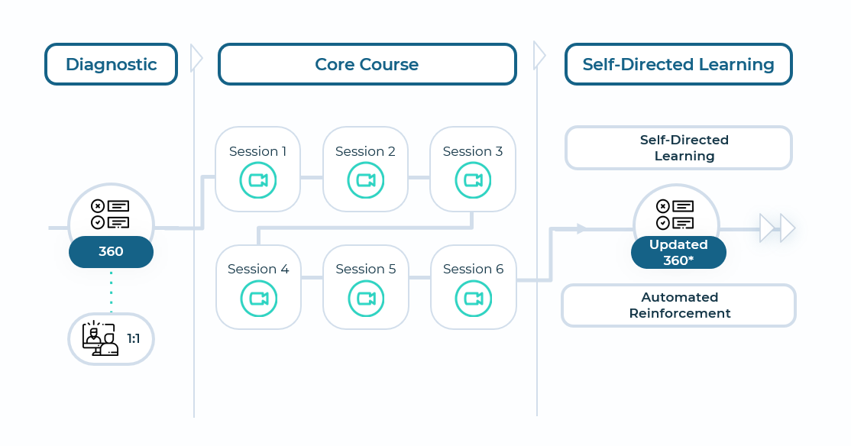
The 7 Habits Of Highly Effective People®
Habits are powerful forces in our lives. They determine our level of effectiveness or ineffectiveness. The purpose of The 7 Habits of Highly Effective People is to help you lead your life in a truly effective way. They represent a proven process of personal and interpersonal growth that can have an immediate and lasting impact.
1
Outcomes
2
Schedule & Commitment
Individuals will learn how to develop increased maturity, greater productivity, and the ability to manage one’s self.
Individuals will also execute critical priorities with laser-like focus and careful planning.
Team engagement, morale, and collaboration will increase.
Team communication and relationship skills will improve.
Organizations will create a framework for developing core values and creating a highly effective culture.
DATE RANGE 16 weeks
Weekly Automated assignments: 30-minutes
Bi-weekly live debrief sessions: 1-hour
3
Course Link
7 Habits of Highly Effective People

Slide 6
Initial Participant Email Send directly after course is assigned in the Impact Platform
Hello Leaders,
We are excited to share that we’ve invested in a relationship FranklinCovey to support your development! FranklinCovey is a leader in impacting the four areas that matter most to our long-term success: leadership, individual effectiveness, culture, and achieving strategic goals.
You’ve been assigned the 7 Habits of Highly Effective People OnDemand course in their Impact Platform. Course objectives are:
Execute critical priorities with laser-like focus and careful planning.
Increase team engagement, morale, and collaboration.
Improve team communication, relationships and culture
This 16-week course consists of engaging content, application challenges and educational articles. The time commitment is only 30-minutes a week for OnDemand completion and 1-hour every two weeks to attend a live debrief session. Please arrive at each session with your downloaded responses and application challenges. We appreciate you prioritizing this investment in yourself! (If relevant, include Capstone information here)
To access the Impact Platform, you should have received an email from learning@app.franklincovey.com alerting you that you’ve been assigned to the course. Please login and follow the prompts to activate your account and then bookmark the site as a favorite in your browser for easy access in the future. If you have trouble please refer here or send me a note.
Please reach out with any questions.
Thank you for your engagement and participation!

Slide 7
Session Reminder Email Send three days before the session
Hello Leaders,
This is a friendly reminder that your 7 Habits of Highly Effective People Discussion session is coming up on DATE. You should have a calendar invite.
We’re investing in this program as part of our commitment to your learning and development (include any additional organizational strategies that this ties into and benefits for the learner).
Pre-work for this session is:
Complete modules X and X (total 1-hour)
Come prepared with your downloaded responses and application challenges (be specific here, ‘delegation planner’ etc.)
Be ready to engage, listen and learn!
To access the 7 Habits of Highly Effective People , you should have received an email from learning@app.franklincovey.com alerting you that you’ve been assigned to the course and have created an account (include any SSO if relevant). If you have trouble please refer here or send me a note.
Please reach out with any questions.
Thank you for your engagement and participation!

Slide 8
Capstone Presentation- Optional Participants present to leadership after the course is complete
Purpose/Benefits:
Participants share their key takeaways and how they will apply the new tools they’ve learned to their work
Instills deeper engagement and commitment to learning the tools and changing behavior
Participants gain exposure with leadership and celebrate their commitment to development
Generate interest from other leaders/departments to participant in a future course
Timing:
Capstones can be done right at the end of a course where learners will discuss their immediate takeaways that they will apply. Or you can schedule them 1-2 months after the course is complete and have leaders report on what tools they’ve applied and how it’s impacted their work, team, organization.
Presentations should only be about 7-10 minutes.
Instructions:
Chose 2 or 3 Habits that were most impactful to you
Share how you’ve applied learnings with your team
Describe the impact from applying the tools on your team
Discuss any benefits these tools have to the entire organization

Slide 9
Discussion Sessions

Slide 10
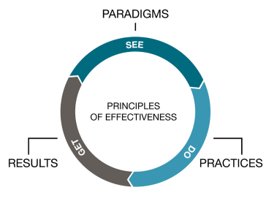
Paradigms and Principles of Effectiveness Weeks 1 & 2 of OnDemand Course
Breakouts – Groups of 3
1. Discussion Questions (10 – 15 minutes)
Where would you like to be more effective?
What new habit have you built into your daily routine?
2. Discussion Questions (10 - 15 minutes)
Share your action plan (if you are comfortable)
Share a paradigm shift you’ve experience (if you are comfortable)
Notes:
Pre-Work: . Remind participants to have their download their responses from the OnDemand Course and be prepared to share their new habit action plan
Opening: Provide context for why they are taking this course. Reiterate the investment int their learning and tie to larger organizational initiatives
Introduction: Show only the Principles of Effectiveness visual. Ask the group their first reactions to the course and the concepts of paradigms. What stood out to them? Share your own preliminary insights
Breakout 1: (10 – 15 minutes)
Whole Group Debrief: (5-10 minutes) Who would like to share what they discussed and any insights they had?
Breakout 2: (10 – 15 minuets)
Whole Group Debrief: (5-10 minuets) Who would like to share what they discussed and any insights they had?
Closing: Key takeaways and committed actions to next steps (hear from everyone if group is small or ask for a few if group is larger)

Slide 11
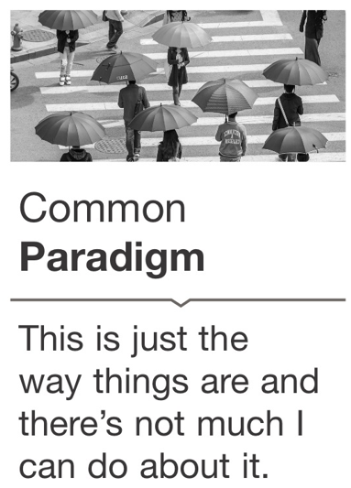
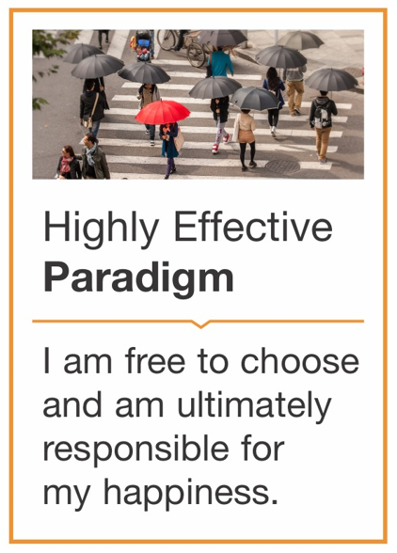
Habit 1: Be Proactive Weeks 3 & 4 of OnDemand Course
Principles of Effectiveness
Responsibility – Choice – Accountability – Initiative – Resourcefulness
Notes:
Pre-Work: . Remind participants to have their download their responses from the OnDemand Course and be prepared to share their new habit action plan
Paradigm Introduction: Show only the Common Paradigm Visual. Ask the group who remembers the highly effective paradigm? Gather preliminary reactions Then reveal the Highly Effective paradigm, gather any final reactions. Share your own insights if needed.
Principles: Who can remember what principles go along with this paradigm? Here from the group and then share principles, gather any final thoughts.

Slide 12
Reactive vs. Proactive Language – Habit 1
Proactive Language:
I can
I’m sorry
I choose to
Let’s look at all other options
I will get this done
There must be something we can do
Reactive Language:
I can’t
It’s not my fault
I have to
We have no other choice
They won’t let me
Breakout 1 – Groups of 3
Discussion Questions (10 – 15 minutes)
Is there anything happening that is causing you to be reactive versus proactive? Is there a situation where you can change your response to be more proactive?
How does using Proactive language improve your working relationships?
Notes:
Reactive Language: (don’t show answers) Who remembers examples of reactive language? What does that sound like? Hear from the group and then reveal answers.
Proactive Language: What about proactive language, What does that sound like? Hear from the group and then reveal answers.
Breakout 1: (10 – 15 minutes)
Whole Group Debrief: (5-10 minutes) Who would like to share what they discussed and any insights they had?

Slide 13
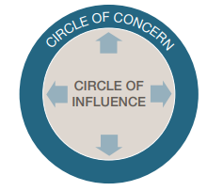
Habit 1: Circle of Influence – Habit 1
Breakout 2 – Groups of 3
Discussion Questions (10 – 15 minutes)
What actions have you taken within your Circle of Influence.
How has this approach impacted outcomes?
Notes:
Circle of Influence: Who can tell me what the circle of influence is? Hear from group and get their initial insights
Circle of Concern: What is the circle of concern? Hear from the group and get their initial insights
Breakout 2: (10 – 15 minuets)
Whole Group Debrief: (5-10 minuets) Who would like to share what they discussed and any insights they had?
Closing: Key takeaways and committed actions to next steps (hear from everyone if group is small or ask for a few if group is larger)

Slide 14
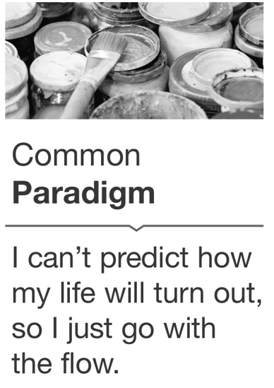
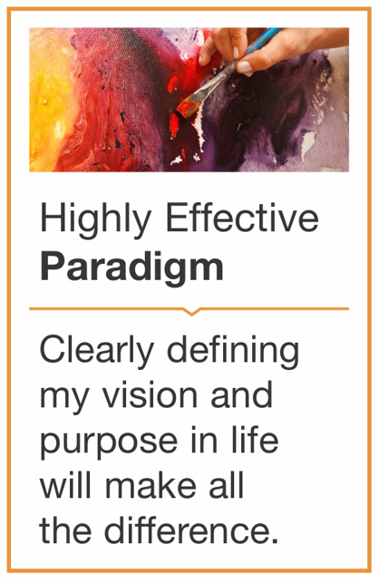
Habit 2: Begin with the End in Mind Weeks 5 & 6 of OnDemand Course
Principles of Effectiveness
Vision – Commitment – Purpose
Notes:
Pre-Work: . Remind participants to have their download their responses from the OnDemand Course and be prepared to share their new habit action plan
Paradigm Introduction: Show only the Common Paradigm Visual. Ask the group who remembers the highly effective paradigm? Gather preliminary reactions Then reveal the Highly Effective paradigm, gather any final reactions. Share your own insights if needed.
Principles: Who can remember what principles go along with this paradigm? Here from the group and then share principles, gather any final thoughts.

Slide 15
Personal Mission Statement – Habit 2
A Good Mission Statement:
Is based on principles of effectiveness.
Clarifies what is most important to you.
Provides direction and purpose.
Represents the best in you
Discovery Questions:
When am I at my best?
What do I really love to do at work? in my personal time?
What are my natural gifts and talents?
If I had unlimited time and resources, what would I choose to do?
What do I see as my most important future contribution?
Breakout 1 - Groups of 3
Discussion Questions (10 – 15 minutes)
Share your personal mission statement. How has creating your personal mission statement changed your daily interactions?
Is there an important relationship you have overlooked? What can you do to refocus on this relationship?
Notes:
Mission Statement: (don’t show answers) what are some aspects of a good mission statement? What questions can you ask yourself to create your mission statement?
Breakout 1: (10 – 15 minutes)
Whole Group Debrief: (5-10 minutes) Who would like to share what they discussed and any insights they had?
OPTIONAL Individual Exercise –Create your personal leadership mission statement and action plan (10 – 15 Minutes)
Brainstorm:
Your strengths
What motivates you
What you want to accomplish in your career
Attributes that you respect in other leaders
What does your team and organization need most
Organize into a statement: From what you’ve learned about your own strengths, passions, and goals, and the traits you admire in others, decide what you want to be known for as a leader. Focus in on one or two key aspects that excite you most, will help you get where you want to go in your career, and align with what your team and organization needs. Incorporate how you want to be seen as a leader from your team and manager.
Action Plan: List actions you’ll need to take in order to fulfill your personal statement with accountability check-points to ensure actions are completed.

Slide 16
Begin with the End in Mind – Habit 2
Define Outcomes for Everyday Situations
The start of every day, week, month, or year.
The start of every meeting.
The start of a new project or endeavor.
When you get ready for an important conversation.
Before you write an email, text, or post on social media.
Breakout 2 – Groups of 3
Discussion Questions (10 – 15 minutes)
Are the work activities that you can create a clear “end in mind” and purpose that would improve the project.
Is there a person or group where you can more clearly define your ‘end in mind’? What would that look like?
Notes:
End in Mind: (don’t show answers) Who can share some everyday situations where you can define desired outcomes? Hear from group and get their initial insights, then reveal answers.
Breakout 2: (10 – 15 minuets)
Whole Group Debrief: (5-10 minuets) Who would like to share what they discussed and any insights they had?
Closing: Key takeaways and committed actions to next steps (hear from everyone if group is small or ask for a few if group is larger)

Slide 17
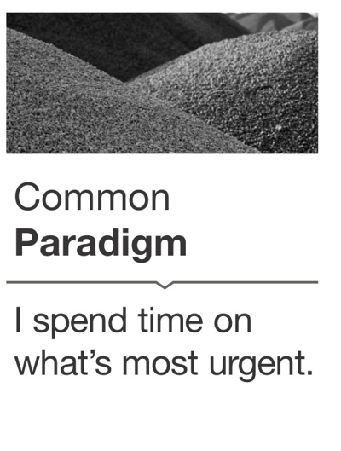
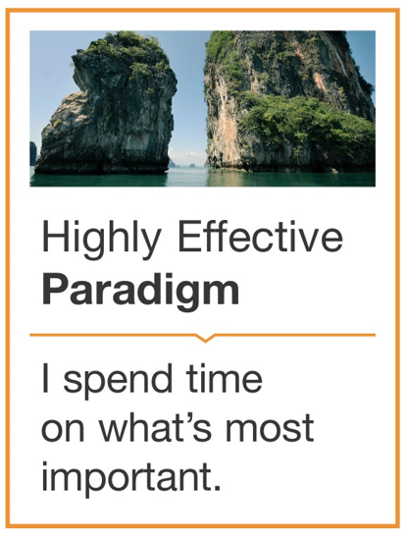
Habit 3: Put First Things First Weeks 7 & 8 of OnDemand Course
Principles of Effectiveness
Focus – Integrity – Discipline – Prioritization
Notes:
Pre-Work: . Remind participants to have their download their responses from the OnDemand Course and be prepared to share their new habit action plan
Paradigm Introduction: Show only the Common Paradigm Visual. Ask the group who remembers the highly effective paradigm? Gather preliminary reactions Then reveal the Highly Effective paradigm, gather any final reactions. Share your own insights if needed.
Principles: Who can remember what principles go along with this paradigm? Here from the group and then share principles, gather any final thoughts.

Slide 18
Focus on Your Highest Priorities & Eliminate the Unimportant – Habit 3
Breakout 1 – Groups of 3
Discussion Questions (10 – 15 minutes)
In what quadrant do you currently spend most of your time?
What one Q3 or Q4 thing could you eliminate to free up time, attention and energy for Q2?
Notes:
4 Quadrants: (don’t show image) Who can remember the 4 quadrants? Hear from the group and then share visual. Gather some initial reactions.
Breakout 1: (10 – 15 minutes)
Whole Group Debrief: (5-10 minutes) Who would like to share what they discussed and any insights they had?

Slide 19
Focus on Your Highest Priorities & Eliminate the Unimportant – Habit 3
Breakout 2 – Groups of 3
Discussion Questions (10 – 15 minutes)
What are your big rocks?
What are the one or two most important things that if you accomplished would have the biggest impact in your role?
Share your action plan
Notes:
Big Rocks: (don’t show answers) What are ‘big rocks’? Hear from group and get their initial insights, then reveal answers.
Breakout 2: (10 – 15 minuets)
Whole Group Debrief: (5-10 minuets) Who would like to share what they discussed and any insights they had?
Closing: Key takeaways and committed actions to next steps (hear from everyone if group is small or ask for a few if group is larger)

Slide 20
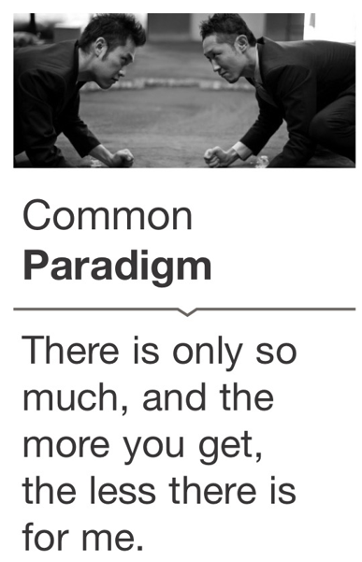
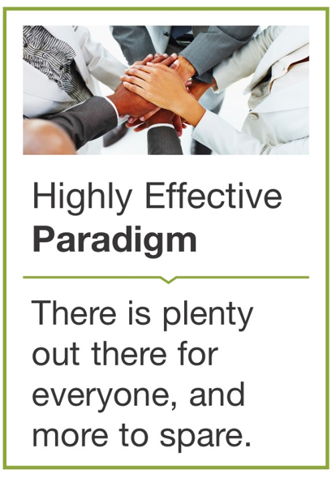
Habit 4: Think Win-Win Weeks 9 & 10 of OnDemand Course
Principles of Effectiveness
Mutual Benefit – Fairness – Abundance
Notes:
Pre-Work: . Remind participants to have their download their responses from the OnDemand Course and be prepared to share their new habit action plan
Paradigm Introduction: Show only the Common Paradigm Visual. Ask the group who remembers the highly effective paradigm? Gather preliminary reactions Then reveal the Highly Effective paradigm, gather any final reactions. Share your own insights if needed.
Principles: Who can remember what principles go along with this paradigm? Here from the group and then share principles, gather any final thoughts.

Slide 21
Abundance– Habit 4
Breakout Groups of 3
Discussion Questions (10 – 15 minutes)
Share an example of when you have been abundant with praise. Was it hard for you to give credit to someone else?
Have you focused on your Emotional Bank account? What are some deposits you have made recently? What are some withdrawals you have made?
Develop an Abundance Mentality
Stop comparing yourself to others.
Celebrate your own unique strengths and contributions.
Celebrate others’ successes.
Share compliments, praise, credit, and rewards liberally.
Notes:
Abundance Mentality: (don’t show answers) What are some ways we can start to develop an abundance mentality? Hear from the group and then share answers. Gather some initial reactions.
Breakout 1: (10 – 15 minutes)
Whole Group Debrief: (5-10 minutes) Who would like to share what they discussed and any insights they had?

Slide 22
Fairness & Mutual Benefit – Habit 4
Be Courageous
Talk Straight
Share your ideas and opinions with confidence
Welcome and listen to honest feedback from others.
Be Considerate
Demonstrate respect
Don’t interrupt
Acknowledge other people’s ideas and opinions
Make sure everyone has a change to speak and be heard
Breakout Groups of 3
Discussion Questions (10 – 15 minutes)
Do you have any relationships that you’d like to strengthen? How can you make progress with that person? (maintain anonymity)
Would people describe you as cooperative or competitive? Why?
Notes:
Be Courageous: (don’t show answers) what are some ways to be courageous with communication? Share answers and get reactions
Be Considerate: (don’t show answers) what are some ways to be considerate with communication? Share answers and get reactions
Breakout 1: (10 – 15 minutes)
Whole Group Debrief: (5-10 minutes) Who would like to share what they discussed and any insights they had?
Closing: Key takeaways and committed actions to next steps (hear from everyone if group is small or ask for a few if group is larger)

Slide 23
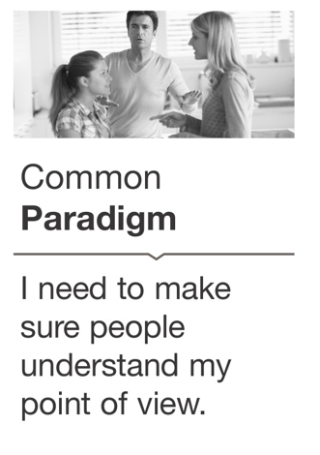
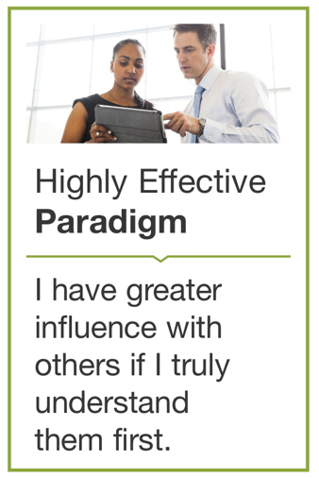
Habit 5: Seek First to Understand, Then to Be Understood Weeks 11 & 12 of OnDemand Course
Principles of Effectiveness
Respect – Mutual Understanding – Empathy – Courage
Notes:
Pre-Work: . Remind participants to have their download their responses from the OnDemand Course and be prepared to share their new habit action plan
Paradigm Introduction: Show only the Common Paradigm Visual. Ask the group who remembers the highly effective paradigm? Gather preliminary reactions Then reveal the Highly Effective paradigm, gather any final reactions. Share your own insights if needed.
Principles: Who can remember what principles go along with this paradigm? Here from the group and then share principles, gather any final thoughts.

Slide 24
Autobiographical Listening – Habit 5
Probe:
What happened?
What led up to this?
Why would you say that?
How's that working out?
Evaluate:
That was really smart.
I totally agree.
You are overreacting.
I'm not surprised.
Advise:
Here’s what I think
If I were you, I would
Have you thought about….?
How about looking at it this way?
Interpret:
You always do that because
I bet you wish you hadn’t.
You were probably trying to.
Breakout Group of 3
Discussion Questions (10 – 15 minutes)
How does listening with the intent to understand change your interactions?
How would you rate your ability to fully engage and listen without trying to respond?
Do you Probe, Evaluate, Advice or Interpret?
Notes:
Probe: (don’t show answers) what are examples of Probe listening? Share answers and get reactions
Evaluate: (don’t show answers) what are examples of Evaluating listening? Share answers and get reactions
Advise: (don’t show answers) what are examples of Advising listening? Share answers and get reactions
Interpret: (don’t show answers) what are examples of Interpret listening? Share answers and get reactions
Breakout 1: (10 – 15 minutes)
Whole Group Debrief: (5-10 minutes) Who would like to share what they discussed and any insights they had?

Slide 25
Empathetic Listening – Habit 5
Empathetic Listening Tips
Say, “Take your time… I’m listening,” and really mean it.
Focus on the other person’s point of view.
Put yourself in the other person’s shoes.
Ask clarifying questions to help the speaker explore his or her thoughts and feelings.
Don’t be in a hurry. Give the other person time and space to think.
Don’t worry about perfect. Focus on being genuine and empathic in body language and in the words you use.
Breakout Groups of 3
Discussion Questions (10 – 15 minutes)
What are some empathetic listening tips?
Share your application challenge on an upcoming meeting or conversation where you are going to practice ‘seeking first to understand’
Notes:
Empathetic Listening Tips: (don’t show answers) what are some ways to be to empathetic when you are listening? Share answers and get reactions
Breakout 1: (10 – 15 minutes)
Whole Group Debrief: (5-10 minutes) Who would like to share what they discussed and any insights they had?
Closing: Key takeaways and committed actions to next steps (hear from everyone if group is small or ask for a few if group is larger)

Slide 26
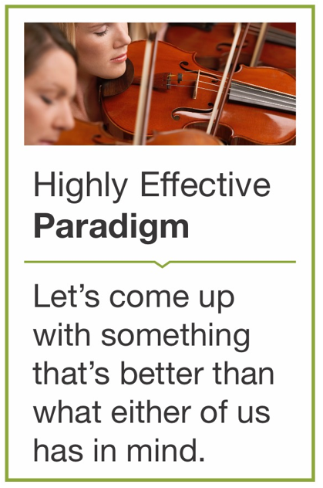
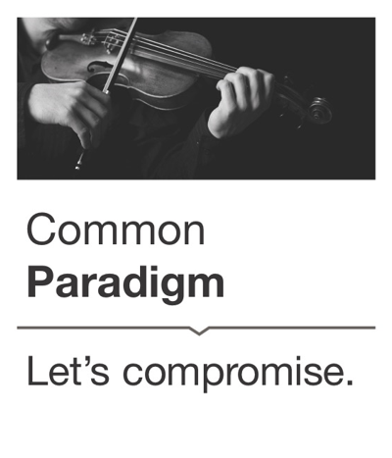
Habit 6: Synergize Weeks 13 & 14 of OnDemand Course
Principles of Effectiveness
Creativity – Cooperation – Diversity – Humility
Notes:
Pre-Work: . Remind participants to have their download their responses from the OnDemand Course and be prepared to share their new habit action plan
Paradigm Introduction: Show only the Common Paradigm Visual. Ask the group who remembers the highly effective paradigm? Gather preliminary reactions Then reveal the Highly Effective paradigm, gather any final reactions. Share your own insights if needed.
Principles: Who can remember what principles go along with this paradigm? Here from the group and then share principles, gather any final thoughts.

Slide 27
Value Differences – Habit 6
Ways to Value Differences
Respect, include, and value everyone’s skills and contributions
Know the unique strengths of the people you work and live with?
Actively seek to learn from others?
Seek out different ideas and points of view?
Take advantage of the strengths of others and differences of opinion to achieve better results?
Breakout Groups of 3
Discussion Questions (10 – 15 minutes)
What insights did you have about re-framing a challenging person in your life to see their strengths? (maintain anonymity)
What could you do today to take greater advantage of the strengths of others in your own work?
Notes:
Value Differences: (don’t show answers) what are ways that we can value differences? Gather from the group and then share answers and get reactions.
Breakout 1: (10 – 15 minutes)
Whole Group Debrief: (5-10 minutes) Who would like to share what they discussed and any insights they had?

Slide 28
Seek 3rd Alternatives– Habit 6
Breakout Groups of 3
Discussion Questions (10 – 15 minutes)
Share your plan for a next big decision. What different perspectives would you like to include?
How will you ensure the Synergize process is incorporated?
Notes:
Seek 3rd Alternatives : (don’t show image) What approaches help us seek 3rd alternatives? Hear from group and then share image
Breakout 1: (10 – 15 minutes)
Whole Group Debrief: (5-10 minutes) Who would like to share what they discussed and any insights they had?
Closing: Key takeaways and committed actions to next steps (hear from everyone if group is small or ask for a few if group is larger)

Slide 29
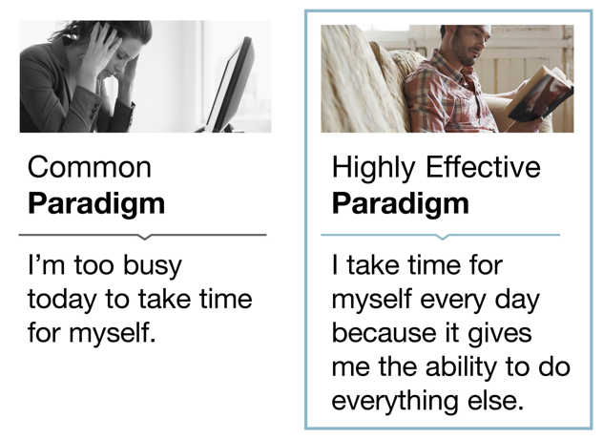
Habit 7: Sharpen the Saw Weeks 15 & 16 of OnDemand Course
Principles of Effectiveness
Renewal – Continuous Improvement – Balance
Notes:
Pre-Work: . Remind participants to have their download their responses from the OnDemand Course and be prepared to share their new habit action plan
Paradigm Introduction: Show only the Common Paradigm Visual. Ask the group who remembers the highly effective paradigm? Gather preliminary reactions Then reveal the Highly Effective paradigm, gather any final reactions. Share your own insights if needed.
Principles: Who can remember what principles go along with this paradigm? Here from the group and then share principles, gather any final thoughts.

Slide 30
Daily Self-Renewal– Habit 7
Breakout Groups of 3
Discussion Questions (10 – 15 minutes)
Share your Daily Private Victory, which renews the body, mind, heart and spirit.
What could you do every day to ensure you accomplish your Private Victory? Does anything get in the way of accomplishing this?
Notes:
Body: (don’t show image) What are some self-renewal actions for our body?
Mind: What are some self-renewal actions for our mind?
Heart: What are some self-renewal actions for our Heart?
Spirit: What are some self-renewal actions for our Heart? (hear from group and then share image)
Breakout 1: (10 – 15 minutes)
Whole Group Debrief: (5-10 minutes) Who would like to share what they discussed and any insights they had?

Slide 31
Work/Life Boundaries– Habit 7
Breakout Groups of 3
Discussion Questions (10 – 15 minutes)
Share your work/life boundary plan.
2. What habit are you working on first and what’s your plan to ensure progress?
Notes:
Body: (don’t show image) What are some self-renewal actions for our body?
Breakout 1: (10 – 15 minutes)
Whole Group Debrief: (5-10 minutes) Who would like to share what they discussed and any insights they had?
Closing: Key takeaways and committed actions to next steps (hear from everyone if group is small or ask for a few if group is larger)
Capstone Presentation Expectations - OPTIONAL

Slide 32
What’s Next? Track Alternative Usage
IMPORTANT! Tracking Alternative Usage
Once you are done with the Flipped Classroom, you will need to make sure you are tracking usage for the VHA contract.
What qualifies as Alternative Usage?
Below are a few examples of the types of usage we need your help tracking!
Instructor Led (In-person or Online) - Full or portions of courses. If you track in TMS, no need to double report.
Facilitator Certification Completion of any FranklinCovey Course
If you share ANY content from FranklinCovey (Articles, videos, tools, etc.) during any of the below forums, please let us know:
Lunch and Learns
Flipped Classrooms
Town Halls
Newsletters
Sent via email, MS Teams and other platforms
Posted in digital platform
How to track Alternative Usage:
Any time you identify Alternative Usage within your facility, please let us know so we can award usage to your facility.
Complete the simple survey here.
Approximately when was the content delivered?
How many VHA Employees participated in the training?
What and how did you share the information?
Please reach out to VACare@FranklinCovey.com if you have any questions
Notes:
NOTE: you will want to provide links to your learners. These links are available through the library under Materials as long as you have admin or facilitator credentials. The learners can also find them under “additional resources” “cards/tools” for 5 Choices.

