Slide 1
Greatness Starts Here.
Multipliers
Flipped Classroom Guide
Veteran’s Health Administration

Slide 2
What is The Flipped Classroom approach?
A type of blended learning, which aims to increase engagement by having learners complete course content independently first and then gather live with colleagues to debrief learnings and discuss application.
Benefits of the flipped classroom approach with OnDemand courses:
Saves facilitation resources by leveraging OnDemand content
Provides flexibility for learners to have access to courses at any time
Maximizes the time spent together live with discussion and application
Creates a sense of community for learners that want to develop their skills

Slide 3
Preparation
Notes:
This is the backup slide if the CP wants a more conditional statement

Slide 4
End-to-End Impact Platform Flipped Class Process
Create Team in Impact Platform
Assign Course in Impact Platform
Email Participants with Context
Schedule Sessions and Send Invites
Facilitate Learning Sessions
Optional Participant Capstone Presentation

Slide 5
Multipliers®: How the Best Leaders Ignite Everyone’s Intelligence
Leaders can’t afford to waste talent. They need people to innovate, to solve problems, to deliver results—and to be excited and engaged as they do so. Introducing Multipliers: How the Best Leaders Ignite Everyone’s Intelligence. In her research, leadership expert Liz Wiseman made a crucial discovery: There’s far more intelligence and energy inside organizations than we realize. Leaders are key to unlocking these capabilities.
1
2
3
Course Link
Outcomes
Schedule and Commitment
Leaders redirect their diminishing tendencies and allow teams to accelerate performance, for greater impact.
Employees are focused on the right problems and opportunities to accelerate progress and find the best solutions.
People’s natural aptitudes at work are unlocked, rekindling energy and enthusiasm for stronger team results.
Team members are stretched to grow, innovate, and share bold thinking.
DATE RANGE 12 WEEKS
Weekly Automated assignments: 30-minutes
Bi-weekly live debrief sessions: 1-hour
Multipliers: How the Best Leaders Ignite Everyone's Intelligence

Slide 6
Participant Email Send directly after course is assigned in the Impact Platform
Hello Leaders,
We are excited to share that we’ve invested in a relationship FranklinCovey to support your development! FranklinCovey is a leader in impacting the four areas that matter most to our long-term success: leadership, individual effectiveness, culture, and achieving strategic goals.
You’ve been assigned Multipliers: How the Best Leaders Ignite Everyone’s Intelligence OnDemand course in their Impact Platform. You will learn to:
Drive growth by accessing people’s full intelligence.
Innovate by encouraging new and bold thinking.
Rekindle people’s energy and enthusiasm.
Access and use the untapped capabilities on your team.
This 12-week course consists of engaging content, application challenges and educational articles. The time commitment is only 30-minutes a week for OnDemand completion and 1-hour every two weeks to attend a live debrief session. Please prioritize this investment in yourself! (If relevant, include language on the Capstone Presentation here).
To access the Impact Platform, you should have received an email from learning@app.franklincovey.com alerting you that you’ve been assigned to the course. Please login and follow the prompts to activate your account and then bookmark the site as a favorite in your browser for easy access in the future. If you have trouble please refer here or send me a note.
Please reach out with any questions.
Thank you for your engagement and participation!

Slide 7
Capstone Presentation - Optional Participants present to leadership after the course is complete
Purpose/Benefits:
Participants share their key takeaways and how they will apply the new tools they’ve learned to their work
Instills deeper engagement and commitment to learning the tools and changing behavior
Participants gain exposure with leadership and celebrate their commitment to development
Generate interest from other leaders/departments to participant in a future course
Timing:
Capstones can be done right at the end of a course where learners will discuss their immediate takeaways that they will apply. Or you can schedule them 1-2 months after the course is complete and have leaders report on what tools they’ve applied and how it’s impacted their work, team, organization.
Presentations should only be about 7-10 minutes.
Instructions:
Choose the Multiplier shift that was the most impactful to you
Share how you’ve applied learnings with your team
Describe the impact from applying the tools on your team
Discuss any benefits these tools have to the entire organization

Slide 8
Discussion Sessions

Slide 9
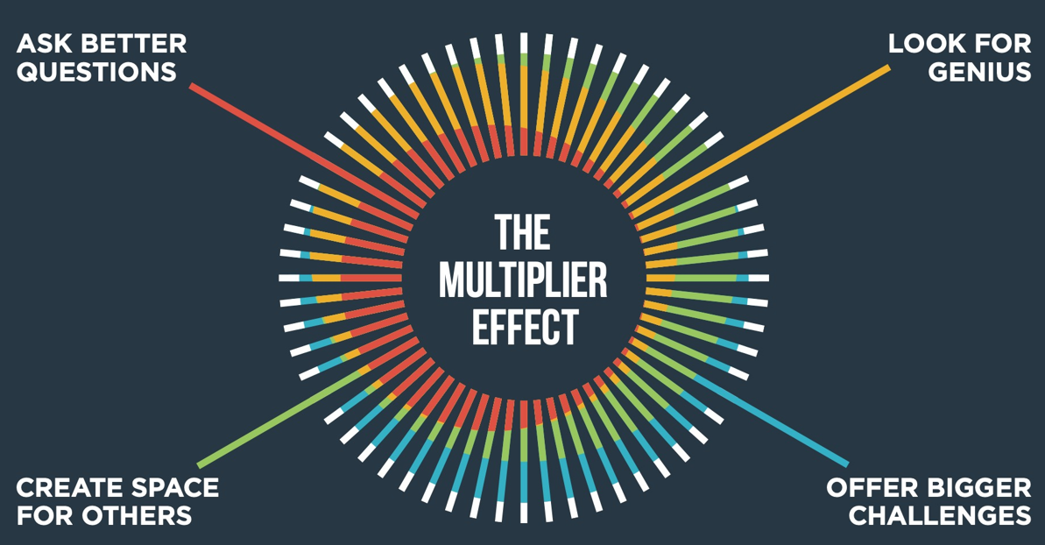
The Multiplier Effect Weeks 1 & 2 of OnDemand Course
Notes:
Pre-work: Have participants come prepared with their downloaded responses from the OnDemand Course.
Opening: Provide context for why the are taking this course. Reiterate the investment in their learning and tie to larger organizational initiatives.
Introduction:
Say: in the OnDemand content, we learned about diminishers and multipliers.
Ask: What are some of the assumptions that diminishers make? What are some of the assumptions that Multipliers make?
Transition: The difference between Multipliers and Diminishers is primarily how they interact with their people. We have all experienced working with Multipliers and Diminishers.
As we reflect and share these experiences, please keep names confidential.

Slide 10
Notes:
Say: Liz Wiseman and her team of researchers found that Diminishers get 48% and Multipliers get around 95% of their people’s intelligence.
Ask: What is your reaction to this? Why do you think that is?

Slide 11
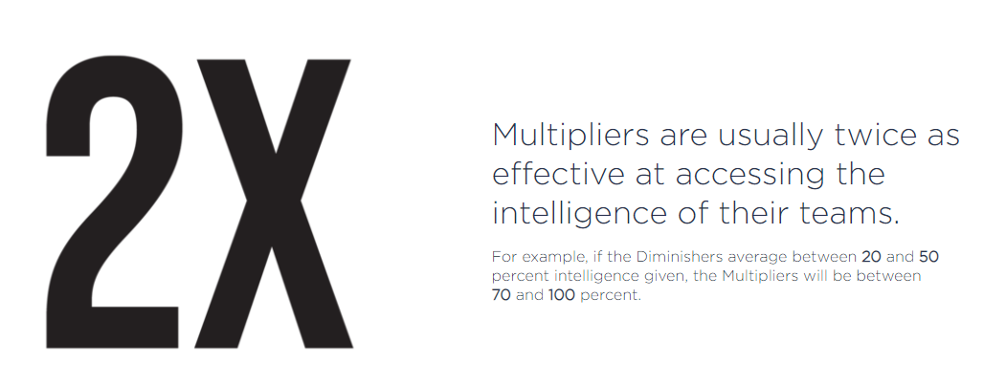
The Multiplier Effect Weeks 1 & 2 of OnDemand Course
Notes:
Say: It turns out that Multipliers are twice as effective at accessing and growing the intelligence of their teams as Diminishers.
Ask: what’s the effect? Who do you think works harder for their results? Ask participants to describe their answer, “Why do you think that is?”
Transition: Multipliers are the leaders you want to work for and the type of leader you want to be. But it’s important to recognize that all this success doesn’t come from one individual’s intelligence. It’s how the Multiplier interacts with others that makes them so effective. Let’s begin the review of Multipliers.

Slide 12
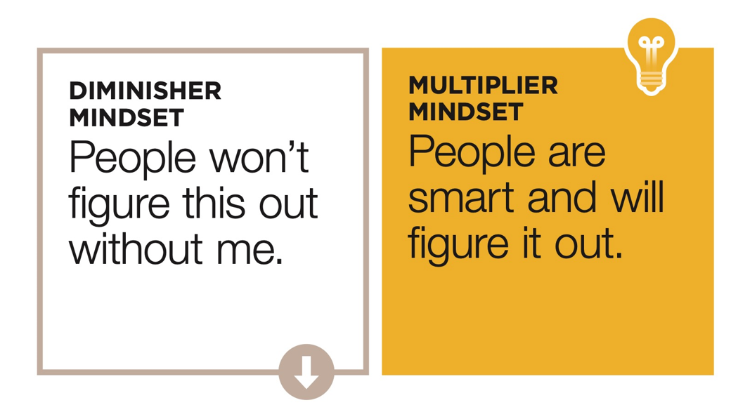
The Multiplier Effect Weeks 1 & 2 of OnDemand Course
Principle: Potential
People are inherently capable of doing great things.
Notes:
Say: The Multiplier Mindset assumes that “People are smart and will figure it out.” Discuss the mindsets.
Ask: What is the difference between the diminisher and the multiplier mindset? How does this impact their actions and behavior? What is it like to work in each environment?
Transition: Let’s talk about the concepts in this section.

Slide 13
The Multiplier Effect Weeks 1 & 2 of OnDemand Course
Breakouts – Groups of 3
Discussion Questions (10 – 15 minutes)
What is your accidental diminisher tendency?
With this knowledge, how can you manage the tendency, so it doesn’t diminish others?
Discussion Questions (10 - 15 minutes)
Share a time when you worked with someone who was accidentally diminishing. How did it impact your work? How did it impact your relationship?
Share a time when you worked with someone who saw your potential. How did it impact you? How did it impact your relationship?
What actions will you take to make a behavior shift in one of the four shift categories?
Ask better questions
Look for Genius
Offer Bigger Challenges
Create Space for Others
Notes:
NOTE: Move to slide 14 to show a visual of the Accidental Diminishers to help learners recall the concept as they participate in discussion.
Introduction: On this slide is a view of the accidental diminisher tendencies. Let’s describe each one.
Idea Fountain –Offer more ideas than anyone else. Enjoy when other appreciate the ideas I bring. Result: People aren’t sure which ideas to act on. The flood of ideas overwhelms others who either shut down or constantly chase the newest idea.
Always On – Often restate important points for emphasis, almost always engaged and energetic, have more energy when sharing than listening. Result: Their energy consumers all the space. Others learn to tune you out.
Pacesetter – People struggle to keep up with the pace, introduce new techniques more often than learning from others, tend to speed up when others fall behind hoping they will catch up. Result: Other people become spectators, they slow down or give up when they can’t keep up.
Rescuer: Give assignments and often end up taking them back, jump in to help others when they have a problem, quick to lend a hand so that others won’t fail. Result: Others become dependent, their opportunities are limited, and they don’t grow or develop.
Rapid Responder – Respond before others have had the chance to read or hear messages, make decisions before others have had a chance to engage with the issues. Result: Others slow down their responses, let the leader deal with issues, and defer more decisions to the leader.
Optimist – Don’t acknowledge how hard things are, would rather focus on victories than setbacks, share another plan or initiative when optimism isn’t shred by others. Result: Others wonder if you appreciate the struggle or understand the possibility of failure.
Protector – Shield people from conflict, reluctant to pass on negative or critical feedback, don’t share strategic uncertainties with team. Result: Others don’t learn to fend for themselves and are limited in their growth.
Strategist - Spend a lot of time communicating my vision of the future to the team, do not think others see the vision clearly enough to reach it without me. Result: Others defer or second-guess what you want. They stop doing their own strategic thinking.
Perfectionist – Feel that they do others a disservice if they don’t point out mistakes or flaws in their work. Am dissatisfied with anything short of perfection. Result: Others feel criticized and disheartened. They stop trying.
Breakout 1 : (10-15 minutes) In small groups, answer the questions on the screen. We’ll have a chance to discuss them in a moment.
Whole Group Debrief: Are there any volunteers willing to discuss their diminisher tendency and how they can manage it to avoid diminishing others? Ask if there are any other insights to share.
Breakout 2: (10 – 15 minutes)
Whole Group Debrief: (5-10 minutes) Are there any volunteers willing to share their experience with a diminisher and how it impacted you work and relationship? How has that differed from when you worked with someone who saw your potential?
Closing What are the key takeaways from this session? What actions will you take to make a behavior shift in one of the four categories? Hear from everyone if group is small or ask for a few if group is larger.

Slide 14
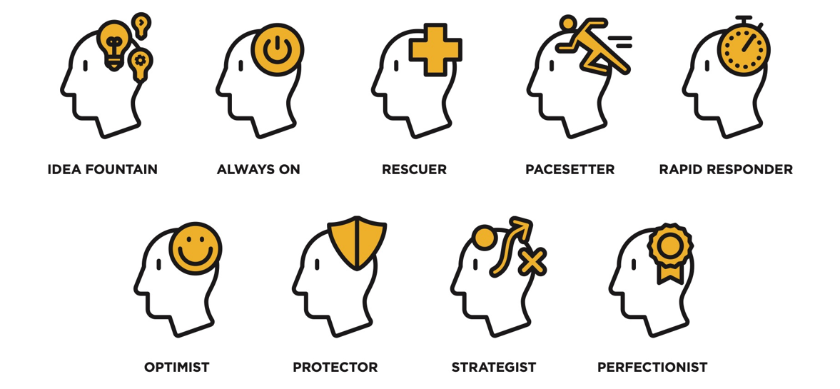
The Multiplier Effect – Accidental Diminishers Weeks 1 & 2 of OnDemand Course
Notes:
Optional: Display this visual as needed when discussing questions on the previous slide.
Say: Most people don't set out to diminish others. Let’s review from Liz’s research trends in how leaders accidentally diminish the people the work with.
Idea Fountain –Offer more ideas than anyone else. Enjoy when other appreciate the ideas I bring. Result: People aren’t sure which ideas to act on. The flood of ideas overwhelms others who either shut down or constantly chase the newest idea.
Always On – Often restate important points for emphasis, almost always engaged and energetic, have more energy when sharing than listening. Result: Their energy consumers all the space. Others learn to tune you out.
Pacesetter – People struggle to keep up with the pace, introduce new techniques more often than learning from others, tend to speed up when others fall behind hoping they will catch up. Result: Other people become spectators, they slow down or give up when they can’t keep up.
Rescuer: Give assignments and often end up taking them back, jump in to help others when they have a problem, quick to lend a hand so that others won’t fail. Result: Others become dependent, their opportunities are limited, and they don’t grow or develop.
Rapid Responder – Respond before others have had the chance to read or hear messages, make decisions before others have had a chance to engage with the issues. Result: Others slow down their responses, let the leader deal with issues, and defer more decisions to the leader.
Optimist – Don’t acknowledge how hard things are, would rather focus on victories than setbacks, share another plan or initiative when optimism isn’t shred by others. Result: Others wonder if you appreciate the struggle or understand the possibility of failure.
Protector – Shield people from conflict, reluctant to pass on negative or critical feedback, don’t share strategic uncertainties with team. Result: Others don’t learn to fend for themselves and are limited in their growth.
Strategist - Spend a lot of time communicating my vision of the future to the team, do not think others see the vision clearly enough to reach it without me. Result: Others defer or second-guess what you want. They stop doing their own strategic thinking.
Perfectionist – Feel that they do others a disservice if they don’t point out mistakes or flaws in their work. Am dissatisfied with anything short of perfection. Result: Others feel criticized and disheartened. They stop trying.

Slide 15
Ask Better Questions Weeks 3 & 4 of OnDemand Course
Principle: Curiosity
When you explore the thinking of others, you achieve better results together.
Notes:
Prework: Have participants come prepared with their downloaded responses from the OnDemand Course.
Introduction: Share the reframe. Asking better questions is all about that principle of curiosity and learning what other people know so you can achieve better results together. The answers aren’t always easy. When Multipliers ask good questions that have hard answers, people will find those answers, and both the Multiplier and the person they interact with grow smarter in the process.
Ask: Will anyone volunteer to describe the reframed thinking? Why is Asking Better Questions critical to a multiplier mindset?
Transition: There’s a stark difference between how Multipliers and Diminishers think about where answers are to be found.

Slide 16
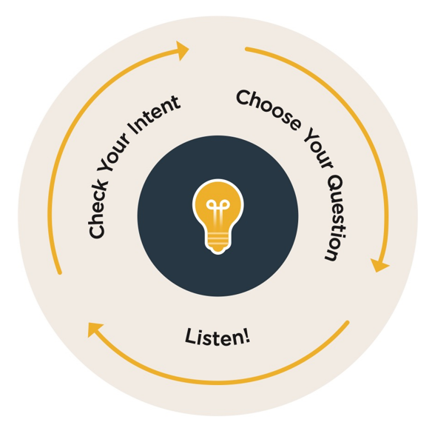
Ask Better Questions Weeks 3 & 4 of OnDemand Course
Breakouts – Groups of 3
1. Discussion Questions (10 – 15 minutes)
What is the purpose of checking your intent when choosing questions?
Describe a time when a question became an accidental diminisher. What was the situation? How could it be improved?
2. Discussion Questions (10 – 15 minutes)
What is your accidental diminisher tendency? How does asking better questions impact this tendency?
What are some of the key takeaways from this shift? What was the most interesting and impactful to you?
How will you set out to Ask Better Questions?
Notes:
Introduction: On the slide is the model that shows how to use questions to access the intelligence of others.
Breakout 1 : (10-15 minutes) In small groups, answer the questions on the screen. We’ll have a chance to discuss them in a moment.
Whole Group Debrief: Are there any volunteers willing to share their experience? Ask if there are any other insights to share.
Breakout 2: (10-15 minutes)
Whole Group Debrief: (5-10 minutes) Are there any volunteers willing to share how asking better questions will help counter their accidental diminisher tendency?
Closing What are the key takeaways from this session? What action will you take to ask better questions in your daily interactions? (Commit to making a debate, lead a meeting by asking only questions, etc.) Hear from everyone if group is small or ask for a few if group is larger.
Optional questions: What back pocket questions will you keep in mind to use at a moment’s notice?

Slide 17
Looking for Genius Weeks 5 & 6 OnDemand Course
Principle: Individuality
People want to contribute their unique abilities in ways that are seen and valued.
Notes:
Prework: Have participants come prepared with their downloaded responses from the OnDemand Course.
Introduction: Share the reframe. People want to contribute their unique abilities in ways that are seen and valued.
Ask: Will anyone volunteer to describe the reframed thinking? How does working with our natural genius help multiply the intelligence of a team?
Transition: Let’s explore the topics in this section.

Slide 18
Looking for Genius Weeks 5 & 6 of OnDemand Course
Breakouts – Groups of 3
1. Discussion Questions (10 – 15 minutes)
What is the best way to identify someone’s natural genius?
Name the genius of someone on your team. How do you know? What behaviors do they display?
What is your genius? How does it feel to be known that way?
2. Discussion Questions (10 – 15 minutes)
Describe a time when you identified someone’s personal genius. What did you notice? How did you use this information when interacting with this person?
Describe a time when you were able to put your natural genius to work. What did it look and feel like? How did that impact your interactions and working relationships?
How will you take action to Look for Genius in your role?
Notes:
Breakout 1 : (10-15 minutes) In small groups, answer the questions on the screen. We’ll have a chance to discuss them in a moment.
Whole Group Debrief: Are there any volunteers willing to share their experience? Ask if there are any other insights to share.
Breakout 2: (10-15 minutes)
Whole Group Debrief: (5-10 minutes) Are there any volunteers willing to share their experience?
Closing What are the key takeaways from this session? What actions will you take to Look for Genius in others in your daily interactions? Hear from everyone if group is small or ask for a few if group is larger.
Optional Questions: How will you look for a teammates genius this week?

Slide 19
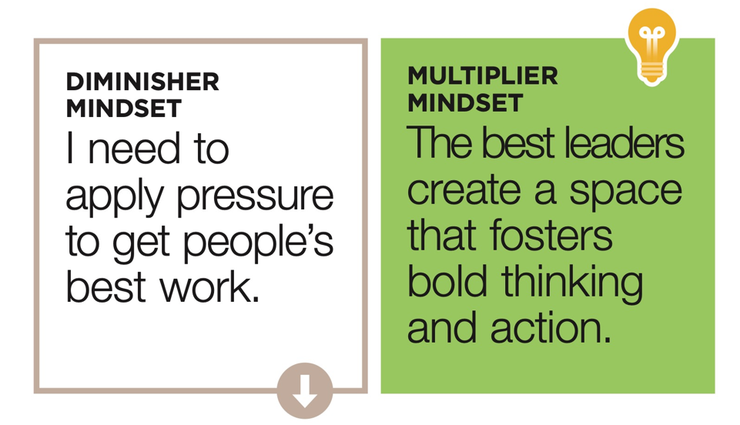
Create Space For Others Weeks 7 & 8 of OnDemand Course
Principle: Opportunity
People do their best when they have space to take initiative and are encouraged to excel.
Notes:
Prework: Have participants come prepared with their downloaded responses from the OnDemand Course.
Introduction: Share the reframe. Multipliers create an environment that requires people’s best and boldest thinking, where everyone’s contributions is valued. In a Multiplier environment, people have the space and the safety they need to do their best work.
Ask: Will anyone volunteer to describe the reframed thinking? Are there any reactions to this mindset shift as we move into the content?
Transition: As we move on to this section, the underlying principle is opportunity. People do their best work when they have space to take initiative and are encouraged to excel.

Slide 20
Create Space For Others Weeks 7 & 8 of OnDemand Course
Breakouts – Groups of 3
1. Discussion Questions (10 – 15 minutes)
Discuss the concept Play Big or Play Small. How does this create space for others to think, speak and learn?
What is the purpose of talking up your mistakes?
Consider your natural diminisher tendency. How does Creating Space For Others help prevent this?
2. Discussion Questions (10 – 15 minutes)
Do you typically Play Big or Play Small when working with your team? What might you do differently after completing this content?
Reflect on a mistake you made. What happened? Where did you go wrong and what did you learn? How might sharing this mistake help others?
Describe a time when you’ve been given space to experiment and take risks. How did this opportunity impact you?
Notes:
NOTE: Move to slide 21 to show a visual of Play Big, Play Small to help learners recall the concept as they participate in discussion.
Breakout 1 : (10-15 minutes) In small groups, answer the questions on the screen. We’ll have a chance to discuss them in a moment. Whole Group Debrief: Are there any volunteers willing to share their experience? Ask if there are any other insights to share.
Breakout 2: (10-15 minutes)
Whole Group Debrief: (5-10 minutes) Are there any volunteers willing to share their experience?
Closing What are the key takeaways from this session? What actions will you take to Create Space for Others in your daily interactions? Hear from everyone if group is small or ask for a few if group is larger.

Slide 21
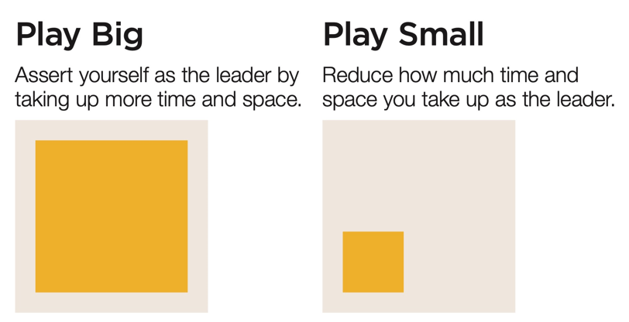
Create Space For Others Weeks 7 & 8 of OnDemand Course
Notes:
Display this visual as needed when discussing questions on the previous slide.

Slide 22
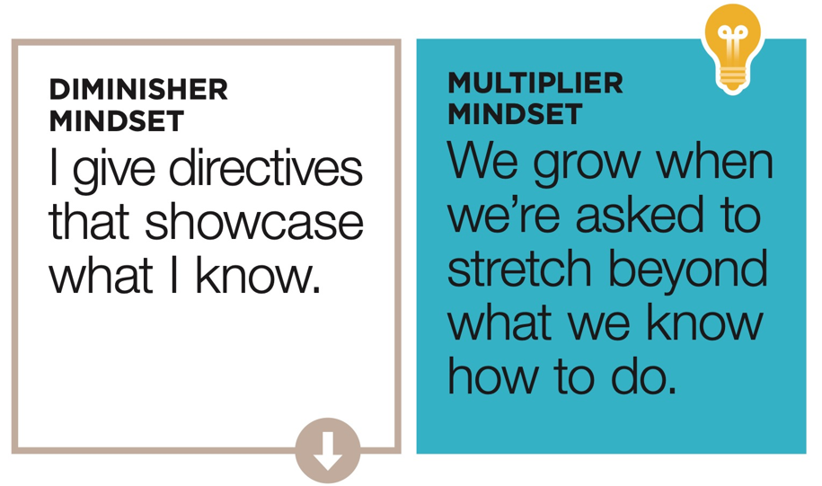
Offer Bigger Challenges Weeks 9 & 10 of OnDemand Course
Principle: Growth
People are wired for challenge and built for growth.
Notes:
Prework: Have participants come prepared with their downloaded responses from the OnDemand Course.
Introduction: Share the reframe. The multiplier mindset is that we grow when we’re asked to stretch beyond what we know how to do.
Ask: Will anyone volunteer to describe the reframed thinking? Are there any reactions to this mindset shift as we move into the content?
Transition: As we move on to this section, the underlying principle is Growth. People are wired for challenge and built for growth.

Slide 23
Offer Bigger Challenges Weeks 9 & 10 of OnDemand Course
Breakouts – Groups of 3
1. Discussion Questions (10 – 15 minutes)
How does Offering Bigger Challenges Multiply the intelligence of a person or team?
Review the four Multiplier Challenges. Which challenge will help with your natural diminisher tendencies?
Where do you see opportunities to Offer Bigger Challenges with your team?
2. Discussion Questions (10 – 15 minutes)
Describe a situation when a leader created a stretch challenge or gave you a Level Up opportunity. What was the opportunity? How was it aligned to your natural genius? What was the result?
Describe a time when you’ve Offered a Bigger Challenge to someone on your team. What was the opportunity? How did it align to their natural genius?
What experiment will you try to Offer Bigger Challenges to your team?
Notes:
NOTE: Move to slide 24 to show a visual of the challenges to help learners recall the concept as they participate in discussion.
Breakout 1 : (10-15 minutes) In small groups, answer the questions on the screen. We’ll have a chance to discuss them in a moment. Whole Group Debrief: Are there any volunteers willing to share their experience? Ask if there are any other insights to share.
Breakout 2: (10-15 minutes)
Whole Group Debrief: (5-10 minutes) Are there any volunteers willing to share their experience?
Closing What are the key takeaways from this session? Actions will you take to Offer Bigger Challenges to others? Hear from everyone if group is small or ask for a few if group is larger.

Slide 24
Offer Bigger Challenges Weeks 9 & 10 of OnDemand Course
Create a Stretch
Help your team grow by offering them a challenge that will stretch them and achieve something significant.
Give 51% of the Vote
Put someone else in charge by giving that person the majority vote.
Give it Back
Give ownership of a project or task back to the person who should have it rather than fixing it for them.
Level Up
Give someone a job that is a size too big.
Notes:
Display this visual as needed when discussing questions on the previous slide.

Slide 25
Multipliers in Action Weeks 11 & 12 of OnDemand Course
Understand how to become an Intentional Multiplier and plan your first steps to take.
Notes:
Prework: Have participants come prepared with their downloaded responses from the OnDemand Course.
Introduction: Weeks 11-12 focused on how to become an Intentional Multiplier and how we can put all of the information together to truly multiply the intelligence of the team.
Ask: Will anyone share their thoughts on becoming an Intentional Multiplier. Are there any reactions to this mindset as we move into the content?
Transition: As we move on to this section, we’ll reinforce how to become an Intentional Multiplier and create an action plan.

Slide 26
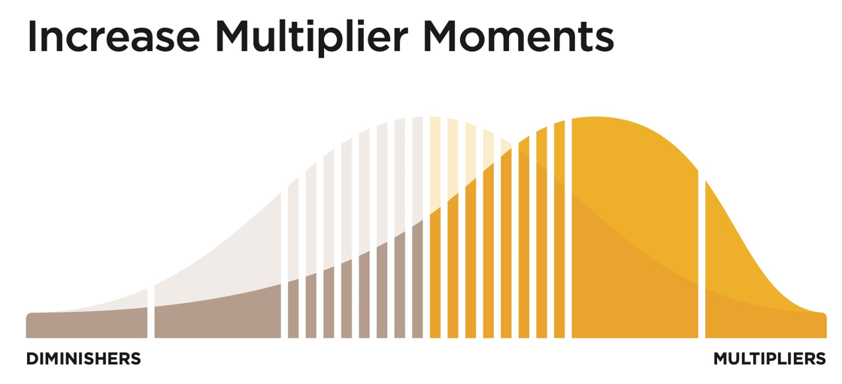
Multipliers in Action Weeks 11 & 12 of OnDemand Course
Breakouts – Groups of 3
Discussion Questions (10 – 15 minutes)
What is the Multiplier Mindset? How is this different than a diminisher mindset.
Describe the Multiplier Effect. How will this be beneficial to your team?
How does Asking Better Questions help counter accidental diminishing behaviors?
Consider your Accidental Diminisher tendency. Based on this, what Multiplier Experiment will you commit to trying, and why?
What does it take to become an Intentional Multiplier?
Notes:
Breakout 1 : (10-15 minutes) In small groups, answer the questions on the screen. We’ll have a chance to discuss them in a moment. Whole Group Debrief: Are there any volunteers willing to share their experience? Ask if there are any other insights to share.
Breakout 2: (10-15 minutes)
Whole Group Debrief: (5-10 minutes) Are there any volunteers willing to share their experience?
Ask: What are the key takeaways from this session? What actions will you take to increase multiplier moments and become an intentional multiplier? Hear from everyone if group is small or ask for a few if group is larger.
NOTE: Skip to slide 28 next slide if the group will not complete the exercise.

Slide 27
Multiplier Action Plan
Create an action plan:
What action steps will you take to become an Intentional Multiplier?
Which Multiplier Shift will you use to create a space where we all feel valued and able to contribute our best?
How will you do it? Be specific. Example – I will create a stretch challenge for my team.
What support will you need?
Share with an accountability partner.
If you are a manager, what will you put into practice today to ignite the full intelligence of those on your team?
Notes:
Optional Individual Exercise
What action steps will you take to become an Intentional Multiplier?
Which Multiplier Shift will you use to create a space where we all feel valued and able to contribute our best?
How will you do it? Be specific.Example – I will create a stretch challenge for my team.
What support will you need?
Share with an accountability partner.

Slide 28
Notes:
Closing Congratulations Team! : Read the slide. Thank you all for your participation.

Slide 29
What’s Next? Track Alternative Usage
IMPORTANT! Tracking Alternative Usage
Once you are done with the Flipped Classroom, you will need to make sure you are tracking usage for the VHA contract.
What qualifies as Alternative Usage?
Below are a few examples of the types of usage we need your help tracking!
Instructor Led (In-person or Online) - Full or portions of courses. If you track in TMS, no need to double report.
Facilitator Certification Completion of any FranklinCovey Course
If you share ANY content from FranklinCovey (Articles, videos, tools, etc.) during any of the below forums, please let us know:
Lunch and Learns
Flipped Classrooms
Town Halls
Newsletters
Sent via email, MS Teams and other platforms
Posted in digital platform
How to track Alternative Usage:
Any time you identify Alternative Usage within your facility, please let us know so we can award usage to your facility.
Complete the simple survey here.
Approximately when was the content delivered?
How many VHA Employees participated in the training?
What and how did you share the information?
Please reach out to VACare@FranklinCovey.com if you have any questions
Notes:
NOTE: you will want to provide links to your learners. These links are available through the library under Materials as long as you have admin or facilitator credentials. The learners can also find them under “additional resources” “cards/tools” for 5 Choices.

