Slide 1
Greatness Starts Here.
Project Management
Flipped Classroom Guide
Veteran’s Health Administration

Slide 2
What is the Flipped Classroom approach?
A type of blended learning, which aims to increase engagement by having learners complete course content independently first and then gather live with colleagues to debrief learnings and discuss application.
Benefits of the flipped classroom approach with OnDemand courses:
Saves facilitation resources by leveraging OnDemand content
Provides flexibility for learners to have access to courses at any time
Maximizes the time spent together live with discussion and application
Creates a sense of community for learners that want to develop their skills

Slide 3
Preparation
Notes:
This is the backup slide if the CP wants a more conditional statement

Slide 4
End-to-End Impact Platform Flipped Class Process
Create Team in Impact Platform
Assign Course in Impact Platform
Email Participants with Context
Schedule Sessions and Send Invites
Lead Discussion Sessions
Celebrate/ Capstone Presentation

Slide 5
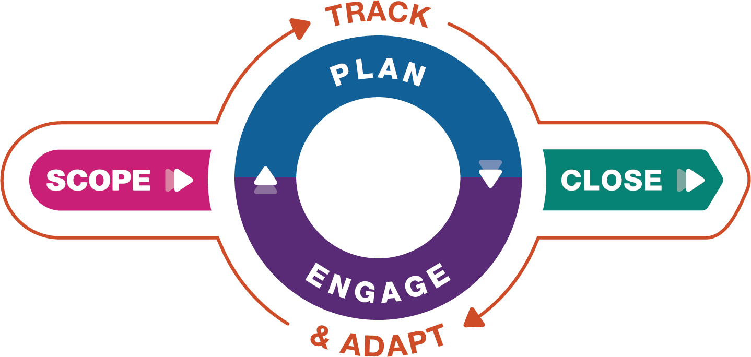
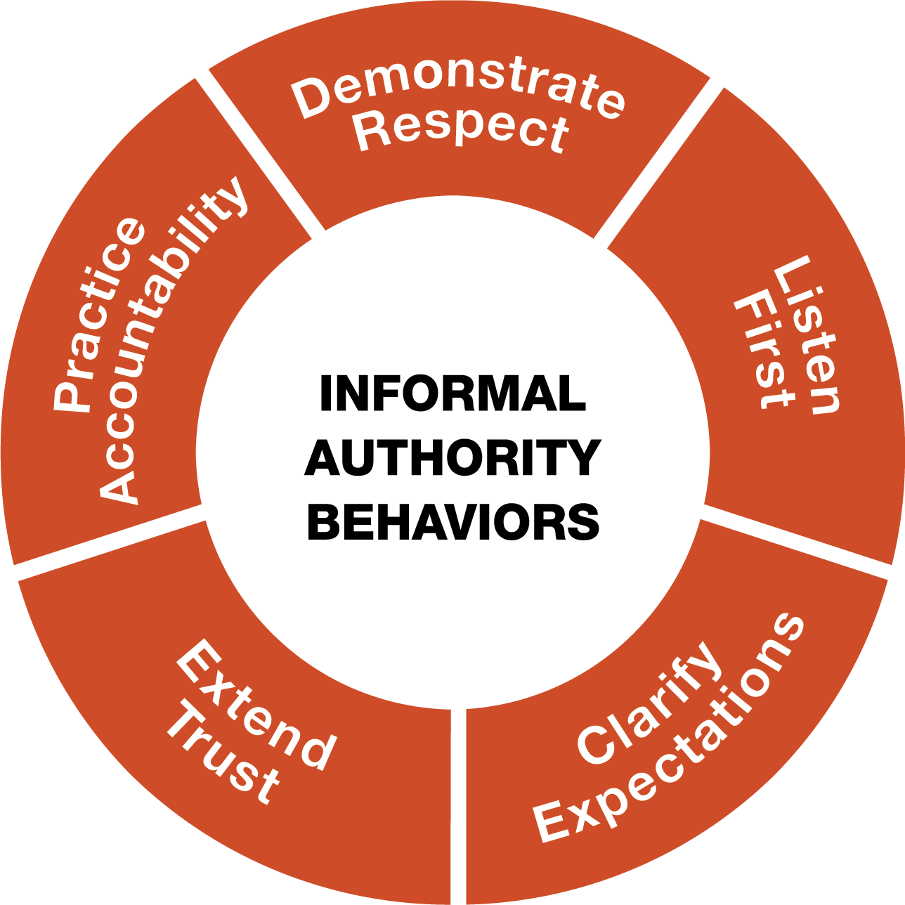
Project Management for the Unofficial Project Manager™
With best practices from agile and waterfall project management, Project Management for the Unofficial Project Manager™ will equipped learners with a mindset, skillset, and toolset to engage team members who may or may not report to them in a way that inspires them to volunteer their best efforts.
Outcomes
Utilize a consistent process to start and finish high-value projects on time and with quality.
Build a strong informal authority that inspires project teams to consistently volunteer their best efforts.
Influence and engage others to define a clear project scope including clear deliverables and risk strategies.
Model openness and agility to apply proactive change management and deliver high-value projects.
Schedule & Commitment
DATE RANGE: 6 Weeks
Weekly Automated assignments: 30-minutes
Bi-weekly live debrief sessions: 1-hour
Course Link
Project Management for the Unofficial Project Manager
Five Fundamental Project Phases
Five Leadership Behaviors

Slide 6
Participant Email Send directly after course is assigned in the Impact Platform
Hello Leaders,
We are excited to share that we’ve invested in a relationship FranklinCovey to support your development! FranklinCovey is a leader in impacting the four areas that matter most to our long-term success: leadership, individual effectiveness, culture, and achieving strategic goals.
You’ve been assigned Project Management for the Unofficial Project Manager OnDemand course in their Impact Platform. Course objectives are:
Utilize a consistent process to start and finish high-value projects on time and with quality.
Build a strong informal authority that inspires project teams to consistently volunteer their best efforts.
Influence and engage others to define a clear project scope including clear deliverables and risk strategies.
Model openness and agility to apply proactive change management and deliver high-value projects.
This 6-week course consists of engaging content, application challenges and educational articles. The time commitment is only 30-minutes a week for OnDemand completion and 1-hour every two weeks to attend a live debrief session. Please prioritize this investment in yourself! (If relevant, include language on the Capstone Presentation here).
To access the Impact Platform, you should have received an email from learning@app.franklincovey.com alerting you that you’ve been assigned to the course. Please login and follow the prompts to activate your account and then bookmark the site as a favorite in your browser for easy access in the future. If you have trouble please refer here or send me a note.
Please reach out with any questions!

Slide 7
Session Reminder Email Send three days before the session
Hello Leaders,
This is a friendly reminder that you’re Project Management for the Unofficial Project Manager discussion session is coming up on DATE. You should have a calendar invite.
We’re investing in this program as part of our commitment to your learning and development (include any additional organizational strategies that this ties into and benefits for the learner).
Pre-work for this session is:
Complete modules X and X (total 1-hour)
Come prepared with your downloaded responses, application challenges, and tools (be specific here, ‘Risk Strategy Tool. ’ etc.)
Be ready to engage, listen and learn!
To access the Project Management for the Unofficial Project Manager you should have received an email from learning@app.franklincovey.com alerting you that you’ve been assigned to the course and have created an account (include any SSO info if relevant). If you have trouble please refer here or send me a note.
Please reach out with any questions.
Notes:
Risk Strategy Tool.

Slide 8
Capstone Presentation - optional Participants present to leadership after the course is complete
Purpose/Benefits:
Participants share their key takeaways and how they will apply the new tools they’ve learned to their work
Instills deeper engagement and commitment to learning the tools and changing behavior
Participants gain exposure with leadership and celebrate their commitment to development
Generate interest from other leaders/departments to participant in a future course
Timing:
Capstones can be done right at the end of a course where learners will discuss their immediate takeaways that they will apply. Or you can schedule them 1-2 months after the course is complete and have leaders report on what tools they’ve applied and how it’s impacted their work, team, organization.
Presentations should only be about 7-10 minutes.
Instructions:
Share how you’ve applied learnings with your team
Describe the impact from applying the tools on your team
Discuss any benefits these tools have to the entire organization

Slide 9
Discussion Sessions
Notes:
You may want to create ground rules for the sessions.

Slide 10
Introduction & Scope Weeks 1 & 2 of OnDemand Course
What are the three components in the project success formula?
Why
Who
How
Notes:
Pre-Work: . Have participants come prepared with their downloaded responses from the OnDemand Course: Key Stakeholders Interview tool, Project Scope Statement, and Application Challenge
Opening: Provide context for why they are taking this course. Reiterate the investment in their learning and tie to larger organizational initiatives
Introduction: (don’t show visual) What are the three components in the project success formula? See who remembers and then share visual. Walk through each:
Value: What is the value of the project? Why does this project matter? In other words, what problems will it solve, or what benefits will it provide the team, the organization, and the customer?
People: Who is involved and who do you need to influence?
Process: How is going to get done?
4. Success in projects comes through pursuing value by inspiring people to give their best while working through a proven process. Would anyone like to share now they connected the purpose of their project to organizational goals and communicated the value to the people involved?

Slide 11
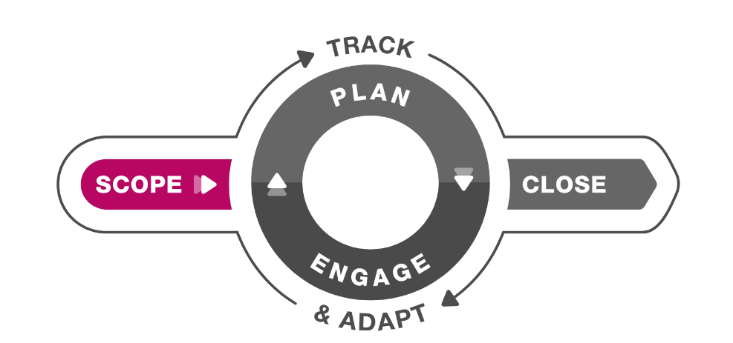
Key Stakeholders & Project Scope Statement Weeks 1 & 2 of OnDemand Course
Breakouts – Groups of 3
1. Key Stakeholder: Discussion Questions (10 – 15 minutes)
Share your Key Stakeholder Interview sheet.
What areas are you unsure about and would like feedback on? Hear ideas from the group.
How did you align the key stake holders to create shared expectations?
2. Project Scope: Discussion Questions (10 - 15 minutes)
Share your Project Scope Statement.
What areas are you unsure about and would like feedback on? Hear ideas from the group.
Scope = clarify shared and measurable expectations by identifying and interviewing key stakeholders and documenting a project scope everyone agrees with.
Notes:
Introduction: What is the purpose of scoping a project? Hear from the group. Scope = clarify shared and measurable expectations by identifying and interviewing key stakeholders and documenting a project scope everyone agrees with.
Breakout 1: (10 – 15 minutes)
Whole Group Debrief: (5-10 minutes) Who would like to share what they discussed and any insights they had?
Breakout 2: (10 – 15 minutes)
Whole Group Debrief: (5-10 minuets) Who would like to share what they discussed and any insights they had?
Closing: Key takeaways and committed actions to next steps (hear from everyone if group is small or ask for a few if group is larger)

Slide 12
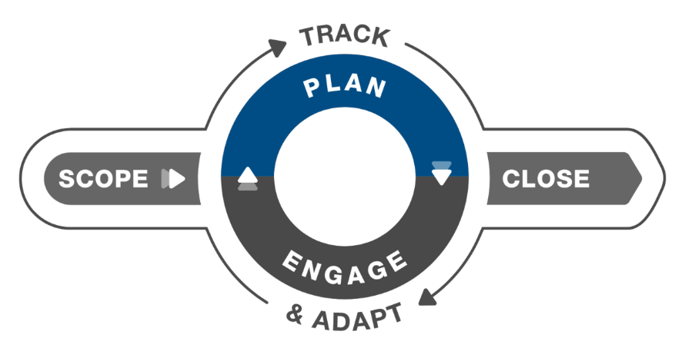
Plan Weeks 3 & 4 of OnDemand Course
Why = to create a clear map for smart decision-making.
How = build a risk strategy and a project schedule.
Notes:
Pre-Work: . Have participants come prepared with their downloaded responses from the OnDemand Course: Risk Strategy Tool and Application Challenge
Introduction:
Why is planning important for a project management? Here from the group and then click forward: We plan to create a clear map for smart decision-making.
How do we start to plan? Here for the group and then click forward: We build a risk strategy and a project schedule

Slide 13
Plan Weeks 3 & 4 of OnDemand Course
How to TAME risk?
Transfer = Shift the risk to a 3rd party
Accept = Acknowledge the risk and deal with it if it occurs
Mitigate = Lessen the risk by reducing the probability of impact
Eliminate = Remove the risk
Breakouts – Groups of 3
1. Risk Strategy: Discussion Questions (10 – 15 minutes)
Share your Risk Strategy Tool.
Are there any risks in your strategy planning that are going well or any that need attention?
2. Project Schedule: Discussion Questions (10 - 15 minutes)
Share your Project Schedule.
Are you on track with your project schedule or do you need to adjust any steps? What support do you need to ensure you stay on track?
Notes:
Introduction: What are the 4 strategies to TAME or manage Risk? Go through each letter of TAME. What does the T stand for, etc.
Transfer = shift the risk to a third party
Accept = Acknowledge the risk and deal with if it occurs
Mitigate = Lessen the risk by reducing the probability of impact
Eliminate = Remove the risk
Breakout 1: (10 – 15 minutes)
Whole Group Debrief: (5-10 minutes) Who would like to share what they discussed and any insights they had?
Breakout 2: (10 – 15 minutes)
Whole Group Debrief: (5-10 minutes) Who would like to share what they discussed and any insights they had?
Closing: Key takeaways and committed actions to next steps (hear from everyone if group is small or ask for a few if group is larger)

Slide 14
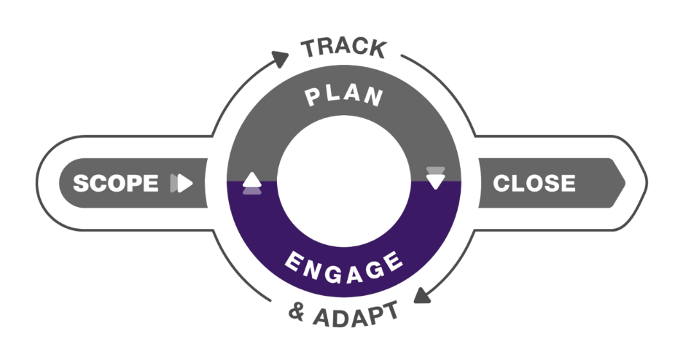
Engage Weeks 5 & 6 of OnDemand Course
Why = inspire shared accountability and provide structure to show the team how they’re winning.
How = through Team Accountability Sessions and the 5 Informal Authority Behaviors.
Notes:
Pre-Work: . Have participants come prepared with their downloaded responses from the OnDemand Course: Conversation Planner and Application Challenge
Introduction:
Why is engaging important for a project management? Here from the group and then click forward: inspire shared accountability and provide structure to show the team how they’re winning.
How do we engage people? Through Team Accountability Sessions and the 5 Informal Authority Behaviors

Slide 15
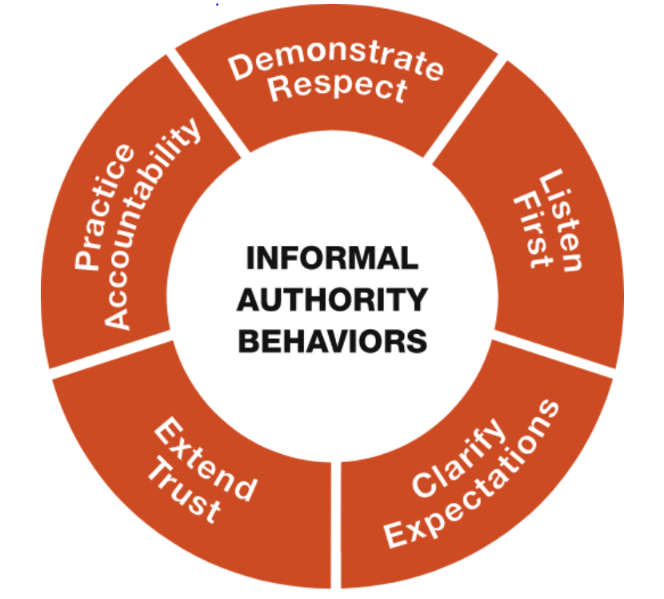
Engage Weeks 5 & 6 of OnDemand Course
Team Accountability Session
Review the updated project schedule as a scoreboard.
Report on last week’s commitments.
State commitments for the next week.
Clear the path.
Breakout – Groups of 3
1. Discussion Questions (10 – 15 minutes)
Has your team aligned their ‘why’ with their work and your team goals? What results are you seeing?
Is everyone on the project engaged and completing their tasks? Have you had an accountability conversation? How did it go?
Notes:
Introduction: (Do Not Show 5 Informal Authority Visual)
What are the 5 Informal Authority Behaviors? See what the group can remember and then show visual. To ENGAGE with your team members and inspire shared accountability, you can provide structure in the form of regular Team Accountability Sessions. These are NOT operations meetings, and they are NOT lengthy meetings to discuss details about all the work being done. Instead, they are weekly checkpoints that show the team how they’re winning—and how to keep winning.
What are the 4 steps to a Team Accountability session? Show steps and review
Breakout 1: (10 – 15 minutes)
Whole Group Debrief: (5-10 minutes) Who would like to share what they discussed and any insights they had?

Slide 16
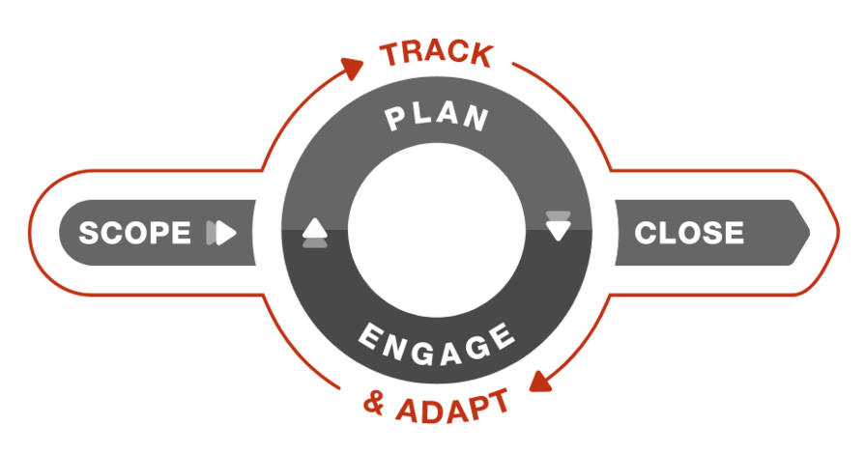
Track & Adapt Weeks 5 & 6 of OnDemand Course
Why = manage scope with agility to ensure value.
How = This phase sits outside the model because it’s an ongoing phase where you make consistent updates to project status and adapt to change.
Notes:
Pre-Work: . Have participants come prepared with their downloaded responses from the OnDemand Course: Project Status Report and Project Change Request Tool
Introduction:
Why is tracking and adapting important for a project management? Here from the group and then click forward
How do we track and adapt? Here for the group and then click forward

Slide 17
Track & Adapt Weeks 5 & 6 of OnDemand Course
Conversation Card: Adapting to Change
Describe what prompted the change
Describe how the change helps
Share the benefits of the change
Share the challenges of the change
Share initial ideas on addressing the challenges together
Give time to process
Invite everyone’s ideas
Breakouts – Groups of 3
1. Discussion Questions (10 – 15 minutes)
Have there been any changes to your project? If so, how have you adjusted to the project based on those changes? (Share your Project Status Report and Project Change Request Tool if relevant.)
Did you have a conversation with your team around the changes leveraging the cards? How did it go?
Notes:
Introduction: (Don’t show Conversation Card) Who remembers some Adapting to Change Conversation steps? Hear from the group and then move slide forward.
Breakout 1: (10 – 15 minutes)
Whole Group Debrief: (5-10 minutes) Who would like to share what they discussed and any insights they had?

Slide 18
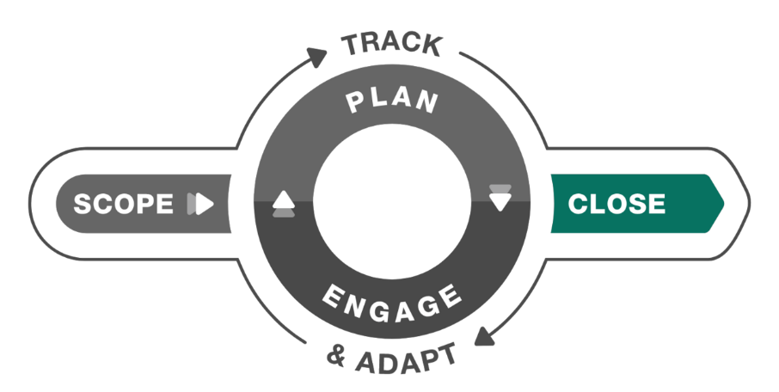
Close Weeks 5 & 6 of OnDemand Course
Why = A project has a beginning and an end. It’s important to officially close a project in a thoughtful, systematic way.
How = Documenting lessons learned, preparing for future success and celebrating are key!
Notes:
Introduction:
Why is having a process to close out the project important? Here from the group and then click forward
What are best practices for closing out a project? Here for the group and then click forward Resources: Close Checklist and Project Retrospective Tool
2. Closing: Congratulations Team! Key takeaways and committed actions to next steps (hear from everyone if group is small or ask for a few if group is larger)

Slide 19
What’s Next? Track Alternative Usage
IMPORTANT! Tracking Alternative Usage
Once you are done with the Flipped Classroom, you will need to make sure you are tracking usage for the VHA contract.
What qualifies as Alternative Usage?
Below are a few examples of the types of usage we need your help tracking!
Instructor Led (In-person or Online) - Full or portions of courses. If you track in TMS, no need to double report.
Facilitator Certification Completion of any FranklinCovey Course
If you share ANY content from FranklinCovey (Articles, videos, tools, etc.) during any of the below forums, please let us know:
Lunch and Learns
Flipped Classrooms
Town Halls
Newsletters
Sent via email, MS Teams and other platforms
Posted in digital platform
How to track Alternative Usage:
Any time you identify Alternative Usage within your facility, please let us know so we can award usage to your facility.
Complete the simple survey here.
Approximately when was the content delivered?
How many VHA Employees participated in the training?
What and how did you share the information?
Please reach out to VACare@FranklinCovey.com if you have any questions
Notes:
NOTE: you will want to provide links to your learners. These links are available through the library under Materials as long as you have admin or facilitator credentials. The learners can also find them under “additional resources” “cards/tools” for 5 Choices.

