Slide 1
Greatness Starts Here.
Unconscious Bias
Flipped Classroom Guide
Veteran’s Health Administration

Slide 2
What is The Flipped Classroom approach?
A type of blended learning, which aims to increase engagement by having learners complete course content independently first and then gather live with colleagues to debrief learnings and discuss application.
Benefits of the flipped classroom approach with OnDemand courses:
Saves facilitation resources by leveraging OnDemand content
Provides flexibility for learners to have access to courses at any time
Maximizes the time spent together live with discussion and application
Creates a sense of community for learners that want to develop their skills

Slide 3
Preparation
Notes:
This is the backup slide if the CP wants a more conditional statement

Slide 4
End-to-End Impact Platform Flipped Class Process
Create Team in Impact Platform
Assign Course in Impact Platform
Email Participants with Context
Schedule Sessions and Send Invites
Facilitate Learning Sessions
Optional Participant Capstone Presentation

Slide 5
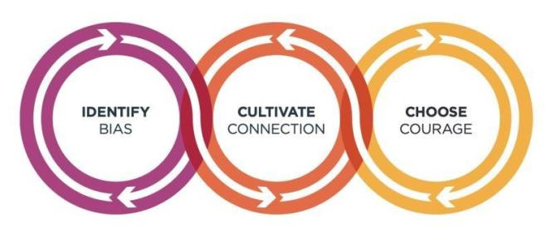
Unconscious Bias: Understanding Bias To Unleash Potential ®
Unconscious biases are how our brains compensate for overload which can inhibit performance and lead to poor decision-making. Helping your leaders and team members address bias will let them thrive, increasing performance across your entire organization.
1
Outcomes
2
Schedule and Commitment
3
Course Link
Create an inclusive workplace and address unconscious bias’s impact on decision making.
Face bias with courage and build a culture where everyone feels respected, included, and valued.
Improve collaboration between newly acquired groups or between existing functional silos.
Close the gap between expected and actual behaviors in how people see and treat each other.
DATE RANGE 6
Weekly Automated assignments: 30-minutes
Bi-weekly live debrief sessions: 1-hour
Unconscious Bias: Understanding Bias to Unleash Potential

Slide 6
Participant Email Send directly after course is assigned in the Impact Platform
Hello Leaders,
We are excited to share that we’ve invested in a relationship FranklinCovey to support your development! FranklinCovey is a leader in impacting the four areas that matter most to our long-term success: leadership, individual effectiveness, culture, and achieving strategic goals.
You’ve been assigned Unconscious Bias: Understanding Bias to Unleash Potential OnDemand course in their Impact Platform. Course objectives are:
Execute critical priorities with laser-like focus and careful planning.
Increase team engagement, morale, and collaboration.
Improve team communication, relationships and culture
This 14-week course consists of engaging content, application challenges and educational articles. The time commitment is only 30-minutes a week for OnDemand completion and 1-hour every two weeks to attend a live debrief session. Please arrive at each session with your downloaded responses and application challenges. We appreciate you prioritizing this investment in yourself! (If relevant, include Capstone information here)
To access the Impact Platform, you should have received an email from learning@app.franklincovey.com alerting you that you’ve been assigned to the course. Please login and follow the prompts to activate your account and then bookmark the site as a favorite in your browser for easy access in the future. If you have trouble please refer here or send me a note.
Please reach out with any questions.
Thank you for your engagement and participation!

Slide 7
Capstone Presentation- Optional Participants present to leadership after the course is complete
Purpose/Benefits:
Participants share their key takeaways and how they will apply the new tools they’ve learned to their work
Instills deeper engagement and commitment to learning the tools and changing behavior
Participants gain exposure with leadership and celebrate their commitment to development
Generate interest from other leaders/departments to participant in a future course
Timing:
Capstones can be done right at the end of a course where learners will discuss their immediate takeaways that they will apply. Or you can schedule them 1-2 months after the course is complete and have leaders report on what tools they’ve applied and how it’s impacted their work, team, organization.
Presentations should only be about 7-10 minutes.
Instructions:
Chose 2 or 3 concepts that were most impactful to you
Share how you’ve applied learnings with your team
Describe the impact from applying the tools on your team
Discuss any benefits these tools have to the entire organization

Slide 8
Discussion Sessions

Slide 9
Understanding the Bias Model Weeks 1 & 2 of OnDemand Course
Notes:
Send reminder email to participants to download their responses from the OnDemand Course and be prepared to share thoughts and examples with others.
Ask the group for their thoughts on Unconscious Bias. Anyone have a paradigm shift they’d like to share or reactions to understanding unconscious bias?

Slide 10
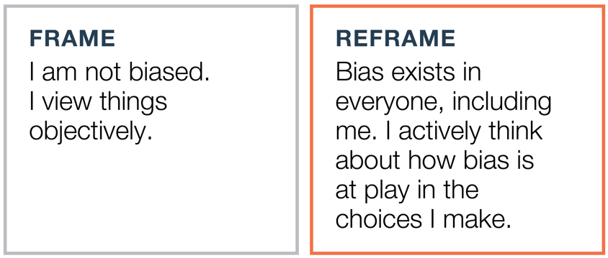
Unconscious Bias: Identify Bias Weeks 1 & 2 of OnDemand Course
Notes:
Send reminder email to participants to download their responses from the OnDemand Course and be prepared to share examples and experiences.
Share the Reframe. Ask the group: describe the reframed thinking. Draw each person to hear their reactions to this section of the content.

Slide 11
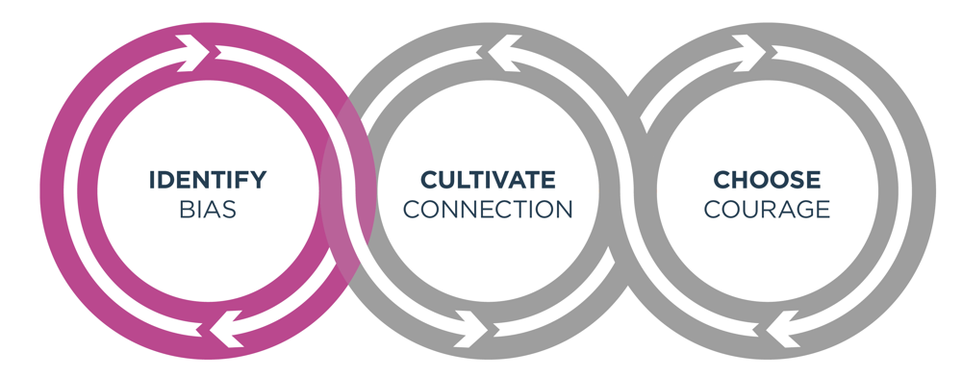
Unconscious Bias: Identify Bias Weeks 1 & 2 of OnDemand Course
Principle: Self-Awareness
Notes:
Say: The fundamental principle that underlies Identify Bias is self-awareness. In order for us to identify bias, we need to look inside ourselves.
When we take the time to understand bias, we are on the path to improving our performance by making more informed decisions and taking more informed actions.
Transition: Let’s discuss the concepts in this section.

Slide 12
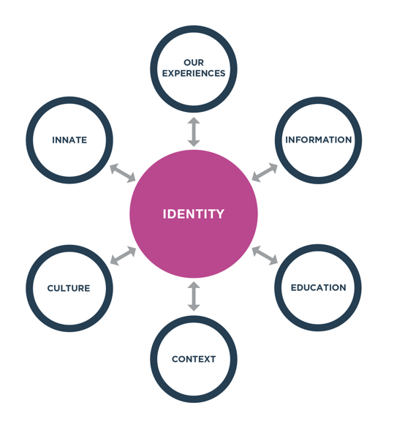
Unconscious Bias: Identify Bias Weeks 1 & 2 of OnDemand Course
Breakouts – Groups of 3
1. Discussion Questions (10 – 15 minutes)
How does identity relate to bias for you?
Discuss what you’ve learned about the connection between identity and bias.
2. Discussion Questions (10 - 15 minutes)
What is the most common bias trap for you? How does the bias show up in your life?
Discuss how you can notice and address this bias in your day-to-day life.
Notes:
2 break outs with groups of 3 (10 – 15 minutes)
Debrief with large group after breakouts (5-10 minuets) Who would like to share what they discussed and any insights they had?

Slide 13
Unconscious Bias: Cultivate Connection Weeks 3 & 4 of OnDemand Course
Notes:
Send reminder email to participants to download their responses from the OnDemand Course and be prepared to share examples and experiences.
Share the Reframe. Ask the group: describe the reframed thinking. Draw each person to hear their reactions to this section of the content.

Slide 14
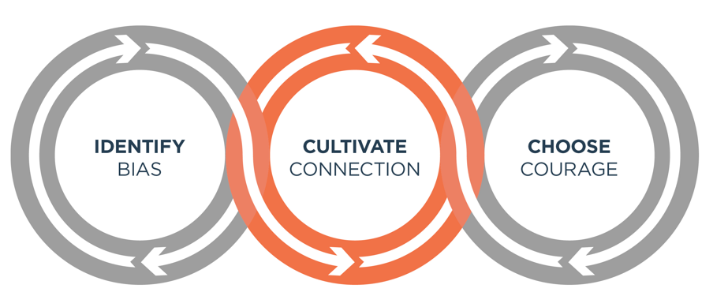
Unconscious Bias: Cultivate Connection Weeks 3 & 4 of OnDemand Course
Principle: Openness
Notes:
Say: The fundamental principle we’ll be working with in this section is openness. When we are open with people, especially those who see the world differently from us, we start seeing things differently, and this helps us see past our own biases.
Transition: Let’s discuss the concepts in this section.

Slide 15
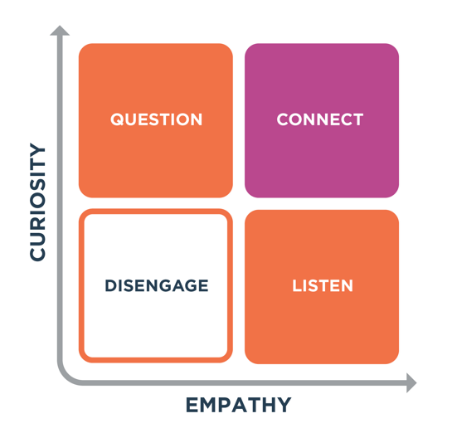
Unconscious Bias: Cultivate Connection Weeks 3 & 4 of OnDemand Course
Breakouts – Groups of 3
1. Discussion Questions (10 – 15 minutes)
How does Cultivating Connection relate to unconscious bias?
Discuss what makes it hard or easy to practice empathy and curiosity when interacting with people.
2. Discussion Questions (10 – 15 minutes)
How do you cultivate connection with people who are not like you?
Describe a situation where “starting safe” helped you build a connection with someone?
What will you commit to do to cultivate connection?
Notes:
Send reminder email to participants to download their responses from the OnDemand Course and be prepared to share examples and experiences.
2 break outs with groups of 3 (10 – 15 minutes)
Debrief with large group after breakouts (5-10 minuets) Who would like to share what they discussed and any insights they had?

Slide 16
Unconscious Bias: Choose Courage Weeks 5 & 6 OnDemand Course
Notes:
Send reminder email to participants to download their responses from the OnDemand Course and be prepared to share examples and experiences.
Share the Reframe. Ask the group: describe the reframed thinking. Draw each person to hear their reactions to this section of the content.

Slide 17
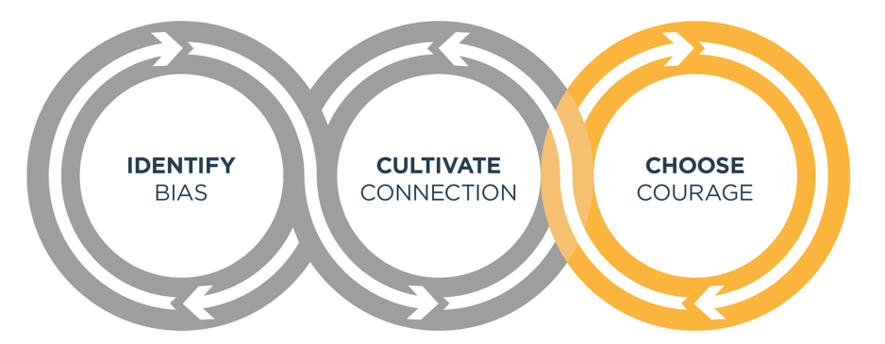
Unconscious Bias: Choose Courage Weeks 5 & 6 of OnDemand Course
Principle: Growth
Notes:
Say: In Choose Courage, we’ll learn about ways to act with courage and create an inclusive culture where everyone can reach their full potential.
As we move on to this section, the underlying principle is growth. Growth is an ongoing process. When we start to understand and address bias, we grow into new levels of performance. We make fewer unfounded judgments, we act more inclusively, and we make better decisions.
Transition: Let’s discuss the concepts in this section.

Slide 18
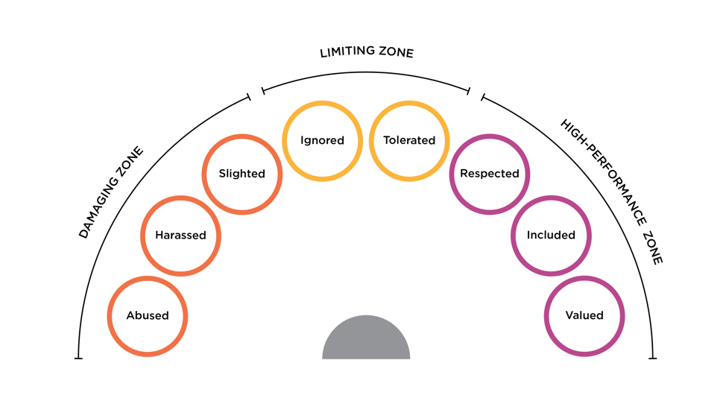
Unconscious Bias: Choose Courage Weeks 5 & 6 of OnDemand Course
Notes:
Ask: Describe how courage can help people move from damaging to more positive and inclusive behaviors.
Everyone's life and experiences are different. Because of this, no two people have the same starting point.
Take a moment to think about this in your own context: Consider places where you feel comfortable or not, whether at work or in your personal life, and ask yourself how others might feel in the same situation.
Ask: Why should we choose courage in these situations?

Slide 19
Unconscious Bias: Choose Courage Weeks 5 & 6 of OnDemand Course
Breakouts – Groups of 3
1. Discussion Questions (10 – 15 minutes)
How does Choosing Courage relate to unconscious bias?
Discuss how we can choose courage to help people perform at their best.
What is your greatest opportunity to apply courage?
2. Discussion Questions (10 – 15 minutes)
Describe a situation when you’ve shown courage when addressing bias. What steps did you take? What was the outcome?
Describe how you can become an advocate in your workplace.
Notes:
Send reminder email to participants to download their responses from the OnDemand Course and be prepared to share examples and experiences.
2 break outs with groups of 3 (10 – 15 minutes)
Debrief with large group after breakouts (5-10 minuets) Who would like to share what they discussed and any insights they had?

Slide 20
Address Bias Action Plan
Create an action plan:
Choose one skill you want to work on.
How will you apply that skill to create a space where we all feel valued and able to contribute our best?
How exactly will you apply it?
What support will you need?
Share with an accountability partner.
If you are a manager, what is one thing you can do to help your team understand and address bias?
Notes:
Optional Individual Exercise
Using the practice cards, choose one skill you want to work on.
How will you apply that skill to create a space where we all feel valued and able to contribute our best?
How exactly will you apply it?
What support will you need?
Share with an accountability partner.

Slide 21
Notes:
Purpose: To summarize that our biases cause us all to see things differently.
Read the quote or ask someone else to.
Ask: What does this mean to you?
Say: Our view of the world is unique to us. Reality can be something quite different. One person sees one thing, another sees something else.
The question for all of us is: How am I bringing my view of the world into the situation? How might my view be biased? What are the other things I need to see to better understand what’s really happening?
Transition: We’re often blind to our biases until we see their impact and how they can limit us and our performance. Let’s learn how this happens from a business story.

Slide 22
What’s Next? Track Alternative Usage
IMPORTANT! Tracking Alternative Usage
Once you are done with the Flipped Classroom, you will need to make sure you are tracking usage for the VHA contract.
What qualifies as Alternative Usage?
Below are a few examples of the types of usage we need your help tracking!
Instructor Led (In-person or Online) - Full or portions of courses. If you track in TMS, no need to double report.
Facilitator Certification Completion of any FranklinCovey Course
If you share ANY content from FranklinCovey (Articles, videos, tools, etc.) during any of the below forums, please let us know:
Lunch and Learns
Flipped Classrooms
Town Halls
Newsletters
Sent via email, MS Teams and other platforms
Posted in digital platform
How to track Alternative Usage:
Any time you identify Alternative Usage within your facility, please let us know so we can award usage to your facility.
Complete the simple survey here.
Approximately when was the content delivered?
How many VHA Employees participated in the training?
What and how did you share the information?
Please reach out to VACare@FranklinCovey.com if you have any questions
Notes:
NOTE: you will want to provide links to your learners. These links are available through the library under Materials as long as you have admin or facilitator credentials. The learners can also find them under “additional resources” “cards/tools” for 5 Choices.

