Slide 1
Flipped Classroom Session Deck
Change: How to Turn Uncertainty Into Opportunity (Leaders)

Slide 2
Discussion Session Components
Kick-Off
Session 1 – (date)
Lead Yourself Through Change
Session 2 – (date)
Lead Your Team Through Change – Part 1
Session 3 – (date)
Lead Your Team Through Change – Part 2

Slide 3
Kickoff
Notes:
This is the backup slide if the CP wants a more conditional statement

Slide 4
Purpose
Include the main purpose for the session, how will these skills improve their work and the business, what are your goals for the course and how will you measure success. Share any information on how these skills and their work contributes to the larger organizational goals.
Notes:
Discussion leads complete this slide to provide the purpose of the session

Slide 5
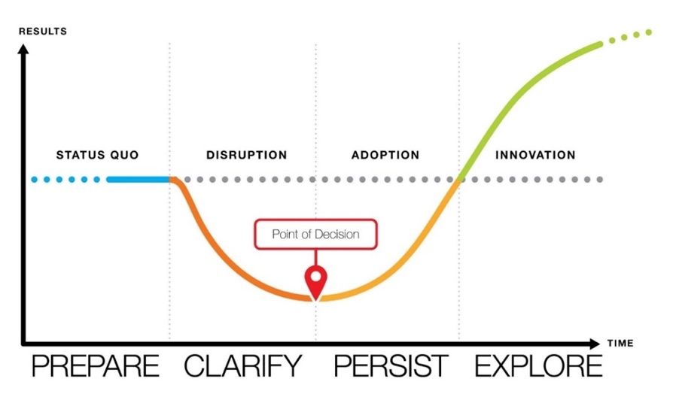
Change: How To Turn Uncertainty Into Opportunity™
When we recognize that change follows a predictable pattern, we can learn to manage our reactions and understand how to navigate change, both functionally and emotionally. This allows us to consciously determine how to best move forward—even in the most challenging stages. Change: How to Turn Uncertainty Into Opportunity helps individuals and leaders learn how to successfully navigate any workplace change to improve results.
Outcomes
2
Schedule & Commitment
Individuals will confidently harness change, turn uncertainty into opportunity, and exceed desired results.
Leaders who understand the fundamentals of change engage their teams to achieve and exceed targeted change results.
Employees at all levels will accelerate and optimize change, even beyond the initial possibilities.
DATE RANGE 6 weeks
Weekly Automated assignments: 30-minutes
3
Course Link
Change: How to Turn Uncertainty Into Opportunity
Notes:
Share the outcomes of the course, the date range, time commitment, and the Impact Platform link. They should have received all this information in your scheduling emails, but this is a reminder.

Slide 6
Participant Expectations & Actions
Access the Impact Platform and save url in your favorites
Complete 30-minutes of OnDemand content a week – tasks will be sent directly to your email and appear on your Impact Platform homepage.
Complete tools and applications challenges as directed by course
Stay on track with the course, the platform will show your progress, you can always catch up if you fall behind!
Attend 45-minute live session every two weeks
Come to live sessions with completed tools and application challenges
Prepare and present Capstone presentation (if applicable)
Engage and have fun!
Notes:
Review the actions and take questions.

Slide 7
Change: How To Turn Uncertainty Into Opportunity™
6- Week Flipped Classroom
Kick-off
On Demand Learning with Flipped Classroom Discussions
Optional Capstone Celebration
Week 1 Lead Yourself Through Change
Week 2 Reinforcement + Learning Lab
Week 3 Lead Your Team Through Change - 1
Kick-off Session
Live or Live Online
Optional Capstone/ Celebration
Week 4 Reinforcement + Learning Lab
Week 5 Lead Your Team Through Change - 2
Week 6
Reinforcement + Learning Lab
30-minutes of OnDemand training a week and live 45-minute discussions every two weeks.
Notes:
Review the course timeline and add in the scheduled dates.

Slide 8
Discussion Session Flow (45-minutes)
1
2
3
4
Introduction, the Why (5-minutes)
Core Principle/Mindset Shift/Learning
Whole group discussion (5 min)
Review
Reflect
Breakout or Individual Exercise (2-3 per group) (10 min)
Discuss
Action
Core Principle/Mindset Shift/Learning
Whole group discussion (5 min)
Review
Reflect
Breakout or Individual Exercise (2-3 per group) (10 min)
Discuss
Action
Key learnings & Next Steps (3-minutes)
Notes:
Walk through the standard flow of each session so participants know what to expect

Slide 9
Capstone Presentation (optional)
Participants present to leadership after the course is complete
Purpose/Benefits:
Participants share their key takeaways and how they will apply the new tools they’ve learned to their work
Instills deeper engagement and commitment to learning the tools and changing behavior
Participants gain exposure with leadership and celebrate their commitment to development
Generate interest from other leaders/departments to participant in a future course
Timing:
Capstones can be done right at the end of a course where learners will discuss their immediate takeaways that they will apply. Or you can schedule them 1-2 months after the course and have leaders report on what tools they’ve applied and how it’s impacted their work/team/organization.
Presentations should only be about 7-10 minutes.
Instructions:
Share one obstacle you faced around change and how you overcame it
Share how you’ve applied learnings with your team
Describe the impact from applying the tools on your team
Discuss any benefits these tools have to the entire organization
Notes:
Share capstone expectations or remove if you are not doing a capstone presentation.

Slide 10
Discussion Sessions
Notes:
You may want to create ground rules for the sessions.

Slide 11
Lead Yourself Through Change
Notes:
Pre-work: Have participants come prepared with their downloaded responses from the OnDemand Course.
Opening: Provide context for why the are taking this course. Reiterate the investment in their learning and tie to larger organizational initiatives.
Introduction:
Say: In the OnDemand content, we learned about Lead Yourself Through Change. The goal of this experience is to not only to manage change but embrace it and unleash our own potential to achieve even greater possibilities because of the change. To do that, we will start by exploring how to lead ourselves through change.
Ask: How do you feel when change happens to you? (participants can respond verbally or in chat)
Transition: Well, here is the good news… No matter how we react to change, we’re not alone. As humans, we’re wired to react to change to survive.

Slide 12
Lead Yourself Through Change
Weeks 1 & 2 of On Demand Course
What are the 5 most common reactions to change?
Move — We quickly charge into action.
Minimize — We change as little as possible.
Wait — We do nothing until others change.
Resist — We dislike the change and convince others to fight it.
Quit — We go elsewhere, or we stay but don’t engage.
Notes:
This is a build slide.
Don’t show the 5 reactions to change until after you get input from the participants.
ASK: who remembers one of the 5 reactions to change? Does anyone want to share their typical reaction?
Reveal the 5 common reactions
Transition: Let’s look at the reactions more closely. To do this we are going to break into small groups to discuss.

Slide 13
Lead Yourself Through Change
Weeks 1 & 2 of On Demand Course
Move
Minimize
Wait
Resist
Quit
Breakouts – Groups of 3
Discussion Questions (10-15 minutes)
Share insights about how you experience change. Please pick a leader in your group to share one insight with everyone after the discussion.
What are a few of the advantages and disadvantages of each of the 5 Common Reactions to Change
Notes:
Breakout 1: (10-15 minutes) In your small groups, answer the questions on the screen. We’ll have a chance to discuss them in a moment.
Whole Group Debrief: (5-10 minutes) Are there any volunteers willing to discuss their insight on how you experience change? What other insights can you share around the 5 Common Reactions to Change?
Transition: In the OnDemand content, we reviewed the four zones of the Change Model.

Slide 14
Lead Yourself Through Change
Weeks 1 & 2 of On Demand Course
Notes:
Say: we all know change can be messy and doesn’t always look like the picture on this slide. Remember the squiggly line from the OnDemand course?
Ask: What does that squiggly line represent?
Answer: It represents the obstacles we face. Every time we confront an obstacle, we experience a new hit of change with all the reactions that come along with it. It’s easy to feel like giving up.
Say: Let’s briefly discuss each of the four zones of the Change Model before our 2nd breakout discussion:
Ask for a volunteer to describe what they remember about each stage of change. Here are some things they might say:.
First, we prepare for change rather than avoid it or simply wait for it to happen. If we’re not caught off guard, we can move out of the status quo with ease when change hits.
Second, we clarify everything we can about the change. When we fight insecurity with information, we reduce disruption. That lets us move to the Point of Decision and commit to the change with greater confidence.
Third, we persist through setbacks, try new things, and learn in the Zone of Adoption. We don’t give up.
Once our new actions feel natural, we explore the opportunities change brings. Instead of settling for a new status quo, we break through to innovation!
Ask: Have you ever experienced a work change that caused disruption and a dip in results?
Ask Follow-Up: What were the disruptions to you or your work?
Transition: Please start thinking about a current change you are experiencing. We are going to break into small groups to discuss.

Slide 15
Lead Yourself Through Change
Weeks 1 & 2 of On Demand Course
Breakouts – Groups of 3
Discussion Questions (10-15 minutes)
Choose a change. Please make sure the change you choose is:
Work-focused.
Is current (or near future).
Takes several weeks or months to complete.
Which zone are you in for your change?
Identify one obstacle you are confronting in your change. What actions are you going to take to overcome the obstacle?
What opportunity, learning, or benefit is possible for you as a result of making your change successful?
Notes:
Breakout 2: (10-15 minutes) In your small groups, answer the questions on the screen. We’ll have a chance to discuss them in a moment.
Whole Group Debrief: (5-10 minutes) Are there any volunteers willing to share their change example? Pick one of these questions for the volunteers to answer: Which zone are you in? Any obstacles? What actions are you going to take to overcome the obstacle? What opportunity, learning, or benefit is possible for you as a result of making your change successful?
Closing: Thanks so much for making the investment in yourself and taking the time to learn how to turn the uncertainty of change into opportunity! What are the key takeaways from this session? What will you do different around change moving forward? Hear from everyone if group is small or ask for a few if group is larger.

Slide 16
Lead Your Team Through Change – Pt.1
Notes:
Pre-work: Have participants come prepared with their downloaded responses from the OnDemand Course.
Opening: Provide context for why the are taking this course. Reiterate the investment in their learning and tie to larger organizational initiatives.
Say: In the OnDemand content, focuses on you realized the critical role you play as a leader and how to help your team envision change successfully—making the case for change
Ask: When you think about Change, how is your reaction as a leader different than if you were an individual contributor. (correct response may include they have to manage their own reaction to change while considering how the team is reacting and lead them through the change). It’s a lot to balance!
Advance to next slide

Slide 17
Lead Your Team Through Change Part 1
True or False?
Organizations change only when their people change
Organizations change only when their people do.
How you lead determines if your team is prepared, committed, and persistent in making change a success.
Notes:
This is a build slide:
Ask: True or false? Organizations change only when their people change? (True)
Ask: How easy or hard is it to ask people to change? (it can be hard)
Click to reveal the Green Box
So we’ll spend the rest of our session today discussing your role in preparing for and gaining commitment to change, specifically in the zone of Status Quo, where your role as a leader isn’t to just explain the change, but to envision the change in a way that helps people move through the zone of Disruption and Adoption faster so they can get to the zone of Innovation.

Slide 18
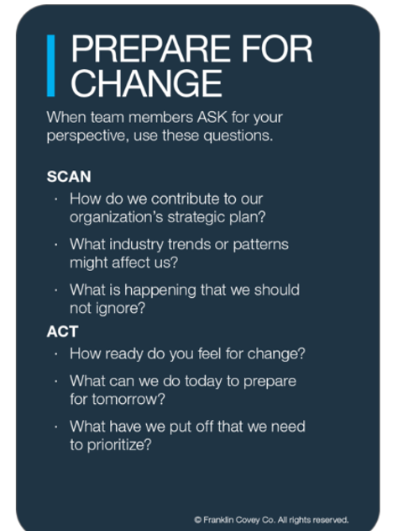
Lead Your Team Through Change Part 1
Staying Prepared for Change
Breakouts – Groups of 3
Discussion Questions (10-15 minutes)
Pull up the “prepare for Change Card”
In your small group discuss the questions on this card as they relate to you and your team today.
Notes:
Say: A powerful way to prepare for change is to have regular conversations with your team about events and trends that may lead to change.
In your small group discuss the questions on this card as they relate to you and your team today.
Breakout 1: (10 – 15 minutes) Practice asking and answering the questions on the card.
Whole Group Debrief: (5-10 minutes) Who would like to share what they discussed and any insights they had?

Slide 19
Lead Your Team Through Change Part 1
Building a Case for Change
In Status Quo:
Envision, Don’t Just Convey
Notes:
DO: Put the Case for Change Worksheet in Chat for people to download (in case someone doesn’t have their completed one)
SAY: we are going to spend the rest of our time together working through the Case for Change Worksheet. Pull up your downloaded answers from the course or pull the blank one out of the chat to use in your breakout rooms

Slide 20
Lead Your Team Through Change Part 1
Building a Case for Change
Breakouts – Groups of 3
Discussion Questions (10-15 minutes)
Step 1: Start your Case for Change by giving a brief one- or two-sentence description of the problem or opportunity targeted by the change.
Step 2: offer a one- or two-sentence description of the change that solves that problem or creates that opportunity.
Give each other feedback or ask clarifying questions
Notes:
Say: Let’s work on a case for change together. As you share this information your breakout rooms, give each other feedback or ask clarifying questions
Breakout 1: (10 – 15 minutes)
Whole Group Debrief: (5-10 minutes) Who would like to share what they discussed and any insights they had?

Slide 21
Lead Your Team Through Change Part 1
Building a Case for Change
Breakouts – Groups of 3
Discussion Questions (10-15 minutes)
Step 3: Now, give a one- or two-sentence description of the benefits of the change for the organization and your team.
Give each other feedback or ask clarifying questions
Notes:
Say: Continue with the last piece of the case for change by discussing the benefit of the change to the organization and your team
Breakout 1: (10 – 15 minutes)
Whole Group Debrief: (5-10 minutes) Who would like to share what they discussed and any insights they had?
Closing: Key takeaways and committed actions to next steps (hear from everyone if group is small or ask for a few if group is larger)

Slide 22
Lead Your Team Through Change – Pt.2
Notes:
Pre-work: Have participants come prepared with their downloaded responses from the OnDemand Course.
Opening: Provide context for why the are taking this course. Reiterate the investment in their learning and tie to larger organizational initiatives.
Say: In this module, you learned skills as a leader for engaging your team through the most challenging aspects of change — disruption and adoption — so they can achieve results and you can reach innovation together. This is part 2 of Lead Your Team Through Change.
Say: today we’ll review the work you did and practice using tools and having conversations to support meaningful dialogue about change.
Advance to next slide

Slide 23
Lead Your Team Through Change Part 2
Weeks 5 & 6 of On Demand Course
The Zone of Disruption
Dialoguing about Reactions: use the Toward or Away tool
Dialoguing about Results and Actions: use the Moving from and Moving To tool
Notes:
Say: we are going to talk about the leader’s role when we are in the Zone of Disruption. Because the change curve follows a predictable pattern, a dip in results and productivity is predictable and expected. In the course, we learned about 2 types of conversations that we have with our teams: 1) reactions and 2) Results and Actions
ASK: What do you do as a leader when you are dialoguing about people’s reactions? (answers may include listen with empathy, try to understand their reaction to change, where they are on the curve)
ASK: What do you do as a leader when you are dialoguing about Results and actions (answers may include—be specific about the results the change is trying to accomplish and specific behaviors people should
Advance to next slide

Slide 24
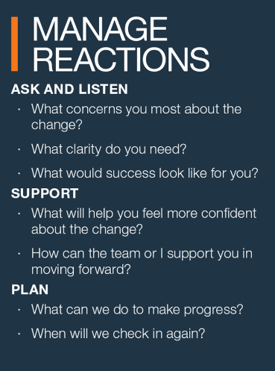
Lead Your Team Through Change Part 2
Weeks 5 & 6 of On Demand Course
Breakouts – Groups of 3
Discussion Questions (10-15 minutes)
Pull up your completed Toward or Away Tool and the Managing Reactions Card
Choose 1 person and share how they seem to be reacting to the change (move, minimize, wait, resist, quit). Why might they be reacting that way?
Using the Managing Reactions Card for guidance, what’s one or two questions you can ask to help move towards the change?
Dialoguing about Reactions: use the Toward or Away tool
Notes:
Say: Continue with the last piece of the case for change by discussing the benefit of the change to the organization and your team
Breakout 1: (10 – 15 minutes)
Whole Group Debrief: (5-10 minutes) Who would like to share what they discussed and any insights they had?

Slide 25
Lead Your Team Through Change Part 2
Weeks 5 & 6 of On Demand Course
Dialoguing about Results and Actions: use the Moving from and Moving To tool
Breakouts – Groups of 3
Discussion Questions (10-15 minutes)
What process, task or activity might your team stop doing to reserve their energy or allow space for adopting the change?
Notes:
Say: Continue with the last piece of the case for change by discussing the benefit of the change to the organization and your team
Breakout 1: (10 – 15 minutes)
Whole Group Debrief: (5-10 minutes) Who would like to share what they discussed and any insights they had?

Slide 26
Lead Your Team Through Change Part 2
Weeks 5 & 6 of On Demand Course
The Zone of Adoption
Levels of Engagement
What are 3 strategies for increasing engagement?
Acknowledge their obstacles
Help prioritize or reduce the obstacles
Celebrate their persistence and wins
Notes:
This is a build slide (do not reveal the 3 strategies for increasing engagement yet)
Say: In the zone of Adoption, our role as leaders is to engage your team to help them persist towards the zone of Innovation, where we recognize real results.
ASK: Does anyone remember the 3 strategies for increasing engagement? Reveal the strategies. Today, we will focus on helping prioritize or reduce obstacles. Why is this important?
How does this improve adoption?

Slide 27
Lead Your Team Through Change Part 2
Weeks 5 & 6 of On Demand Course
Stop Something Now
Cut out or shorten a meeting
Streamline a process
Repair/replace equipment that isn’t fully functioning
Brainstorm with your team
Map out activities and identify one or two that aren’t adding value
Breakouts – Groups of 3
Discussion Questions (10-15 minutes)
What process, task or activity might your team stop doing to reserve their energy or allow space for adopting the change?
Notes:
This is a build slide
Say: Help prioritize or reduce obstacles will help your team reserve their energy or allow space for adopting the change. See a couple of examples on the slide. In your breakout room discuss these and other ideas. Get creative in your brainstorming!
Breakout 1: (10 – 15 minutes)
Whole Group Debrief: (5-10 minutes) Who would like to share what they discussed and any insights they had?

Slide 28
Change: Turning Uncertainty Into Opportunity™
Notes:
Say: So you have made a lot of progress in becoming a Change Leader over the last several weeks. Congratulate yourself for making the time and committing to using these new skills and tools. A leader’s job is tough, but it gets better and more rewarding when you have the competence and confidence to work with your team.
Say: there are many tools in your Change Leader tool kit that can help you and your team beyond what we have covered in this session. Has anyone looked at the tool or used any of the information in it? can someone share what they have used and how it has positively impacted their team. if no one shares, provide the link and give participants a minute to download it.
Before we end the session, make one commitment to yourself for continuing to develop your skills as a Change Leaders. Consider blocking time on your calendar each week to review one of the tools from this course and continue to help your team as new changes arrive.

Slide 29
Celebrate!

Slide 30
“For knowledge to flourish, the workplace must be one where people feel free to share their knowledge.”
— Amy Edmondson
Notes:
Closing Congratulations Team! : Read the slide. Thank you all for your participation.

