Slide 1
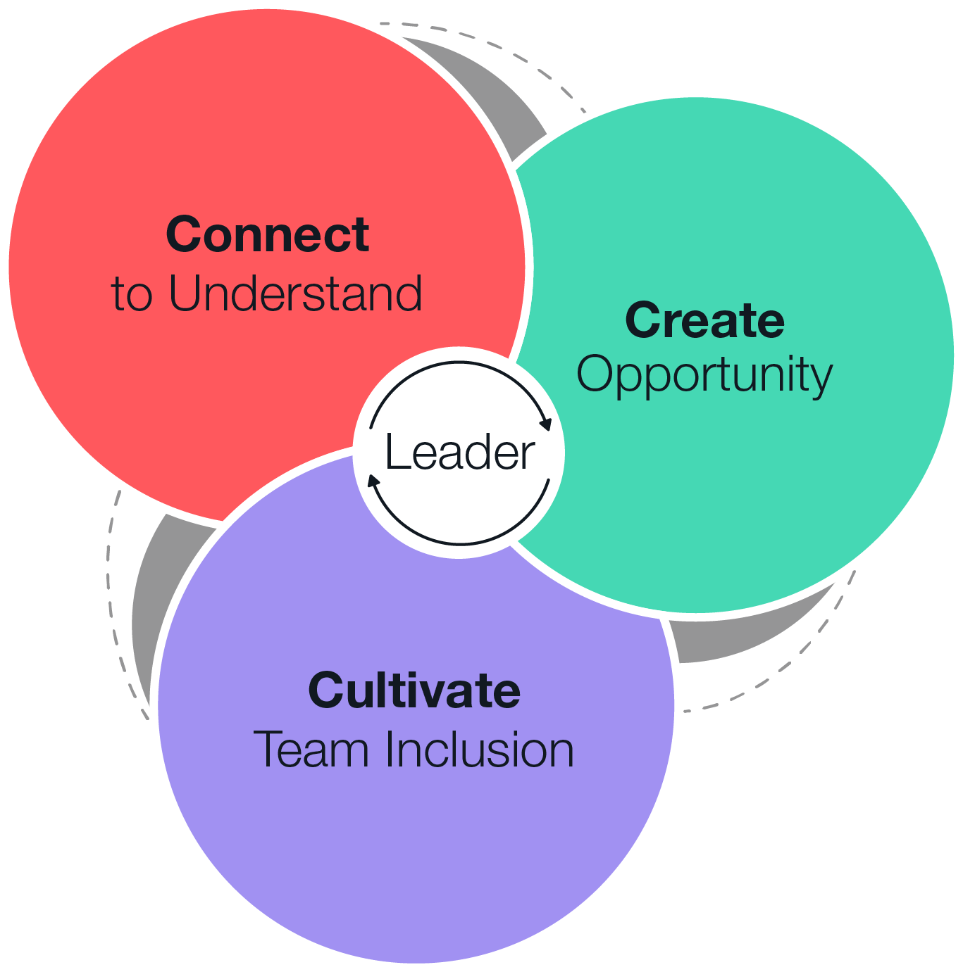
Flipped Classroom Session Deck
Inclusive Leadership

Slide 2
Discussion Session Components
Kick-Off
Session 1 – (date)
  Connect to Understand
Session 2 – (date)
  Create Opportunity
Session 3 – (date)
  Cultivate Team Inclusion

Slide 3
Inclusive Leadership
Kickoff
Notes:
You may want to create ground rules for the sessions.

Slide 4
Purpose
Include the main purpose for the session, how will these skills improve their work and the business, what are your goals for the course and how will you measure success. Share any information on how these skills and their work contributes to the larger organizational goals.
Notes:
Discussion leads complete this slide to provide the purpose of the session

Slide 5
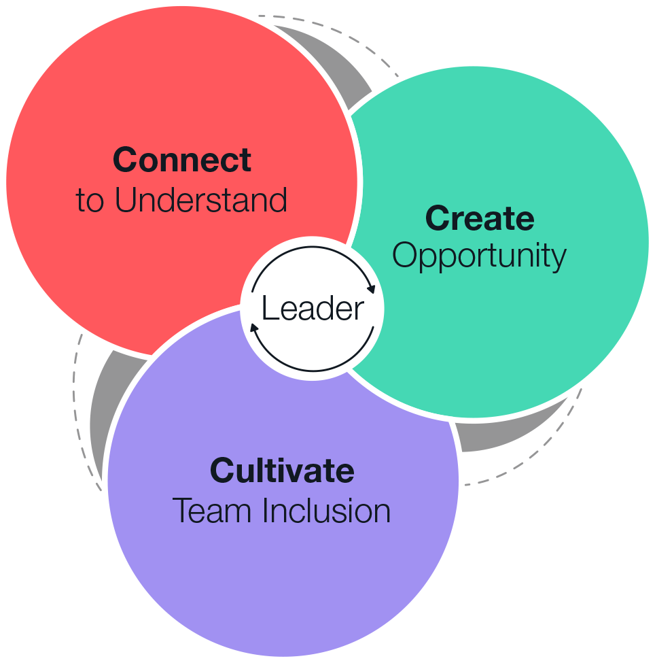
Inclusive Leadership: Practical Ways to Cultivate Inclusion & Build a Better Team™
Inclusive Leadership: Practical Ways to Cultivate Inclusion & Build a Better Team shows leaders how to effectively prioritize inclusion and increase DEI and belonging on their teams. Leading inclusively has a profound positive impact on teams and the results achieved together.
Outcomes
Schedule & Commitment
Connect to understand every team member by choosing curiosity to learn their unique interests, skills, and vision for their future.
Create opportunity by looking for potential in every team member, addressing any barriers to success, and advocating for them along the way.
Cultivate team inclusion by engaging the team to define specific behaviors that will shape and sustain a culture of belonging.
DATE RANGE 6 WEEKS
Weekly Automated assignments: 30-minutes
Bi-weekly live debrief sessions: 45-minues
Course Link
Inclusive Leadership
Notes:
Share the outcomes of the course, the date range, time commitment, and the Impact Platform link. They should have received all this information in your scheduling emails, but this is a reminder.

Slide 6
Participant Expectations & Actions
Access the Impact Platform and save url in your favorites
Complete 30-minutes of OnDemand content a week – tasks will be sent directly to your email and appear on your Impact Platform homepage.
Complete tools and applications challenges as directed by course
Stay on track with the course, the platform will show your progress, you can always catch up if you fall behind!
Attend 45-minute live session every two weeks
Come to live sessions with completed tools and application challenges
Prepare and present Capstone presentation (if applicable)
Engage and have fun!
Notes:
Review the actions and take questions.

Slide 7
Inclusive Leadership
  6- Week Flipped Classroom
Kick-off
On Demand Learning with Flipped Classroom Discussions
Optional Capstone Celebration
Week 1
Connect to Understand
Week 2
Reinforcement + Learning Lab
Week 3
Create Opportunity
Kick-off Session
Live or Live Online
Optional
Capstone/ Celebration
Week 4
Reinforcement + Learning Lab
Week 5
Cultivate Team Inclusion
Week 6
Reinforcement + Learning Lab
30-minutes of OnDemand training a week and live 45-minute discussions every two weeks.
Notes:
Review the course timeline and add in the scheduled dates.

Slide 8
Discussion Session Flow (45-minutes)
1
2
3
4
Introduction, the Why
(5-minutes)
Core Principle/Mindset Shift/Learning
  Whole group discussion (5 min)
    Review
    Reflect
  Breakout or Individual Exercise (2-3 per group) (10 min)
    Discuss
    Action
Core Principle/Mindset Shift/Learning
  Whole group discussion (5 min)
    Review
    Reflect
  Breakout or Individual Exercise (2-3 per group) (10 min)
    Discuss
    Action
Key learnings & Next Steps (3-minutes)
Notes:
Walk through the standard flow of each session so participants know what to expect

Slide 9
Capstone Presentation (optional)
Participants present to leadership after the course is complete
Purpose/Benefits:
  Participants share their key takeaways and how they will apply the new tools they’ve learned to their work
  Instills deeper engagement and commitment to learning the tools and changing behavior
  Participants gain exposure with leadership and celebrate their commitment to development
  Generate interest from other leaders/departments to participant in a future course
Timing:
  Capstones can be done right at the end of a course where learners will discuss their immediate takeaways that they will apply. Or you can schedule them 1-2 months after the course is complete and have leaders report on what tools they’ve applied and how it’s impacted their work, team, organization.
  Presentations should only be about 7-10 minutes.
Instructions:
  Choose 2 or 3 key learnings that were most impactful to you
  Share how you’ve applied learnings with your team
  Describe the impact from applying the tools on your team
  Discuss any benefits these tools have to the entire organization
Notes:
Share capstone expectations or remove if you are not doing a capstone presentation.

Slide 10
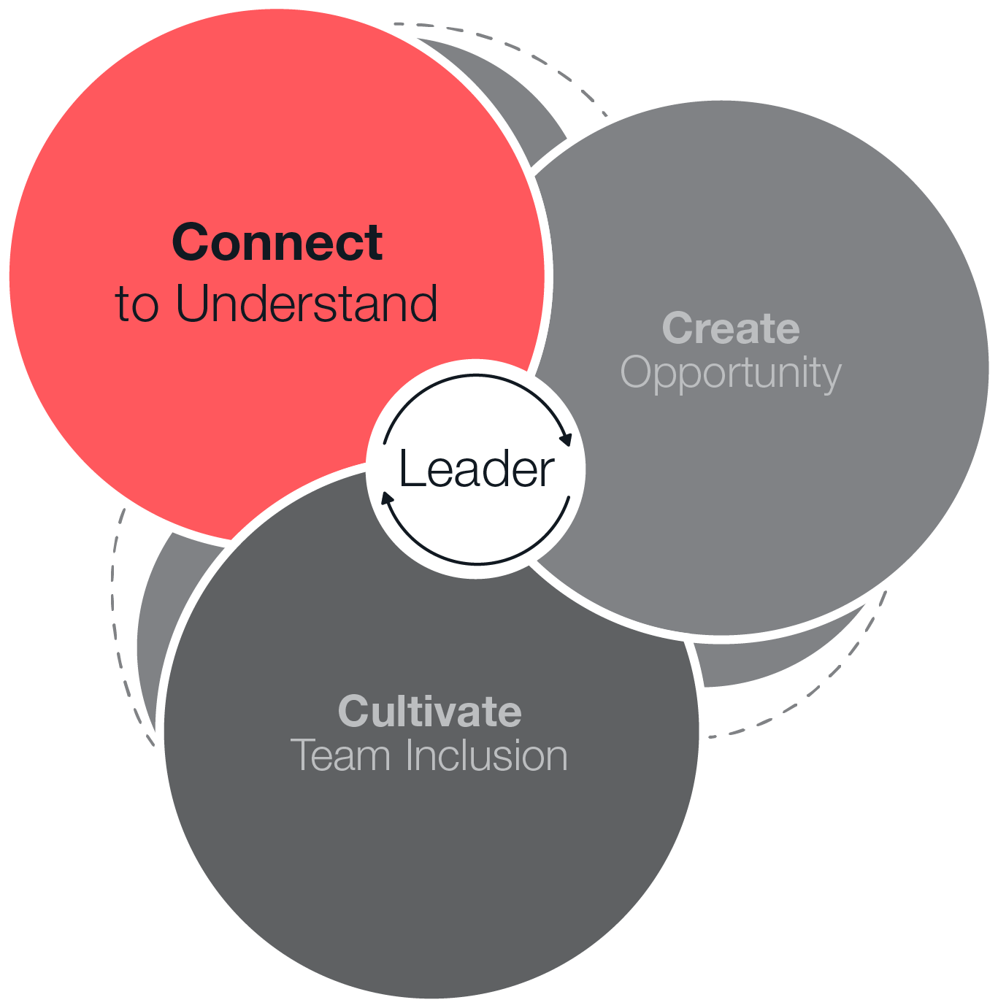
Session 1
  Part 1:
Connect to Understand
Notes:
You may want to create ground rules for the sessions.

Slide 11
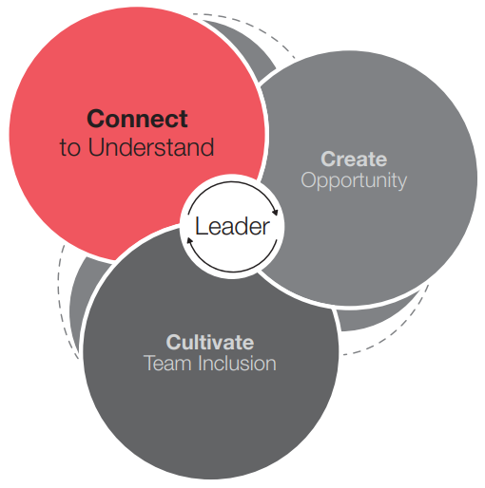

Connect to Understand
Weeks 1 & 2 of OnDemand Course
Common Mindset:
  People need to speak up if they want me to know something.
Effective Mindset:
  I need to connect or people won’t speak up.
Notes:
Pre-Work: . Have participants come prepared with their downloaded Connection Questions from the OnDemand Course and 3 Key Questions to Gauge Connection
Opening: Provide context for why they are taking this course. Reiterate the investment int their learning and tie to larger organizational initiatives
Introduction: Show only the Common Mindset. Ask the group what the Effective Mindset is. Draw out the differences in the to mindsets. What stood out to them? Share your own preliminary insights

Slide 12

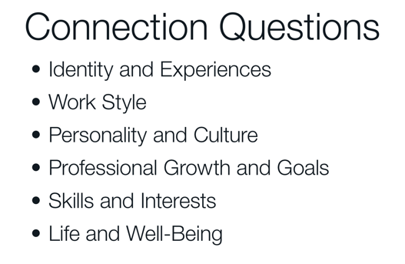
Practice Asking Connection Questions
Breakout 1 – Pairs of 2
Discussion Questions (10-15 minutes)
    Take 30 seconds to introduce yourselves and decide who will go first. The person with the earlier birthday in the calendar year should go first.
    Partner 1 will use their selected connection question to start the conversation. Listen thoughtfully and ask follow-up questions to build understanding.
    After 3 minutes, Partner 2 will use their question to start a new conversation.
Notes:
Opening: You’ll each have a turn to start a conversation with your selected Connection Question. The point is not to just ask and answer the one question, but to have a conversation. Listen thoughtfully and ask follow up questions to build understanding. Switch halfway through and ensure that both participants have enough time to ask and respond.
Breakout 1: (10 – 15 minutes) Remind the group to have their Connection Questions downloaded and prepared
Whole Group Debrief: (5-10 minutes) Who would like to share what they discussed and any insights they had?

Slide 13
3 Key Questions to Gauge Connection
Application Challenge
3 Key Questions to Gauge Connection
  What are you most excited about, personally or professionally?
  What are you most worried about, personally or professionally?
  Where do you see yourself in 1-3 years?
Breakout 2 – Groups of 3
Discussion Questions (5 - 10 Minutes)
    Take turns asking each other the 3 key questions to gauge connection
    How do you respond to the answers provided? Do you dig in deeper to find out more information? Are you naturally curious?
    How did that feel? (Normal, uncomfortable, safe, anxious)?
Notes:
Opening: (don’t’ show answers) Review the 3 Key Questions to Gauge Connection and state that “You may not use these exact words, but consistently asking your team members questions that help you understand their needs allows you to adapt how you engage them”.
Breakout 2: (10 – 15 minuets)
Whole Group Debrief: (5-10 minuets) Who would like to share what they discussed and any insights they had?
Closing: Key takeaways and committed actions to next steps (hear from everyone if group is small or ask for a few if group is larger)

Slide 14
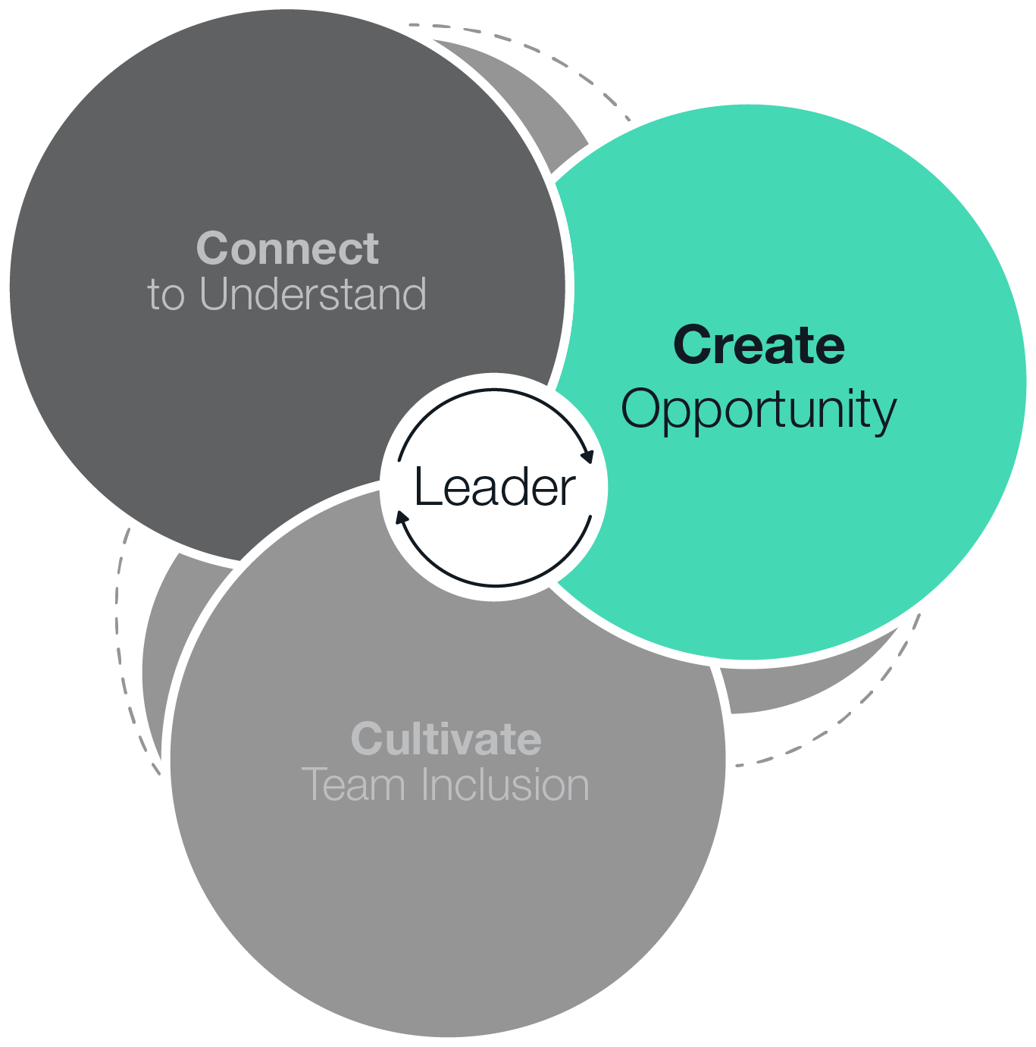
Session 2
  Part 2:
Create Opportunity

Slide 15
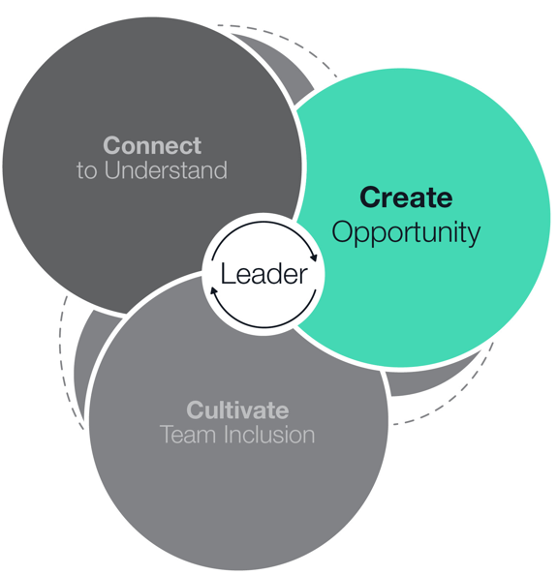
Create Opportunity
Weeks 3 & 4 of OnDemand Course
Common Mindset:
I know potential when I see it.
Effective Mindset:
I see potential when I look for it.
Notes:
Pre-Work: . Have participants come prepared with their downloaded responses from the OnDemand Course and Headwinds and Tailwinds identity markers
Introduction: Show only the Common Mindset. Ask the group what the Effective Mindset is. Draw out the differences in the to mindsets. What stood out to them? Share your own preliminary insights

Slide 16
Headwinds and Tailwinds Reflection
What are your identity headwinds and tailwinds?
  Age group
  Family status
  National origin
  Political views
  Sex
  Education level
  Gender identity
  Personality
  Race/ethnicity
  Sexual orientation
  Expertise
  Hobbies/interest
  Physical ability
  Religion
  Socioeconomic status
Breakout 1 - Groups of 3
  Discussion Questions - (10 -15 minutes)
    Take 1 minute to introduce yourselves
    Take 3-5 minutes to share the headwinds or tailwinds for each identity marker you chose, or whatever you are comfortable sharing.
        Go in order of shortest to longest hair
Notes:
Opening: (don’t show answers) Ask if anyone can share some Headwinds and Tailwinds, gather thoughts from the group, then share answers.
Breakout 1: (10 – 15 minutes)
Whole Group Debrief: (5-10 minutes) Who would like to share what they discussed and any insights they had?

Slide 17
Expand Your View: Reflection
Application Challenge
Dimensions of work
  Volume: How much work the person is responsible for.
  Variety: How many different activities the work involves.
  Difficulty: How challenging the work is.
  Visibility: How much of the work process or outcomes are visible to others.
Breakout 2 – Pairs of 2
Discussion Questions (5 - 10 Minutes)
    Take 1 minute for introductions and to determine who has most recently been on a plane. That person should go first.
    Share which dimension of work you chose and how it was a headwind or tailwind (or both).
    Share what your leader could have done to create opportunity for you if they’d know how that dimension affected you.
Notes:
Opening: Review the Dimensions of Work Assignments and state that “We’ll now do a paired breakout talking about our experiences with work-based headwinds and tailwinds”.
Breakout 2: (10 – 15 minutes)
Whole Group Debrief: (5-10 minuets) Who would like to share what they discussed and any insights they had?
Closing: Key takeaways and committed actions to next steps (hear from everyone if group is small or ask for a few if group is larger)

Slide 18
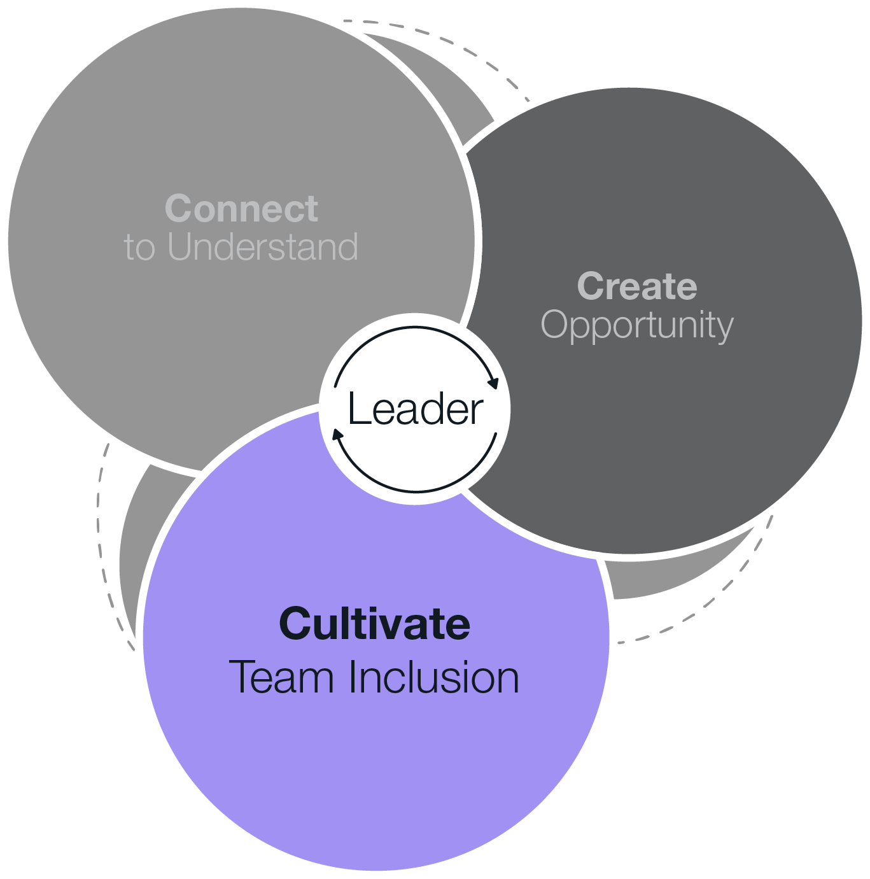
Session 3
  Part 3:
Cultivate Team Inclusion

Slide 19
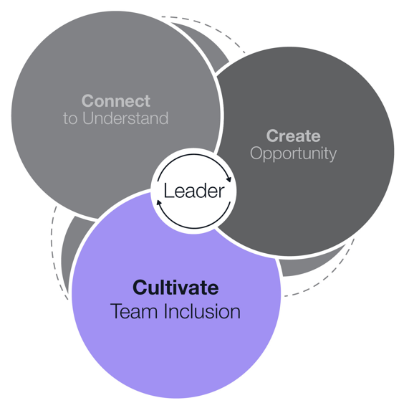
Cultivate Team Inclusion
Weeks 5 & 6 of OnDemand Course
Common Mindset:
  I define team culture so people behave inclusively.
Effective Mindset:
  We establish inclusive behaviors and create a culture of belonging together.
Notes:
Pre-Work: Have participants come prepared with their downloaded responses from the OnDemand Course, Inclusive Behavior Statement
Introduction: Show only the Common Mindset. Ask the group what the Effective Mindset is. Draw out the differences in the to mindsets. What stood out to them? Share your own preliminary insights

Slide 20
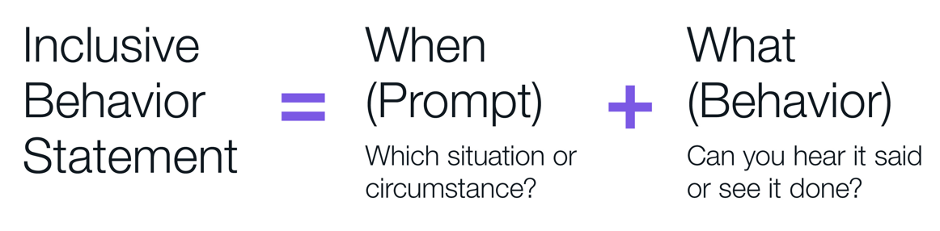
Inclusive Behavior Statement
Inclusive Behavior Statement
Does it include a behavior – something you can see someone do or hear someone say?
Does it include a specific prompt – a situation or circumstance that prompts the team to do it?
Does it address the identified problem with inclusion?
Individual Exercise
  (5 minutes)
  Take the next minute to identify an inclusion problem your team may be facing
  Write an inclusive behavior statement that includes a specific “when” and “what” to address this problem
Breakout Groups of 3
Discussion Questions - (15 minutes)
    Each person shares their inclusive behavior statement
    While one person is sharing the others should be listening and offering feedback using the questions to the left
Notes:
Opening: Remind participants that inclusive behavior statements are specific; they include a “when” or prompt, and a “what” or behavior. Ask them to identify an inclusion problem their team might be facing. If a problem doesn’t come to mind, think about a behavior or norm they’d like to improve.
Breakout 1: (10 – 15 minutes)
Whole Group Debrief: (5-10 minutes) Who would like to share what they discussed and any insights they had?

Slide 21
Celebrate!
Notes:
It’s important to acknowledge the hard work of the participants and ignite excitement to continue to apply their learnings to their work. Some options are below:
A short capstone presentation on how they will apply learnings. Audience can be their internal team or a larger group of leaders.
Capturing key learnings in a deck and re-visiting in team meetings for updates on how application is going.
Call out the participants on a larger team call for their great work and improvements based on learnings.
Provide gift cards to participants to get lunch or a small gift

