Slide 1
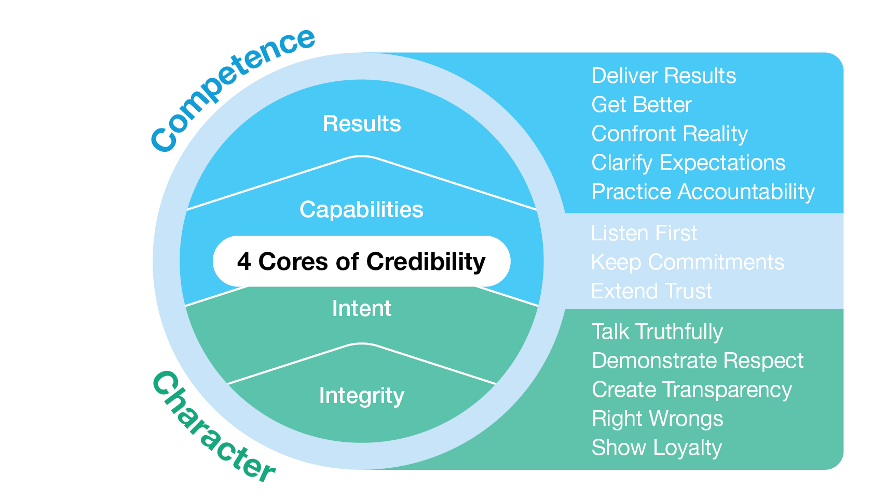
Flipped Classroom Guide
Leading at the
Speed of Trust

Slide 2
Discussion Session Components
Kick-Off
Session 1 – (date)
The Case for Trust
Session 2 – (date)
Be a High-Trust Leader
Session 3 – (date)
Extend, Restore, and Develop Trust

Slide 3
Kickoff
Notes:
You may want to create ground rules for the sessions.

Slide 4
Purpose
Include the main purpose for the session, how will these skills improve their work and the business, what are your goals for the course and how will you measure success. Share any information on how these skills and their work contributes to the larger organizational goals.
Notes:
Discussion leads complete this slide to provide the purpose of the session

Slide 5
Participant Expectations & Actions
Access the Impact Platform and save url in your favorites
Complete 30-minutes of OnDemand content a week – tasks will be sent directly to your email and appear on your Impact Platform homepage.
Complete tools and applications challenges as directed by course
Stay on track with the course, the platform will show your progress, you can always catch up if you fall behind!
Attend 45-minute live session every two weeks
Come to live sessions with completed tools and application challenges
Prepare and present Capstone presentation (if applicable)
Engage and have fun!
Notes:
Review the actions and take questions.

Slide 6
Leading at the Speed of Trust
6- Week Flipped Classroom
Kick-off
On Demand Learning with Flipped Classroom Discussions
Optional Capstone Celebration
Week 1 The Case for Trust
Week 2 Reinforcement + Learning Lab
Week 3 Be a High-Trust Leader
Kick-off Session
Live or Live Online
Optional Capstone/ Celebration
Week 4 Reinforcement + Learning Lab
Week 5 Extend, Restore, Develop Trust
Week 6
Reinforcement + Learning Lab
30-minutes of OnDemand training a week and live 45-minute discussions every two weeks.
Notes:
Review the course timeline and add in the scheduled dates.

Slide 7
Discussion Session Flow (45-minutes)
1
2
3
4
Introduction, the Why (5-minutes)
Core Principle/Mindset Shift/Learning
Whole group discussion (5 min)
Review
Reflect
Breakout or Individual Exercise (2-3 per group) (10 min)
Discuss
Action
Core Principle/Mindset Shift/Learning
Whole group discussion (5 min)
Review
Reflect
Breakout or Individual Exercise (2-3 per group) (10 min)
Discuss
Action
Key learnings & Next Steps (3-minutes)
Notes:
Walk through the standard flow of each session so participants know what to expect

Slide 8
Capstone Presentation (optional)
Participants present to leadership after the course is complete
Purpose/Benefits:
Participants share their key takeaways and how they will apply the new tools they’ve learned to their work
Instills deeper engagement and commitment to learning the tools and changing behavior
Participants gain exposure with leadership and celebrate their commitment to development
Generate interest from other leaders/departments to participant in a future course
Timing:
Capstones can be done right at the end of a course where learners will discuss their immediate takeaways that they will apply. Or you can schedule them 1-2 months after the course is complete and have leaders report on what tools they’ve applied and how it’s impacted their work, team, organization.
Presentations should only be about 7-10 minutes.
Instructions:
Choose 2 or 3 key learnings that were most impactful to you
Share how you’ve applied learnings with your team
Describe the impact from applying the tools on your team
Discuss any benefits these tools have to the entire organization
Notes:
Share capstone expectations or remove if you are not doing a capstone presentation.

Slide 9
Discussion Sessions
Discussion
Sessions

Slide 10
Leading at the Speed of Trust
Module 1
The Case for Trust

Slide 11
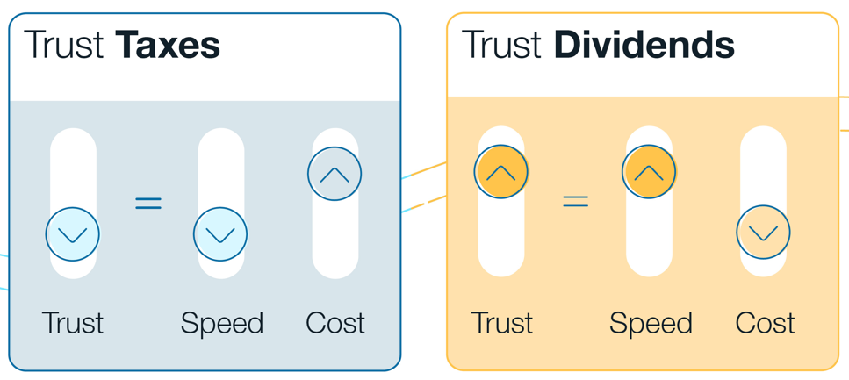
The Case For Trust
Weeks 1 & 2 of OnDemand Course
Notes:
Pre-Work: . Have participants come prepared with their downloaded responses
Opening: Provide context for why they are taking this course. Reiterate the investment in their learning and tie to larger organizational initiatives
Introduction: Do not show visual - Ask the Group What is Trust?
Trust Taxes and Trust Dividends: Show the Trust Taxes and Trust Dividends visual Ask the group –
What is a Trust Tax? Behaviors that slow down the speed of work. What are some examples? Hear from group
What is a Trust Dividend? Behaviors that speed of work and produce results. What are some examples?

Slide 12
The Case For Trust: Trust Taxes & Dividends
Application Challenge
Trust Taxes
Toxic work environment
Poor communication
Disengagement
Work in silos
Lack of creativity
Low productivity
Trust Dividends
Safe work environment
Great communication
High engagement
Collaboration
Agility
Innovation
Breakout 2 – Groups of 3
Discussion Questions (5 - 10 Minutes)
What are some Trust Taxes that you’ve experienced in the past?
Are there any Trust Taxes that you are unintendedly contributing to?
What are some ways you can contribute to Trust Dividends?
Notes:
Opening: We’re going to get into breakouts to discuss further, here are some examples of Trust Taxes and Dividends that we just discussed
Breakout 2: (10 – 15 minuets)
Whole Group Debrief: (5-10 minuets) Who would like to share what they discussed and any insights they had?
Closing: Key takeaways and committed actions to next steps (hear from everyone if group is small or ask for a few if group is larger)

Slide 13
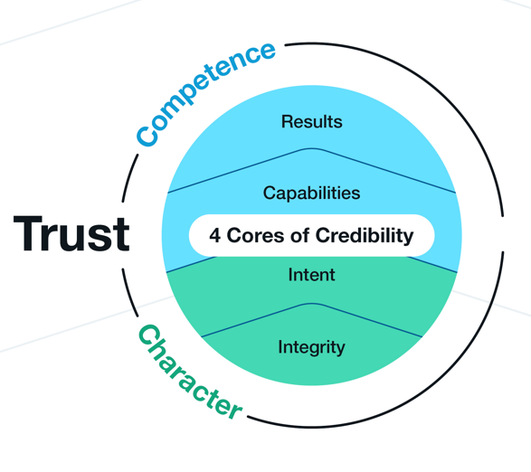
The Case For Trust: 4 Cores of Credibility
Breakout 1 – Pairs of 2
Discussion Questions (10-15 minutes)
Did anything stand out to you while taking the 4 Cores of Credibility Self-Assessment?
Describe the differences between your answers to the Self –Assessment vs the Team’s perception results. What insights did you have?
What areas do you want to focus on improving and what’s your action plan?
Notes:
Opening: Don’t show visual – Who can remember the 4 Cores of Credibility? Hear from the group and then share visual. Ask for a definition of each of the 4 Cores of credibility from the group
Integrity: Congruence, Humility, Courage
Intent: Motive, Agenda, Clarity
Capability: Talents, Attitudes, Skills, Knowledge, Style
Results – Performance: Past, Current and Anticipated
Breakout 1: (10 – 15 minutes) Remind the group to have their Self-Assessment downloaded and prepared
Whole Group Debrief: (5-10 minutes) Who would like to share what they discussed and any insights they had?

Slide 14
Leading at the Speed of Trust
Module 2
Be a High-Trust Leader

Slide 16
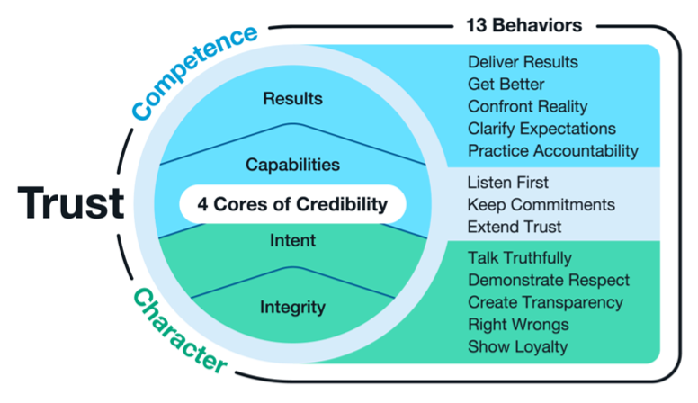
Be a High Trust Leader
Weeks 3 & 4 of OnDemand Course
Do I trust myself?
Do I give others a leader they can trust?
Effective Mindset:
I see potential when I look for it.
Notes:
Pre-Work: . Have participants come prepared with their downloaded responses from the OnDemand Course
Introduction: Look at the Trust Framework: What does it mean to be a high-trust leader? Hear from the group and ask for examples. To be a high-trust leader, we must answer 2 key questions:
Do I trust myself
Do I give others a leader they can trust
3. High trust isn’t created by credibility alone; it also requires high-trust behavior. The 13 Behaviors of High Trust are listed on the right side of the Trust Framework. The five behaviors at the bottom of the list in the framework are associated with Character, the five at the top are associated with Competence, and the three in the middle are associated with both Character and Competence.

Slide 17
13 Behaviors at a Glance
Pick one to focus on and discuss
Breakout 2 – Groups of 3
Discussion Questions (10 Minutes)
Which if the 13 behaviors might you need to work on and why?
Based on your SOT Leader Assessment results, were there any surprises?
Notes:
Opening: In our last session you discussed which of the 13 Behaviors of High Trust you want to focus on. Now we’re going to break you in pairs to discuss what you’ve noticed about focusing on this area.
Breakout 2: (10 minutes)
Whole Group Debrief: (5-10 minuets) Who would like to share what they discussed and any insights they had?

Slide 18
Counterfeit Behaviors Application Challenge
What are counterfeit behaviors?
Behaviors that look like High-Trust Behaviors on the surface. But when we look closely, we see that they’re not quite authentic.
Breakout 1 - Groups of 3
Discussion Questions (10 -15 minutes)
Describe the counterfeit behavior(s) you noticed in yourself or others.
What high-trust behavior did you replace with the counterfeit behavior and what was the impact?
What are the keys to stopping Counterfeit behaviors?
Acknowledging that we all do them from time to time.
Recognizing the situations in which we tend to Counterfeit.
Choosing High-Trust Behaviors in those situations instead.
Notes:
Opening: (don’t show answers)
What is a Counterfeit Behavior? Hear from the group and ask for examples. Counterfeit behaviors look like High-Trust Behaviors on the surface. But when we look closely, we see that they’re not quite authentic. Often, our Counterfeits are learned behaviors. We don’t usually use them to deceive or trick others, but we may use them to survive challenging situations
What are the keys to stopping Counterfeit Behaviors? Hear from the group and ask for examples
Acknowledging that we all do them from time to time.
Recognizing the situations in which we tend to Counterfeit.
Choosing High-Trust Behaviors in those situations instead.
Breakout 1: (10 – 15 minutes)
Whole Group Debrief: (5-10 minutes) Who would like to share what they discussed and any insights they had?

Slide 19
Key Takeaways and Actions
Notes:
Closing: Ask the group what their key takeaways and committed actions are from their discussions. Leverage the visual to promote discussion.

Slide 20
Leading at the Speed of Trust
Module 3
Extend, Restore, and Develop Trust
Notes:
NOTE for Discussion Leads: We’ve provided 3 exercises for each section of Extend, Restore, and Develop Trust. You can choose only 2 exercises if you’d like to stay in the 45 min – 1-hour timeframe, or you can extend the session to include all three.

Slide 21
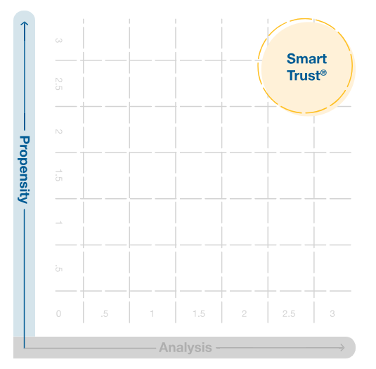
Extend Trust
Weeks 5 & 6 of OnDemand Course
What is Smart Trust?
Extending Trust wisely, which depends on:
1. Propensity to Trust
Our past experiences
Our upbringing
Our temperament or personality
2. Analysis
Opportunity
Risk
Credibility
Notes:
Pre-Work: Have participants come prepared with their downloaded responses from the OnDemand Course,
Introduction: What is Smart Trust? Hear from the group and ask for examples. You do not need to Extend Trust unconditionally to everyone. We want to Extend Trust wisely, which is called Smart Trust. To decide whether to Extend Trust depends on two components.
Propensity to Trust: Or willingness to Trust others. Propensity to trust is influenced by:
Our past experiences: whether we've had positive or negative experiences trusting others.
Our upbringing: whether we were taught or raised to be suspicious or trusting.
Our temperament or personality: whether we are naturally more trusting or suspicious.
Analysis: Helps us to move out of fear or threat-based reactions into clearer thinking
Opportunity: What are the expected outcomes for the situation and the person you may Extend Trust to? For example, trusting a colleague to help you with a project could be an opportunity for the project to succeed and for you and your colleague to strengthen your relationship.
Risk: What is at stake? If you're on a team that's building a spaceship, and you're partnered with an inexperienced person to design the engine, both the risk and cost of failure would be very high.
Credibility: We've learned a way to evaluate a person's credibility. What is it?

Slide 22
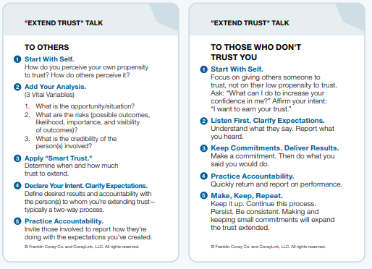
Extend Trust Talk
Breakout 1 - Groups of 3
Discussion Questions (10 -15 minutes)
Have you identified a person that you want to Extend Smart Trust with?
What steps are you going to take to Extend Trust with this individual?
Individual names can remain anonymous
Notes:
Opening: Once you decide to Extend Smart Trust, you prepare for a Extend Trust Talk. What stands out to about the Extending Trust Talk template? Anything unclear?
Breakout 1: (10 – 15 minutes) OPTION: You can change Discussion Questions portion to a Role Play
Whole Group Debrief: (5-10 minutes) Who would like to share what they discussed and any insights they had?

Slide 23
Restore Trust
Weeks 5 & 6 of OnDemand Course
What are some ways you can lose trust?
What are some ways you can Restore Trust?
Notes:
Introduction:
What if you had trust and lost it? Mistakes happen and many times, losing trust is accidental. What are some ways that you can lose trust with another person? Hear from the group and ask for examples.
What are some ways you can Restore Trust? Hear from the group and ask for examples.
Reiterate how High-trust people should consistently go first to restore trust

Slide 24
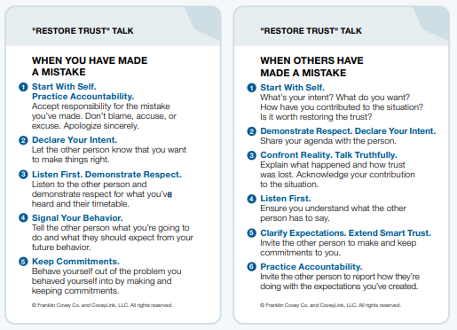
Restore Trust
Breakout 1 - Groups of 3
Discussion Questions (10 -15 minutes)
Have you identified a person that you want to Restore Trust with?
What steps are you going to take to Restore Trust with this individual?
Individual names can remain anonymous
Notes:
Opening: once you decide to Restore Trust, you prepare for a Restore Trust Talk. What stands out to about the Restore Trust Talk template? Anything unclear?
Breakout 1: (10 – 15 minutes) OPTION: You can change Discussion Questions portion to a Role Play
Whole Group Debrief: (5-10 minutes) Who would like to share what they discussed and any insights they had?

Slide 25
Develop Trust
Weeks 5 & 6 of OnDemand Course
What’s the difference between Developing Trust and Restoring Trust?
What are some ways you can Develop Trust?
Start with Self
Declare Your Intent
Listen First
Create Transparency
Keep Commitments
Practice Accountability
Notes:
Introduction:
What’s the difference between Developing Trust and Restoring Trust? Hear from the group and ask for examples. Developing trust is building trust with a new person or maintaining and growing trust with others.
What are some ways you can Develop Trust? Hear from the group and ask for examples.
Reiterate how High-trust people should consistently go first to restore trust

Slide 26
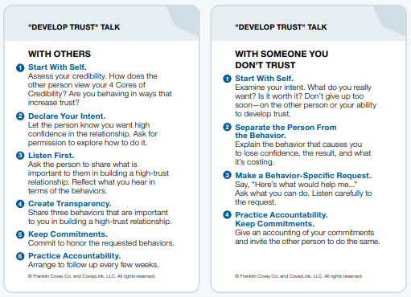
Develop Trust
Breakout 1 - Groups of 3
Discussion Questions (10 -15 minutes)
Have you identified a person that you want to Develop Trust with?
What steps are you going to take to Develop Trust with this individual?
Individual names can remain anonymous
Notes:
Opening: once you decide to Develop Trust, you prepare for a Develop Trust Talk. What stands out to about the Develop Trust Talk template? Anything unclear?
Breakout 1: (10 – 15 minutes) OPTION: You can change Discussion Questions portion to a Role Play
Whole Group Debrief: (5-10 minutes) Who would like to share what they discussed and any insights they had?

Slide 27
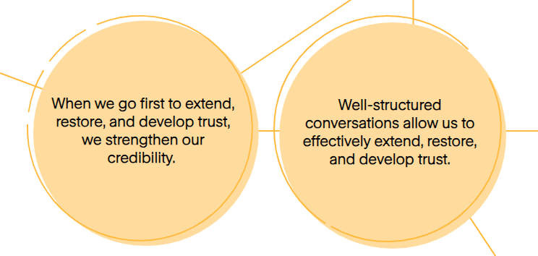
Extend, Restore & Develop Trust
Key Trust Mindsets
Notes:
Closing: Ask the group what their key takeaways and committed actions are from their discussions. Leverage the visual to promote discussion.

Slide 28
Celebrate!
Notes:
It’s important to acknowledge the hard work of the participants and ignite excitement to continue to apply their learnings to their work. Some options are below:
A short capstone presentation on how they will apply learnings. Audience can be their internal team or a larger group of leaders.
Capturing key learnings in a deck and re-visiting in team meetings for updates on how application is going.
Call out the participants on a larger team call for their great work and improvements based on learnings.
Provide gift cards to participants to get lunch or a small gift

